Slide 1
AHRQ’s Safety Program for Nursing Homes: On-Time Pressure Ulcer Healing Facilitator Training
Introduction to Pressure Ulcer Healing Reports

Slide 2
Pressure Ulcer Healing Electronic Reports
Electronic Reports
Existing Pressure Ulcers Report
Pressure Ulcers at Risk for Delayed Healing
Weekly Wound Rounds Report
Weekly Pressure Ulcer Treatment Summary Report
Pressure Ulcer Counts by Month Report

Slide 3
Teaching the Pressure Ulcer Healing Electronic Reports
The teaching sessions for each report should include the following content:
Purpose of the report
Content of the report
Calculation details
Quizzes and exercises

Slide 4
ON-TIME PRESSURE ULCER ASSESSMENT

Slide 5
Purpose of On-Time Pressure Ulcer Assessment
Provides information used in healing reports.
Provides a set of structured, standardized data elements for comprehensive documentation of weekly pressure ulcer characteristics.
Incorporates elements from the Bates-Jensen Wound Assessment Tool (BWAT) with standardized treatment and intervention descriptors.
Treatment interventions are consistent with those cited in current International Pressure Ulcer Prevention and Treatment Guidelines.

Slide 6
Content of On-Time Pressure Ulcer Assessment
Ulcer origin (present on admission [POA] or in-house acquired [IHA])
Onset date
Site
Initial stage
Size (length, width, depth)
Wound edges
Undermining
Tunneling
Necrotic tissue type and amount
Drainage/exudate type and amount

Slide 7
Content of On-Time Pressure Ulcer Assessment
Periwound area (skin color, heat/redness, edema, induration)
Granulation tissue
Epithelialization
Ulcer pain
Current stage
Followup status (improving, no change, worsening) per nurse observation
Treatments
Adjunctive therapies
Interventions and consultations

Slide 8
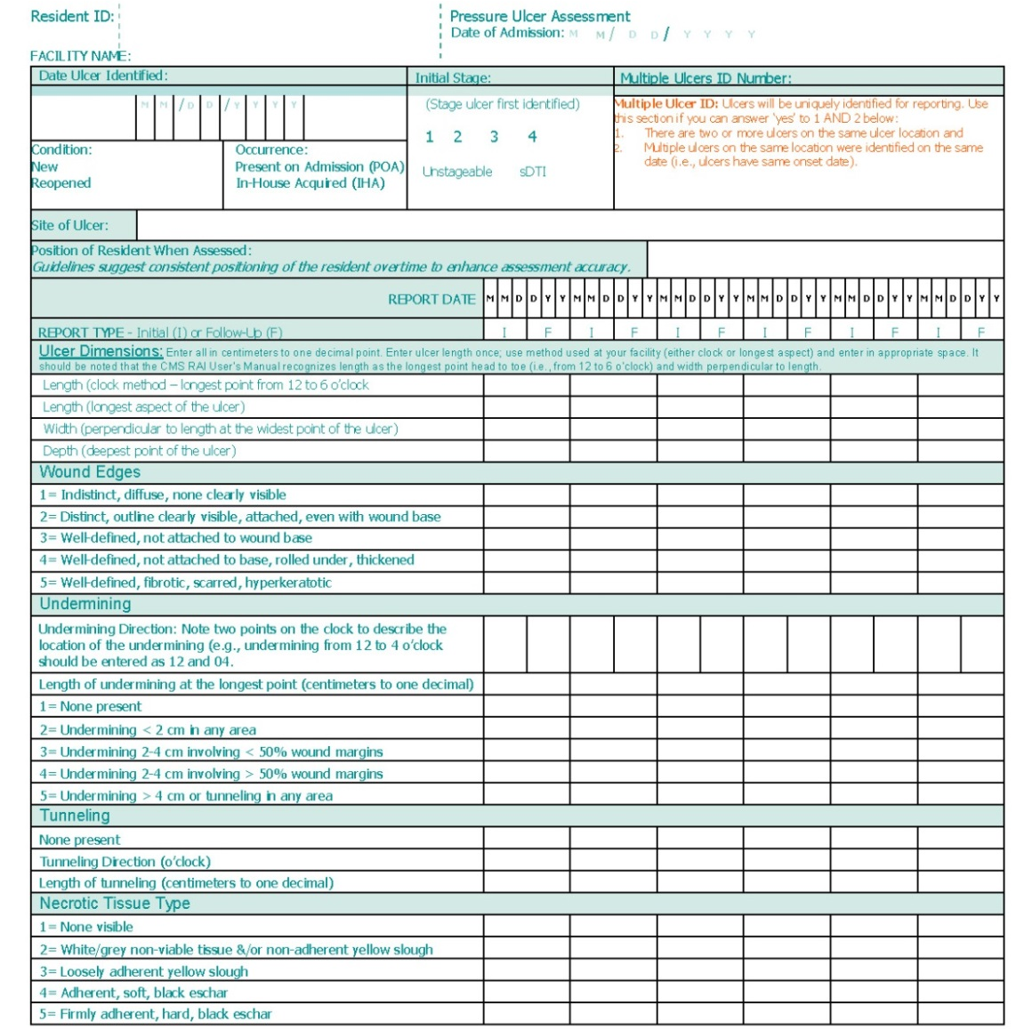
Sample On-Time Pressure Ulcer Assessment

Slide 9
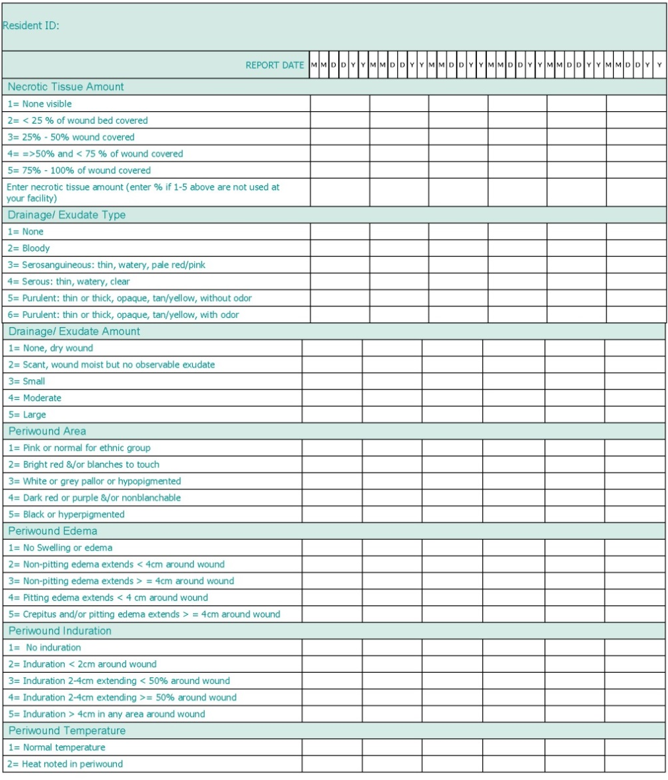
Sample On-Time Pressure Ulcer Assessment

Slide 10
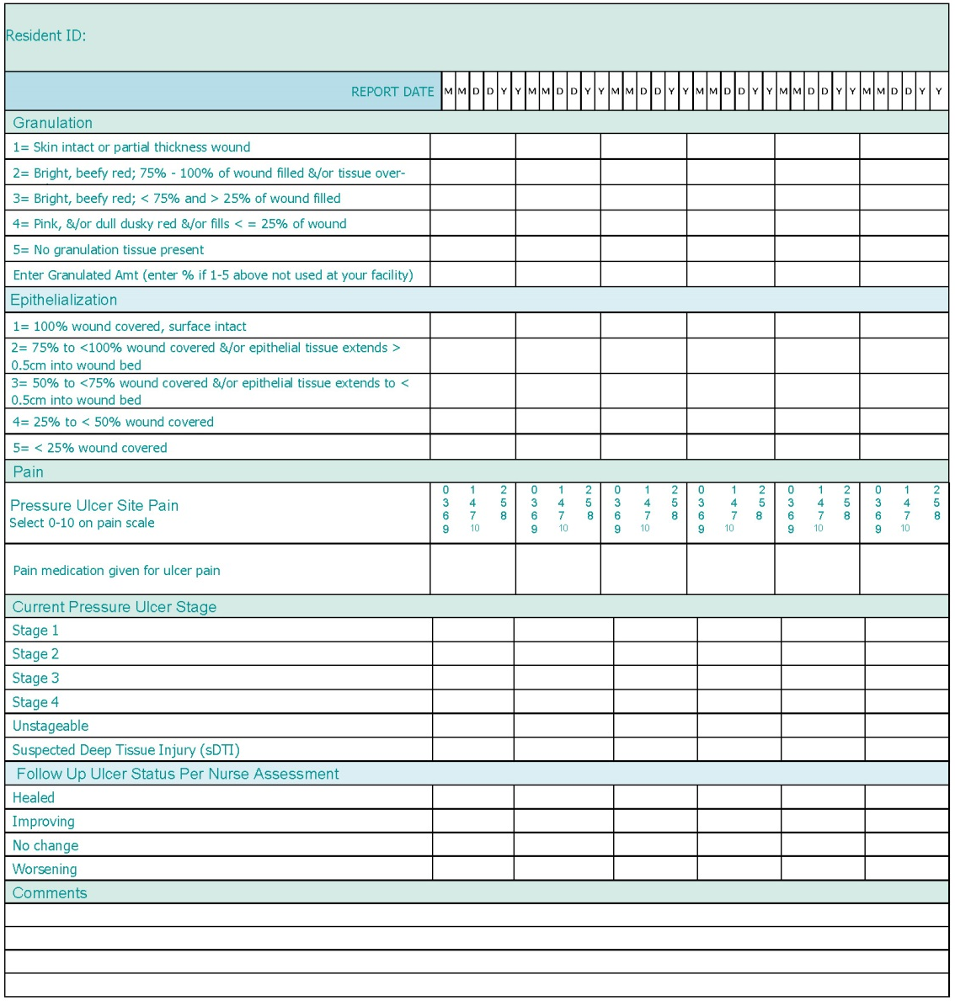
Sample On-Time Pressure Ulcer Assessment

Slide 11
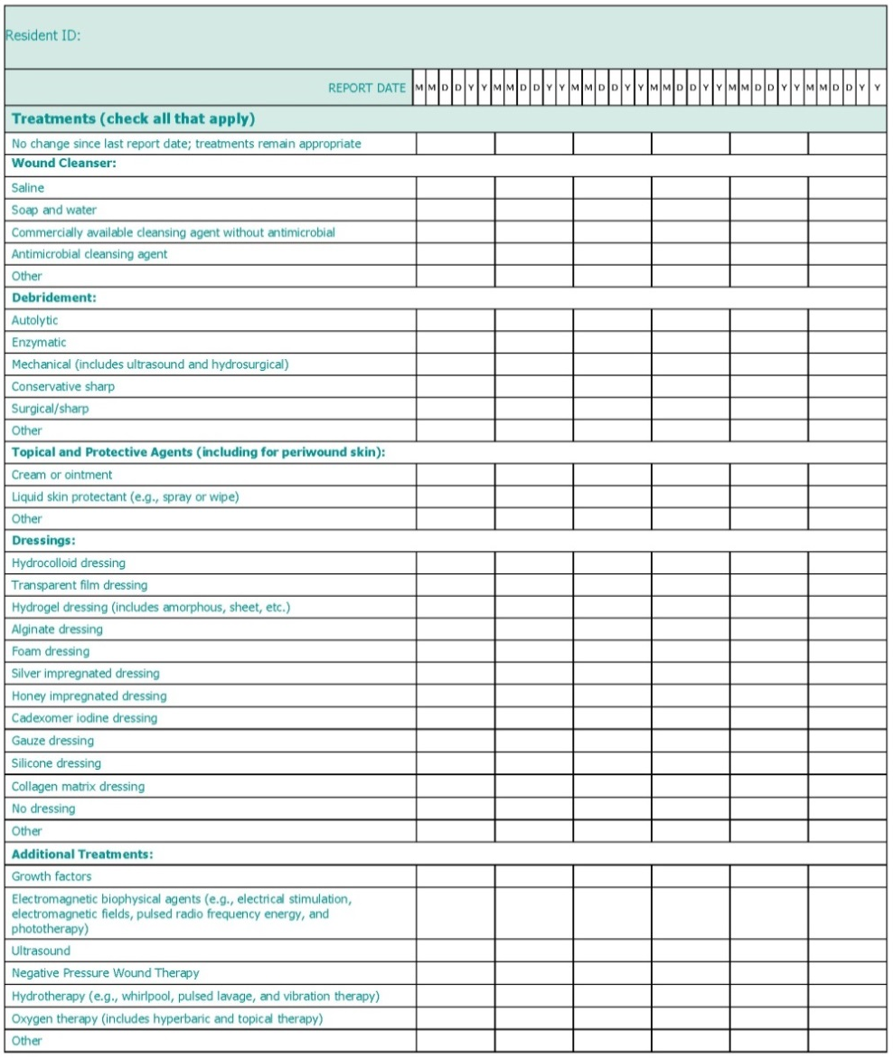
Sample On-Time Pressure Ulcer Assessment

Slide 12
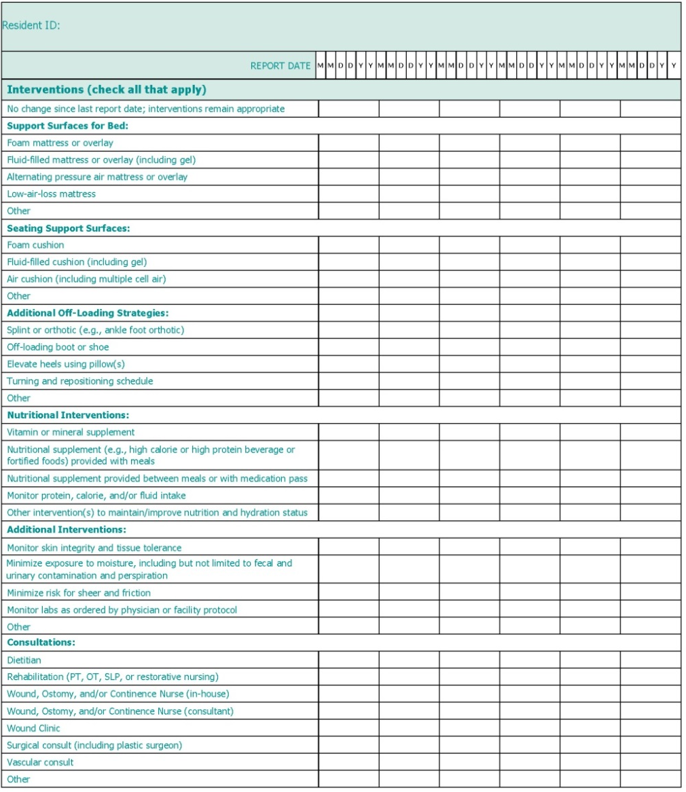
Sample On-Time Pressure Ulcer Assessment

Slide 13
Existing pressure ulcers report

Slide 14
Existing Pressure Ulcers Report
Provides the clinician with a comprehensive list of all residents currently in the facility who have at least one existing pressure ulcer during the report week
Displays the following:
Resident name and room number
Days from admission to ulcer onset and ulcer days
Ulcer onset date, site, initial and most recent stage
Ulcer status, number of treatments
If an ulcer is considered “at risk for delayed healing”

Slide 15
Existing Pressure Ulcers Report
Drawn from nurse documentation of weekly pressure ulcer assessments
Displays each pressure ulcer separately (i.e., residents with >1 ulcer will appear multiple times)
Can be filtered to display residents at the unit and facility level
Not intended to be used as a standalone report in care planning and clinical decisionmaking but can provide a summary of current pressure ulcers being monitored

Slide 16
Existing Pressure Ulcers Report
Complete information displays for each ulcer if the pressure ulcer assessment date is within 10 days of the prior report date.
If an ulcer has not healed and the last assessment date is >10 days prior, the following values will be blank:
Ulcer status
Number of treatment changes
At risk for delayed healing indicator
Most recently assessed ulcer stage
Ulcer days

Slide 17
Sample Existing Pressure Ulcers Report
On-Time Existing Pressure Ulcers Report Unit: A Date: 02/10/14
Resident Name (last, first) | Room Number | Days From Admit to Ulcer Onset | Ulcer Onset Date | Ulcer Site | Ulcer Days | Initial Ulcer Stage | Most Recent Assess Ulcer Stage | Ulcer Origin | Ulcer Status | # TX Order Changes | At Risk for Delayed Healing
Resident A | 102 | 0 | 12/26/13 | COX | 47 | 3 | 4 | POA* | IM | 3 | X
Resident B | 111 | 482 | 12/23/13 | ILIAC L | 50 | 3 | 3 | IHA | IM | 2
Resident D | 113 | 49 | 12/30/13 | HEEL R | 43 | 4 | 4 | IHA | WO | 3 | X
Resident D | 113 | 0 | 11/12/13 | TROCH R | 91 | 4 | 4 | POA | WO | 1 | X
Resident H | 121 | 0 | 12/14/13 | ANKO R | 59 | 1 | 3 | POA* | NC | 1 | X
Resident J | 101 | 35 | 01/20/14 | EAR L |  | 1 |  | IHA
Note: POA* indicates that the pressure ulcer was present on admission but has gotten worse (increased in ulcer stage since admission).

Slide 18
Reviewing Existing Pressure Ulcers Report Calculation Details
Days From Admit to Ulcer Onset
Ulcer Onset Date
Ulcer Location
Ulcer Days
Initial Ulcer Stage
Most Recent Assessed Ulcer Stage
Ulcer Origin
Ulcer Status
Number of Treatment Order Changes
At Risk for Delayed Healing

Slide 19
Check Your Understanding: Existing Pressure Ulcers Report Quiz
Residents with multiple pressure ulcers will appear multiple times on the Existing Pressure Ulcers Report.
True
False
The Existing Pressure Ulcers Report may be used as a “standalone” report when making care planning decisions.
True
False

Slide 20
Check Your Understanding: Existing Pressure Ulcers Report Quiz
Complete information will not display for each ulcer if an assessment has been done:
1 day before the report date
5 days before the report date
7 days before the report date
11 days before the report date
None of the above

Slide 21
PRESSURE ULCERS AT RISK FOR DELAYED HEALING REPORT

Slide 22
Pressure Ulcers at Risk for Delayed Healing Report
Alerts staff to residents with pressure ulcers showing signs of potential delayed healing
Promotes earlier identification so that interventions can be modified to hasten healing
Displays the following:
Pressure ulcer details (onset date, location, initial stage, origin, current stage, number of treatment changes
Surface area (initial and 3 most recent measures)
BWAT (initial and 2 most recent scores)
Delayed healing criteria

Slide 23
Pressure Ulcers at Risk for Delayed Healing Report
Delayed healing criteria developed with consideration of the current International Pressure Ulcer Prevention and Treatment Guideline and input from clinical experts in pressure ulcer and long-term care.

Slide 24
Pressure Ulcers at Risk for Delayed Healing Report
Delayed healing criteria:
No reduction in surface area in past 2 weeks
Increase in pressure ulcer stage
Decline in tissue characteristics:
Decline in quality of granulation tissue
Appearance of necrotic tissue when there was none on prior assessment
Increase in necrotic tissue in wound bed

Slide 25
Pressure Ulcers at Risk for Delayed Healing Report
Delayed healing criteria:
Drainage characteristics:
Presence of foul odor
Increase in amount of drainage
Worsening in the nature of the drainage (e.g., new onset of bloody or purulent drainage)
Periwound characteristics:
Increased heat in the skin around the ulcer
Increased induration in the skin around the ulcer
Increase in pressure ulcer pain

Slide 26
Sample Pressure Ulcers at Risk for Delayed Healing Report
On-Time Pressure Ulcers at Risk for Delayed Healing Report All Units Date: 02/10/14
Resident Name | Room | Ulcer Onset Date | Ulcer Location | Ulcer Days | Initial Ulcer Stage | Ulcer Origin | Current Stage | # Tx Order Changes | Surface Area |  |  |  | BWAT |  |  | At Risk for Delayed Healing Reasons
 |  |  |  |  |  |  |  |  | Initial and 3 Most Recent |  |  |  | Initial and 2 Most Recent
 |  |  |  |  |  |  |  | Since Onset | Initial | 1/23/14 | 1/30/14 | 2/6/14 | Initial | 1/13/14 | 1/20/14 | No Reduction in SA in 2 weeks* | Increase in Stage | Decline in Tissue Characteristics | Drainage | Periwound | Increase in PU Pain
Resident A | 102 | 12/26/13 | COX | 47 | 3 | POA* | 4 | 3 | 2.6 | 1.6 | 1.3 | 1.1 | 38 | 24 | 23 |  |  |  |  | H
Resident D | 113 | 12/30/13 | HEEL R | 43 | 4 | IHA | 4 | 3 | 4.0 | 3.2 | 2.9 | 3.2 | 44 | 25 | 24 | X |  |  |  |  | X
Resident D | 113 | 11/12/13 | TROCH R | 91 | 4 | POA | 4 | 1 | 2.3 | 1.3 | 1.2 | 1.3 | 43 | 27 | 25 | X |  |  |  | H | X
Resident H | 121 | 12/14/13 | ANKO R | 59 | 1 | POA* | 3 | 1 | 0.8 | 1.7 | 1.7 | 1.6 | 26 | 26 | 28 |  |  |  | O
Resident S | 221 | 01/20/14 | SACR | 22 | 3 | POA* | 4 | 3 | 5.2 | 6.7 | 6.2 | 5.5 | 45 | 29 | 29 |  |  |  | W | H
Resident V | 222 | 02/02/14 | HEEL R | 9 | 4 | POA | 4 | 3 | 2.0 | 2.0 | 2.3 | 2.3 | 26 | 27 | 27 | X |  | N
Resident W | 233 | 12/13/13 | COX | 60 | 3 | IHA | 3 | 2 | 1.8 | 1.2 | 1.2 | 1.2 | 23 | 20 | 20 | X |  | G
Resident Y | 311 | 01/20/14 | ISCHIA R | 22 | 3 | IHA | 4 | 2 | 2.0 | 1.7 | 1.5 | 1.5 | 29 | 25 | 23 |  | X |  | A↑ |  | X
Notes: Decline in Tissue Characteristics: G = decline in quality of granulation tissue; N= new appearance of necrotic tissue; N↑= increase in necrotic tissue.
Drainage: O= foul odor; A↑= increase in the amount of drainage; W = worsening in the character of the drainage.
Periwound: H= heat in periwound skin; I= induration in periwound skin.
POA* indicates that the pressure ulcer was present on admission but has higher ulcer stage since admission.

Slide 27
Reviewing Pressure Ulcers at Risk for Delayed Healing Report Calculation Details
Information displayed is identical to that displayed on the Existing Pressure Ulcers Report for:
Ulcer Onset Date,
Ulcer Site,
Ulcer Days,
Initial Ulcer Stage,
Current Stage,
Ulcer Origin, and
Total Treatment Changes
Surface Area – Initial and 3 Most Recent
BWAT – Initial and 2 Most Recent
At Risk for Delayed Healing Reasons

Slide 28
Check Your Understanding: Pressure Ulcers at Risk for Delayed Healing Quiz
Signs of delayed healing include possible infection.
True
False
“Most Recent Stage,” as displayed on the Existing Pressure Ulcers Report and the Pressure Ulcers at Risk for Delayed Healing Report, shows the highest stage ever recorded for a pressure ulcer.
True
False

Slide 29
Check Your Understanding: Pressure Ulcers at Risk for Delayed Healing Quiz
Pressure ulcers will be flagged on the Pressure Ulcers at Risk for Delayed Healing Report if the surface area has not improved in the past week.
True
False
If a resident has two pressure ulcers and one is healing on schedule and the other is showing signs of delayed healing, both pressure ulcers will display on the Pressure Ulcers at Risk for Delayed Healing Report because they belong to the same resident.
True
False

Slide 30
WEEKLY WOUND ROUNDS REPORT

Slide 31
Weekly Wound Rounds Report
Provides the wound team and other clinicians monitoring residents’ pressure ulcers with clinical details about factors that may affect healing
Informs clinical decisionmaking and prompts earlier followup

Slide 32
Weekly Wound Rounds Report
Displays resident-specific ulcer information
Includes details from the prior week’s assessments related to:
Pressure ulcer (e.g., site, stage, dimensions)
Date last seen by primary care provider/wound clinic
Resident (e.g., decline in mobility, transfer, and toileting, nutrition risk, average weekly meal intake, vitamin and supplement information, temperature, increase in urinary and bowel incontinence)
Indicates risk for delayed healing

Slide 33
Sample Weekly Wound Rounds Report

Slide 34
Reviewing Weekly Wound Rounds Report Calculation Details
Information identical to that displayed on the Pressure Ulcers at Risk for Delayed Healing Report for:
Ulcer Onset Date,
Ulcer Site,
Ulcer Days,
Initial Ulcer Stage,
Current Stage,
Ulcer Origin, and
Total Treatment Changes
Ulcer Length, Width, Depth
Surface Area Change
Days From Admit to Ulcer Onset
Last Seen Date by Primary Care Provider
Last Seen Date in Wound Clinic
On-Time Nutrition Risk

Slide 35
Reviewing Weekly Wound Rounds Report Calculation Details
Nutrition
Weekly Average Meal Intake
Temperature
Increase in Urine Incontinence
Increase in Bowel Incontinence
Decline in Mobility
Decline in Toileting
At Risk for Delayed Healing

Slide 36
Check Your Understanding: Weekly Wound Rounds Report Quiz
The Weekly Wound Rounds Report displays declines in ADLs that have occurred in the past:
Month
Quarter
Week
None of the above
Complete information will display for each ulcer if the pressure ulcer assessment has been done:
1 day before the report date
2 days before the report date
5 days before the report date
7 days before the report date
All of the above

Slide 37
Check Your Understanding: Weekly Wound Rounds Report Quiz
An increase in incontinence noted in the past month will display on the Weekly Wound Rounds Report.
True
False

Slide 38
WEEKLY PRESSURE ULCER TREATMENT SUMMARY REPORT

Slide 39
Weekly Pressure Ulcer Treatment Summary Report
Displays a 6-week view of treatments administered for a single ulcer, as well as characteristics of the pressure ulcer during that time
Provides clinicians with a comprehensive summary of treatment changes over time that can be referenced if/when a pressure ulcer worsens
Helps generate discussion and collaboration about the underlying root cause of lack of pressure ulcer healing and supports decisionmaking and care planning

Slide 40
Weekly Pressure Ulcer Treatment Summary Report
Includes descriptive details about the ulcer as in the Wound Rounds Report and Pressure Ulcer at Risk for Delayed Healing Report, but also notes information about the following treatments and interventions:
Treatments (e.g., wound cleanser, debridement, topical and protective agents, dressings)
Surfaces (e.g., bed, seating, other off-loading strategies)
Nutritional interventions (e.g., vitamins, supplements)
Consults (e.g., dietitian, rehab)
Lab values

Slide 41
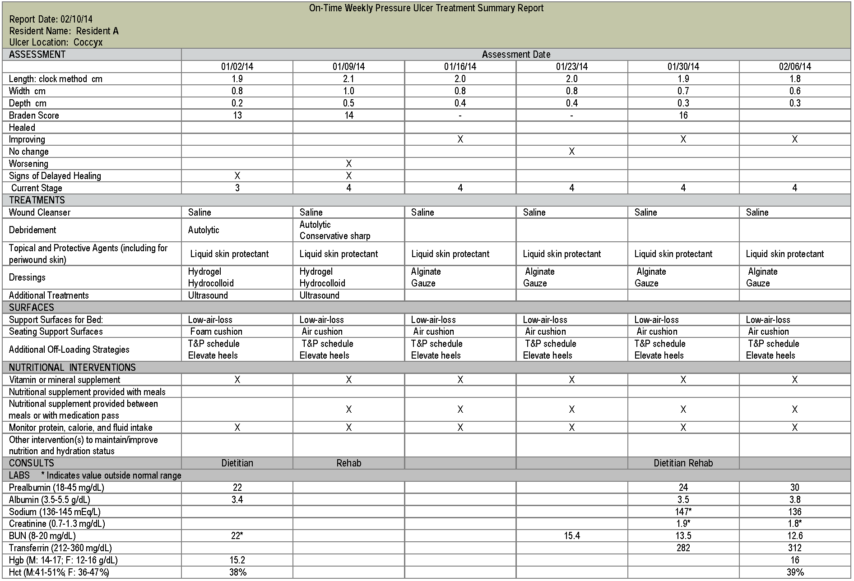
Sample Weekly Pressure Ulcer Treatment Summary Report

Slide 42
Reviewing Weekly Pressure Ulcer Treatment Summary Report Calculation Details
Ulcer Location
Assessment Date
Length, Width, and Depth
Braden Score
Healed, Improving, or Worsening
Signs of Delayed Healing
Current Stage
Treatments
Surfaces
Nutritional Interventions
Consults
Labs

Slide 43
Check Your Understanding: Weekly Pressure Ulcer Treatment Summary Report Quiz
The Weekly Pressure Ulcer Treatment Summary displays the following information for each pressure ulcer:
Location
Dimensions
Stage
Dressing
Nutritional interventions
All of the above
Pressure ulcer stage is reported as the highest stage the ulcer is/was regardless of current healing status.
True
False

Slide 44
Check Your Understanding: Weekly Pressure Ulcer Treatment Summary Report Quiz
Pressure ulcer status (improving, worsening, no change) is derived from the values recorded for the Braden Score.
True
False
Which of the following pieces of information would you not find on the Treatment Summary Report:
Whether antimicrobials had been administered
The pressure ulcer’s Braden Score
Whether the resident had experienced a decline in ADL
The site/location of the pressure ulcer on the resident

Slide 45
PRESSURE ULCER COUNTS BY MONTH

Slide 46
Pressure Ulcer Counts by Month Report
Assists clinicians with internal reporting and helps monitor pressure ulcer rates each month.
Intended to be run monthly at the end of each month
Used in combination with other reports for root cause analysis
Displays information for an entire facility with breakdown by unit

Slide 47
Pressure Ulcer Counts by Month Report
Captures pressure ulcer data in the weekly pressure ulcer assessment
Provides an option to select one or more pressure ulcer measures or pressure ulcer counts

Slide 48
Sample Pressure Ulcer Counts by Month Report

Slide 49
Sample Pressure Ulcer Counts by Month Report

Slide 50
Sample Pressure Ulcer Counts by Month Report

Slide 51
Reviewing Pressure Ulcer Count by Month Calculation Details
Current Pressure Ulcers by Stage
New Pressure Ulcers
Worsening Pressure Ulcers

Slide 52
Reviewing Pressure Ulcer Count by Month Calculation Details
Pressure Ulcer Measures
Pressure Ulcer Prevalence
Numerator: Number of current residents with at least one pressure ulcer
Denominator: Number of all current residents
% of Residents With New Pressure Ulcers
Numerator: Number of current residents with a pressure ulcer that developed during the month
Denominator: Number of all current residents

Slide 53
Reviewing Pressure Ulcer Count by Month Calculation Details
Pressure Ulcer Measures
% of Pressure Ulcers That Have Declined in Stage
Numerator: Number of current pressure ulcers that declined in stage during the month
Denominator: Number of all current pressure ulcers
% of IHA Pressure Ulcers That Have Declined in Stage
Numerator: Number of current IHA pressure ulcers that declined in stage during the month
Denominator: Number of all current IHA pressure ulcers
% of POA Pressure Ulcers That Have Declined in Stage
Numerator: Number of current POA pressure ulcers that declined in stage during the month
Denominator: Number of all current POA pressure ulcers

Slide 54
Reviewing Pressure Ulcer Count by Month Calculation Details
Pressure Ulcer Counts
Number of Residents With More Than One Pressure Ulcer
May be any stage (or unstageable)
May be POA or IHA
Count is taken on the last day of the month
Number of Residents With More Than One IHA Pressure Ulcer
Number of Residents With More Than One POA Pressure Ulcer

Slide 55
Check Your Understanding: Pressure Ulcer Count by Month Quiz
The Pressure Ulcer Counts by Month Report may be used by the quality improvement team to identify a unit where there is a trend for pressure ulcers to worsen.
True
False

Slide 56
Check Your Understanding: Pressure Ulcer Count by Month Quiz
If a unit is identified with a trend for worsening pressure ulcers, what questions would the quality improvement committee ask?
Were these residents identified as at risk for delayed healing of their pressure ulcers?
What interventions were written into their care plans to promote healing?
Were the interventions in the care plan developed by a multidisciplinary team? If so, which disciplines were involved?
Were the interventions written in the care plan carried out? Why or why not?
All of the above

Slide 57
Check Your Understanding: Pressure Ulcer Count by Month Quiz
A pressure ulcer that develops and heals during the report month is not counted in the number of current pressure ulcers.
True
False

