Slide 1
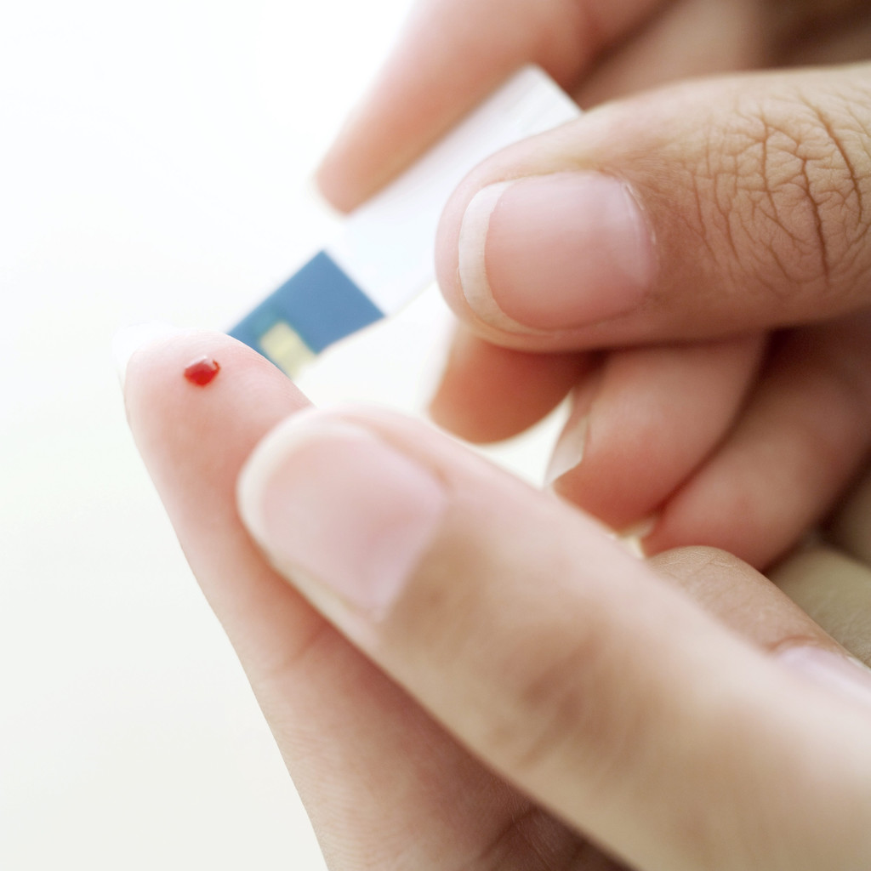


Implementing Team Approaches for Improving Diabetes Care in Health Centers
Hector P. Rodriguez, PhD, MPH (hrod@berkeley.edu)
UC Berkeley School of Public Health

Slide 2
iCARE (Innovative Care Approaches through Research & Education)
Acknowledgements
Other Research Team Members (University of California and RAND)
Dylan H. Roby, PhD, MPP, Ana E. Martinez, MPH, Arturo Vargas-Bustamante, PhD, MPP, Mark Friedberg, MD, MPP, Philip van der Wees, PhD, Marc N. Elliott, PhD, Allen Fremont, MD, PhD, Xiao Chen, PhD, Nigel Lo, and Sean Wu
QI/Interventions (Community Health Partnership, UCSF Center for Excellence in Primary Care, and CA Primary Care Association)
Kent Imai, MD, Elena Alcala, MPH, Tom Bodenheimer, MD, MPH, Dolores Alvarado, MSW, MPH, Kat Contreras, Val Sheehan, MPH, Alpana Verma-Alag, MD, MBA
Clinic Organizations (Intervention staff, IT/Data staff, primary care teams, leadership)
North East Medical Services, Gardner Family Health Network, Mayview Community Health Center, Indian Health Center, Salud Para la Gente
Funded by the Agency for Healthcare Research and Quality (AHRQ), under the American Recovery and Reinvestment Act (ARRA) (1R18HS020120-01).

Slide 3
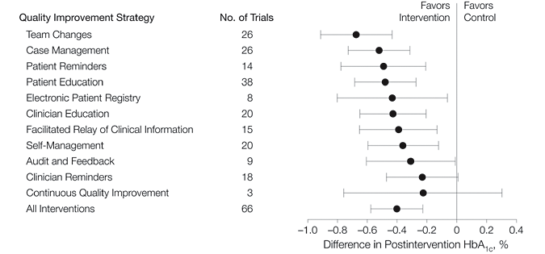
The Effectiveness of QI Strategies: Findings from a Recent Review of Diabetes Care
Shojania, K. G. et al. JAMA 2006;296:427-440.
Notes:
The Shojania article, also included in the earlier summary slide, illustrates the variety of QI strategies attempted and their effectiveness.

Slide 4
Community Health Centers and Chronic Care Management
Prior to the iCARE trial, the largest multi-site trial of diabetes care improvement in the safety net was conducted as part of the Diabetes Health Disparities Collaborative (BPHC HRSA)
Chart review of 969 patients, 17 health centers
Processes of care improved (testing for HbA1c, foot exams, eye exams, and lipids)
HbA1c control improved somewhat (borderline significant)
Note: Chin MH et al, Diabetes Care, 2004

Slide 5
Primary Research Aims
To compare the effectiveness of 1) office-based medical assistant panel managers and 2) community-based health workers in improving diabetes care quality, patient self-management, and patients’ experiences of primary care in CHCs.
To clarify the organizational facilitators and barriers to the effective integration of the strategies into routine care in CHCs

Slide 6
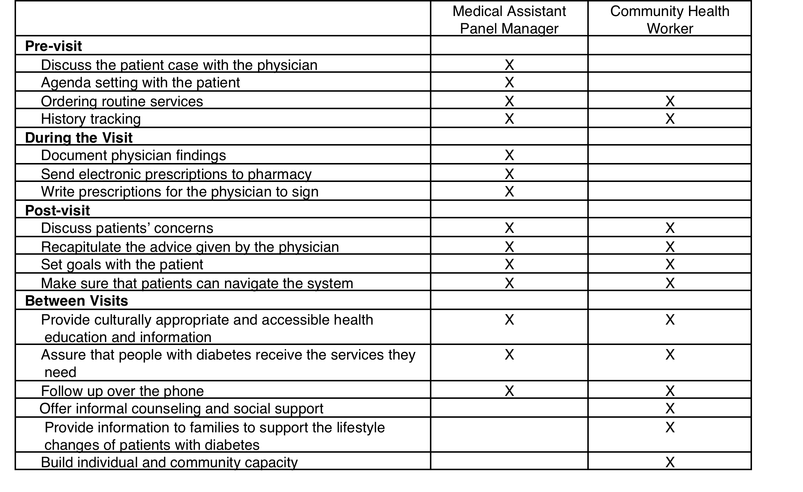
Comparing Two Team-Based Approaches to Diabetes Care Management
Notes:
Based on Bodenheimer’s teamlet model of primary care

Slide 7
Cluster Randomized Design
14 participating clinics (originally 17)
Santa Clara, San Francisco, and San Benito counties (Bay Area)
California
Medical Assistant
panel management
N=3
Community Health Worker
health coaching
N=3
Control
N=11
1 drop out 2 months into the intervention period
1 drop out 2 months into the intervention period
1 excluded because of low patient volume

Slide 8
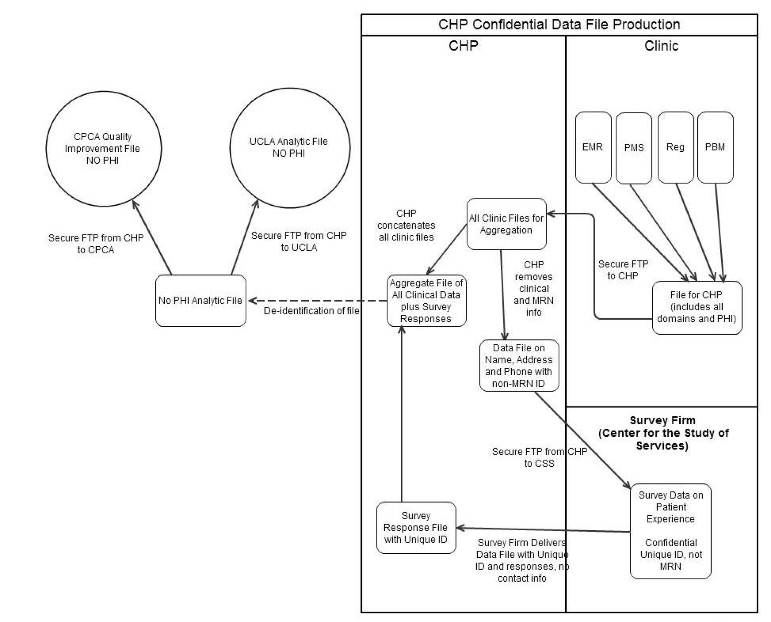

Slide 9
Project Data Sources
17 CHC sites in Northern CA with over 10K diabetic patients
Practice Climate Survey (n=249; RR=81%) in 2011
Clinical Quality, Demographic, and Diagnostic information for all adult patients with diabetes (n=6,111) in 2011 and 2012
Patient Experience Survey (random samples of patients with 2+ visits) (2012 RR= 45%, n=907; 2013 RR=63%, n=714)
Key Informant Interviews of practice stakeholders in early (2012) and late (2013) intervention period (n=24)
Practice structural capabilities survey (RR=100% in 2011 and 2013)

Slide 10
Focus on Intervention Effects
Change Over Time Results
  Intermediate Outcomes of Diabetes Care
    Hemoglobin A1c
    LDL-Cholesterol
    Blood pressure
  Patients’ Experiences of Care
    CG-CAHPS Communication (k=6)
    Patient Assessment of Chronic Illness Care (n=11)
Key Implementation Insights for Health Centers Implementing Team-Based Diabetes Care Approaches with MAs and/or CHWs

Slide 11
Primary Care Clinicians and Staff Occupations (n=249)

Slide 13
Notes:
Using a combination of new items and items drawn from existing surveys, we devised a new survey instrument to assess CCHC characteristics. This instrument was intended to assess aspects of care team functioning (e.g., team composition, stability, and culture) and organizational readiness for change (e.g., communication openness, organizational learning processes, and adaptive reserve) and included a single item to measure respondents’ professional satisfaction.
we settled on a higher-order factor model which specified these four factors loading on a higher order factor, and also specified the 2 factors that were sufficiently distinct from the previous 8 factor solution (see figure X). This final model fit the data extremely well in the exploratory sample (CFI = .958, TLI = .956 and RMSEA =.056) and the suitability of the structure was confirmed with the validation sample (CFI = .935, TLI = .932 and RMSEA =.065).

Slide 14
Source: Van der Wees PJ, Friedberg MW, Alcala E, Ayanian JZ, Rodriguez HP. Comparing the implementation of team approaches for improving diabetes care in community health centers. BMC Health Services Research. In press.

Slide 15
Source: Van der Wees PJ, Friedberg MW, Alcala E, Ayanian JZ, Rodriguez HP. Comparing the implementation of team approaches for improving diabetes care in community health centers. BMC Health Services Research. In press.

Slide 16
Patient Survey Respondent Characteristics:
Education and Language (n=907)

Slide 17
Methods- Change Over Time
Analytic sample definition: 6,111 adult diabetic patients with 2+ visits in pre-intervention year (2011) and 1+ visit in the intervention year (2012)
Cluster randomization of clinics did not result in balanced patient characteristics. Exact matching was used to improve causal inference.
Age (in 10 year bands), gender, race/ethnicity, language preference, and insurance type were used as matching variables
Notes:
We lose 38 from the MA group and 59 from the CHW group. There are two reasons for this. First, we restricted the sample to the interior of the convex hull, thus patients in the intervention that had no corresponding match were excluded. This resulted in a loss of 11 intervention patients from the MA group and 26 intervention patients from the CHW group. Second, since it was a one-to-one match without replacement to the pool of control patients, there were some combinations where there were more intervention than control patients and thus the intervention patients without a match were dropped. This resulted in a loss of 27 patients (~5%) from the MA group and 33 patients (~7%) from the CHW group.

Slide 18
Improving the Balance of Patients across the Study Arms
Notes:
Overall 6,041 patients of the 6,111 matched (98.9)

Slide 19
Source: Van der Wees PJ, Friedberg MW, Alcala E, Ayanian JZ, Rodriguez HP. Comparing the implementation of team approaches for improving diabetes care in community health centers. BMC Health Services Research. In press.

Slide 20
Adjusted analyses control for patient age, gender, race/ethnicity, and insurance status. Patient and clinic random effects are used to account for the clustering of time within patients and patients within clinics, respectively.

Slide 21
LDL-Cholesterol Control (≤100 mg/dL) Changes Over Time
Adjusted analyses control for patient age, gender, race/ethnicity, and insurance status. Patient and clinic random effects are used to account for the clustering of time within patients and patients within clinics, respectively.
Notes:
MA intervention arm has 8.4% point improvement in LDL-C control

Slide 22
Blood Pressure Control (≤140/90 mmHg)Over Time
Adjusted analyses control for patient age, gender, race/ethnicity, and insurance status. Patient and clinic random effects are used to account for the clustering of time within patients and patients within clinics, respectively.
Notes:
CHW intervention arm has 6.1% point improvement (p=0.10)

Slide 23
Adjusted analyses control for patient age, gender, race/ethnicity, and insurance status. Patient and clinic random effects are used to account for the clustering of time within patients and patients within clinics, respectively.

Slide 24
Adjusted analyses control for patient age, gender, race/ethnicity, and insurance status. Patient and clinic random effects are used to account for the clustering of time within patients and patients within clinics, respectively.
Notes:
MA arm statistically sig

Slide 25
Outcomes Summary
Clinical Outcomes:
  Improved LDL-C control for the MA arm (8.4% points)
  Improved blood pressure control for CHW arm (6.1% points)
Patient Experience:
  More improvement (7.6 points) in patients’ experiences of chronic illness care (PACIC-11) for MA arm.
  No differential improvements in clinician-patient communication

Slide 26
Implementation Insights
  Practice Modifications
    Changes to diabetes care management were concentrated in the five intervention sites
    Only one control clinic respondent indicated any changes to the management of diabetic patients during early or late intervention periods.
  Support of New Team Member Role Integration
    Perceived support of health coaching role of MA or CHW at all levels of the organization for the 5 intervention sites
    Dedicated time of MA and CHW crucial for implementation
    Rotating responsibilities for health coaching among staff impeded the learning process.

Slide 27
Implementation Insights II
Structural capabilities (like registry use for diabetics) were perceived as foundational requirements for implementing CHW or MA team-based approaches
Cultural adaptations to the models were important
  Emphasizing physician-led teams for Chinese patients
  Emphasizing family roles and social support for Latino patients
  Gender seemed to play a role in the implementation of CHW home visits

Slide 28
Key Conclusions
Diabetic patients improved intermediate outcomes (Blood pressure for CHW; LDL-C for MA panel manager) in the short run (1 year)
First multi-site intervention study to pool patient-level data across diverse CHC organizations serving different ethnic communities and link with patient experience surveys.
Patient experiences of care quite low- need for improvement and appear to be difficult to change over time.
Money and Facilitation Isn’t Enough!: Even with implementation resources, extensive data management support and intervention technical assistance, intervention sites did not achieve breakthrough improvements.

Slide 29
Should We Be Spreading These Team-Based Approaches in the Safety Net?
The right thing to do for patients, but effect sizes are discouraging (compared to control)
Frontline experiences (key informant interviews) indicate that the study period (2011-2013) was turbulent for CHCs (EHR implementation, staff turnover).
Without supportive payment policies, implementation of MA and CHW models will not likely spread
More practice-based evidence to support future implementation?
Patient experience has got to be front and center of future efforts, as team-based models require patient acceptance.

Slide 30
Additional Questions?
Hector Rodriguez
  hrod@berkeley.edu, (510) 642-4578

