Slide 1
TAKEheart:
AHRQ’s Initiative to Increase Patient Participation in Cardiac Rehabilitation
What We Planned, What Happened, and What We Learned
Michael Harrison and Dina Moss
April 26, 2023
(Edited 5-25-23)
Notes:
Dina was COR and implementation lead; Michael was co-COR and evaluation/dissemination lead.

Slide 2
Overview
Part 1: Background
Part 2: Project Design
Part 3: What Happened
Part 4: Key Takeaways
Part 5: What’s Next
Notes:
What happened includes:
What did and did not go as planned
What worked and didn’t
What we were and were not able to accomplish

Slide 3
Part 1: Background
The Problem
The Evidence-Based Solutions

Slide 4
The Problem
The problem: glaring underuse of Cardiac Rehab (CR) despite proven health benefits
  CR = medically- supervised, multi-faceted, 36-week program proven to improve patient outcomes (decreased chance of heart attack recurrence, better medication adherence, and better quality of life) and reduce readmissions
  In 2019, < 25% of eligible patients received CR services
  Even greater underuse among women, older adults, traditionally underserved/disadvantaged populations
The 2017 a road map from the Million Hearts Cardiac Rehabilitation Collaborative states that
  Increasing CR participation from 20% to 70% could save 25,000 lives and prevent 180,000 hospitalizations annually in the United States
Notes:
Each year, over 1 million Americans have a coronary event or undergo a cardiac-related procedure that makes them eligible for cardiac rehabilitation (CR).
CR includes supervised exercise training, risk factor management, patient education and heart-healthy skills development, and counseling on stress and other psychosocial factors. CR is typically delivered in the outpatient setting but can be initiated in the inpatient setting. It optimally consists of 36 one-hour sessions. CR is customized to meet each patient's individual needs, optimizing its benefits.

Slide 5
The Solutions
To address this problem, CDC/MillionHearts nominated promoting increased participation in Cardiac Rehab (CR) for AHRQ PCOR-funding
They further proposed promoting use of two specific strategies for increasing uptake, as described in the MillionHearts Cardiac Rehab Change Package (CRCP):
  Automatic referral (AR)
  Enhanced care coordination (CC)
Notes:
CRCP is a collection of process improvements that CR champions can implement with links to vetted tools and resources
It was developed by the Centers for Disease Control and Prevention (CDC), in collaboration with the American Association of Cardiovascular and Pulmonary Rehabilitation (AACVPR) and from other experts and expected end users
Care coordination - personal connection with patient and follow through supporting enrollment – role can be filled by navigator, patient ambassador, program staff --volunteer or staff member.

Slide 6
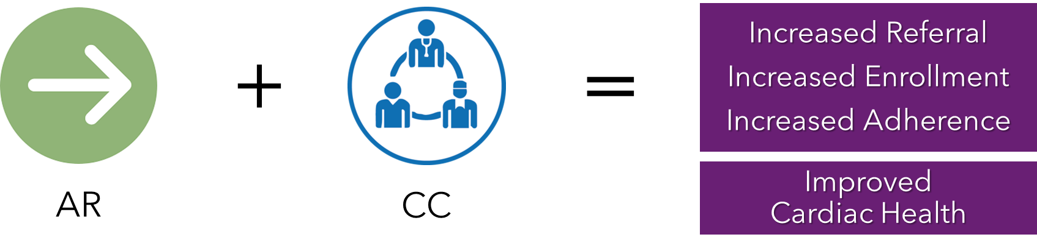
AR + CC
  Automatic referral (AR) to ensure that all patients eligible for CR are referred, regardless of provider
  Enhanced care coordination (CC) to educate patients and facilitate the enrollment process
Treatment | % Eligible Patients Referred to CR
Control | 32%
AR alone | 70%
AR & effective CC | 86%
Notes:
A 2011 study demonstrated that implementing AR and effective CC are quality improvement steps that hospitals can take to increase CR participation in their health systems and communities.
Citation:
Grace, S.L. et al. Effect of cardiac rehabilitation referral strategies on utilization rates: a prospective, controlled study. Arch Intern Med. 2011 Feb 14;171(3):235-41. doi: 10.1001/archinternmed.2010.501.

Slide 7
Part 2: Project Design
Mechanism: ACTION Task Order
Total Cost: $6m
Approach:
  Statement of Objectives
  Dissemination/Implementation + Evaluation
Timeframe: 3 years (3/2019-3/2022)
  Modified due to COVID: end date 12/2022

Slide 8

Project Objectives
Raise awareness about the problem of CR underuse and available solutions
Promote hospital uptake of strategies to increase participation in CR by providing training and coaching in process redesign
Generate new knowledge about other strategies for increasing CR participation and addressing disparities in referral and enrollment by engaging members of CR community in peer-to-peer learning
Prepare final training materials for future, stand-alone use
Evaluate extent to which D and I outcomes were achieved
Training + Awareness + Knowledge + Engagement
Notes:
Initial short term impact through training; Longer term impact through final training materials

Slide 9
Project Components: D and I
Objectives | Project Elements -- D and I
Increase awareness of evidence for benefits and underutilization of CR | Project Website Target Audiences: hospital CR staff and other healthcare providers; QI teams and orgs Public information to inform and educate Private work space
Promote hospital uptake of strategies to increase participation in CR by providing training and coaching in process redesign for implementing AR/CC | Recruitment of 100 hospitals pre-committed to implementing AR +CC to receive training and coaching through 2 sequential training cohorts Monthly, expert-led training webinars Monthly, coach-facilitated discussions to reinforce content, answer questions, share experiences and materials, monitor progress Limited additional TA NEW in 2022: Third, smaller, training cohort -- self-paced and focused on CC alone
Engage CR community in peer to peer learning to generate knowledge of other strategies for increasing CR participation | Host a Learning Community for ~250 participants Specific interest in strategies for addressing disparities in participation among traditionally underserved populations Organized into “Affinity Groups” of varying sizes/ durations; topics proposed by members NEW in 2022: HYCR Learning Community Workgroup

Slide 10
Project Components (2):
Evaluation and Final Materials
Objective | Project Elements
Assess success and increase knowledge about how to disseminate and implement PCOR evidence going forward | Evaluation Components Formative evaluation: Provide interim feedback to project staff to support program management and adaptation Assess implementation outcomes: Conduct mixed methods evaluation of degree and variations in adoption of strategies for implementing AR and CC CR participation outcomes (If possible): Analyze hospital data to asses pre-post changes in CR referral, enrollment, retention Extract learnings that can inform future AHRQ D and I initiatives
Final Materials for posting on AHRQ Website upon completion of the project | Based on experiences of Partner Hospitals, redesign training materials produced for the project so Final Training Materials can be used by hospitals that vary in available resources, program operations and QI experience, and that differ in their starting points and aims in the absence of coaching/TA

Slide 11
Project Team
Prime Contractor: Abt Associates
  PD = Cynthia Klein, PhD
    supported by outstanding Abt staff
  Subcontractors
    Dr. Hicham Skali, Brigham and Women’s Hospital, Clinical PI
    Crosby Communications
    HRET/AHA
Content Expertise and Leadership: CDC/MillionHearts
  Hilary Wall and Haley Stolp
Contract Management: AHRQ Team
  Moss, Harrison, Makulowich

Slide 12
Part 3: What Happened
What did and did not go as planned
What worked and didn’t
What we were and were not able to accomplish – during a pandemic

Slide 13
What Happened/What Was Accomplished:
Website
Crosby Team built a beautiful, easy to navigate site that swiftly and nimbly responded to time-sensitive needs
  Rapid adaptation to covid-related project adaptations and to HHS pandemic communication requirements
  Reconfigured for final incorporation into AHRQ Website
  Developed social media messages; coordinated messaging with OC
Website usage stats showed limited overall use of site
  Public: Need for additional general info about CR may have been limited given availability of other sites (e.g. Million Hearts).
  Participating hospitals:
    No interest in private, password-protected site for information and collaboration
    While site served as location to post recordings of training videos, participants did not need to go to there for project materials since we provided those to them directly by email

Slide 14
What Happened and Was Accomplished:
Recruitment
Partnered with national organizations
  AHA/HRET (sub and lead), Million Hearts, AACVPR, America’s Essential Hospitals
Successfully recruited over 90 hospitals in initial recruitment effort -- before launch of cohort 1 (pre-pandemic)
  With over-representation of hospitals serving high needs communities
  Even more were interested but not ready (instead encouraged to join the TAKEheart Learning Community)

Slide 15
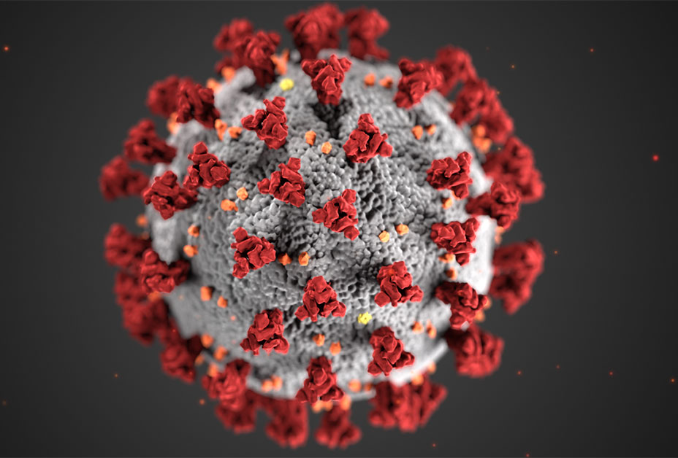
What Happened:
Trainings/Support
Notes:
Two months into the trainings, COVID happened.

Slide 16

COVID Forced a Pause…
Trainings were suspended as CR staff were redirected to assist with COVID patient care and some CR programs shut down entirely

Slide 17
During the Pause
Continued to work on content, speakers for future trainings
  The extra time was invaluable
JUMP-STARTED THE LEARNING COMMUNITY
Maintained close contact with PHs
  Conducted readiness assessments
  Conducted another round of recruitment

Slide 18
When Trainings Resumed:
What Happened
Training cohorts were reconfigured; first cohort included many returning PHs, plus new recruits
  Onboarding session and introductory training sessions for new hospitals
Outstanding, expert-led trainings conducted monthly
Instructional “Implementation Guides” produced and distributed to all participants with links to rich resources
Monthly Partner Hospital Discussion Groups were reconfigured around common characteristics vs. geography
While some overlap between 2 cohorts:
  Some adaptations in response to lessons learned
  Cohort 1 hospitals shared experience with cohort 2 hospitals

Slide 19
Training, Support, Implementation:
What We Did and Didn’t Accomplish (1)
>60% attendance in trainings and discussions for first two cohorts (implementation cohorts)
Discussion attendance in cohort 3 (self-paced; CC only) started lower (42%) and dropped to 29%
All survey respondents reported training sessions were applicable to their organization. Nearly all (83%-100%) said discussions (PH-PAG) were useful.

Slide 20
Training, Support, Implementation:
What We Did and Didn’t Accomplish (2)
> 75% of Partner Hospital teams completed the training/coaching program across 3 cohorts
  132 hospitals began training with one of the cohorts
  108 completed the full training program
Results:
  70% reported AR progress;
  Qualitative reports of enhanced CC, tracking referral rates, focus on patient retention
Less implementation of AR/CC than hoped for, but learning from trainings continued post-training, with help of resources provided with each module
Notes:
Implementation: substantial engagement in implementation trainings and peer groups; reported AR progress by 70% of survey respondents; qualitative reports of progress on enhancing CC, tracking referral rates, and an increased focus on patient retention . But this was less than hoped-for progress on AR and CC – due to pandemic challenges; lack of site capacity for QI (limited prior experience, limited data availability and experience in use; limited prioritization by top leadership; heterogeneity of participants’ capacity, needs, interests.)

Slide 21
What Happened:
Learning Community
Launched LC earlier than intended
  Opportunistic response to thirst for information on how others were adapting CR operations to the pandemic
  Initial 7 LC Webinars focused on CR program response during PHE, each with 100-200 participants
    Innovative Adaptations to Operations; Methods and Materials for Remote Patient Support; Patient Safety Considerations;
Remaining 13 LC Webinars focused on innovative strategies for increasing CR participation including CR for special pops (e.g., women; heart failure patients)
850+ individual participants X 20 LC Webinars
Sessions addressing cutting edge issues (e.g. CMS payment for CR, telehealth) were most popular
Notes:
LC WEBINARS
Addressing Challenges with CR amid the COVID-19 Pandemic
Adapting CR Program Operations in Response to Coronavirus Pandemic Impacts
Patient Support Resources and Educational Materials Utilized by CR Programs during the Pandemic
Patient Safety While Resuming In-person CR Program Operations
Operational Adjustments while Resuming In-person CR Programs
Emerging Strategies for Supporting CR Patients between Onsite Visits
Coping with Staffing Challenges in Today’s CR Programs
CMS Final Rule and Strategic Planning for 2021
Improving Support for Women Who Need CR; Innovations That Can Improve Your CR Program; Enhancing Care for Heart Failure Patients
Using Hybrid CR to Expand System Capacity and Patient-Centeredness; Practical Methods for Improving Care Coordination for CR Patients; Maximizing Physician Support for CR; Creating and Operating a Successful Hybrid CR Program

Slide 22
Learning Community:
What We Did and Did Not Accomplish
“Meeting hospitals where they were” promoted and maintained extremely high levels of engagement DURING PANDEMIC.
Engagement translated into participation in trainings when these resumed
More than half of post-session-survey respondents reported discussing/making changes following participation in LC sessions
  But very low survey response rates
BUT: Plan for small, cohesive “affinity groups” meeting more than once to discuss strategies and share experiences and resources for increasing participation did not materialize

Slide 23
HYCR Workgroup and Environmental Scan:
What Happened
In response to growing interest in – and limited available info about –“hybrid” CR models, AHRQ sought/received additional PCOR funds for
  HYCR Workgroup to generate and capture insights and resources to assist hospitals in developing hybrid CR options
  Environmental Scan to inform workgroup discussions; identity gaps
14 participants with different levels/types of HYCR experience to ensure the Workgroup possessed the perspectives of all of the audiences for whom Workgroup-based resources were to be created.
Chaired by national expert; met monthly for 6 months
Extremely high level of engagement, including
  Animated discussions
  Document sharing and effective communication through Teams Platform
Notes:
Diverse workgroup participants – included members:
Planning to offer hybrid CR within 6-12 months;
Began offering hybrid CR within the past year;
Have an established HYCR option (> 1 year)
Environmental Scan = brief literature scan on select HYCR topics = final report summarized
This mix of program backgrounds was intended to ensure the Workgroup possessed the perspectives of all of the audiences for whom Workgroup-based resources were to be created.
(b) the results of the “real world” scanning activities conducted in associated with the HYCR Workgroup.
Lessons learned for implementation of similar working groups on high priority health care topics in the future (presented to AHRQ in a separate report).
The HYCR Workgroup’s insights and resources about creating and successfully administering a hybrid CR option were presented at the end of the project to the larger LC community at an AG session open to the entire Learning Community

Slide 24
HYCR Workgroup and Environmental Scan:
What Was Accomplished
Training Module (Slides, Implementation Guide, Resource Guide; Video of live remote exercise session)
Final LC Webinar to share insights and resources for launching and operating a successful HYCR program
Final Scan Report summarizing what is known, what is still unknown, and future directions for research

Slide 25
Final Materials:
What Happened/What Was Accomplished
Restructured original 10 Training Modules into Four Consolidated Curricula:
  Getting Started ( = The Fundamentals of QI and Process Redesign)
  Implementing AR
  Enhancing CC
  Implementing HYCR To Expand Access and Capacity
Each set with revised, streamlined:
  Customizable Slide Deck (no recording)**
  Comprehensive Implementation Guide
  Resource Guide
User’s Guide
** Links to the recordings of relevant original training webinars are embedded in the Slide Decks

Slide 26
What Happened:
Evaluation
Modifications in response to pandemic:
  A few planned data gathering activities were scaled back or eliminated; others added as need recognized.
  Delay of training cohort 1 eliminated time planned for analyzing participant surveys and providing input to cohort 2 planning. Summaries of qualitive data and informal feedback from coaches provided periodic input to project management
Partner hospital surveys produced broad information on uptake of CRCP training components, but response rates (26-51%) raised possibility of positive bias.
Additional qualitative data and data triangulation strengthened inferences about uptake and uses of training materials.
Hospitals did not supply pre-post CR data
Limited evidence on causes of underuse and on practices enhancing CR use by underserved. Exception: hybrid CR – major became emergent focus of learning community and may help reach underserved.
Notes:
Added: readiness assessments; implementation hospital debriefs; Cancelled: physician interviews, 2nd survey of LC participants; (exit interviews – not relevant.); modified: interviews with selected champions changed to group interviews.

Slide 27
What We Learned (1)
Project team maintained participant engagement by
  Acknowledging and directly addressing participants’ challenges and concerns
  Providing learning and training that were valuable and immediately useful for participants
  Being flexible in timelines, activity sequencing
  Modifying implementation expectations.
Encountered limits to participants’ implementation capacity (e.g., sr. leadership support, data analysis capacity, interest in proposed new practices); divergence in readiness and implementation objectives when training resumed
Pandemic increased implementation challenges and participant diversity, but challenges not unique to PHE
Notes:
More thorough, advanced investigation of implementation and improvement contexts might have helped us better address implementation and learning barriers that predated the pandemic and were made worse by it.
We gradually recognized that our original plan and timetable were overly ambitious and did not sufficiently respond to diversity among participating hospitals. We needed to tailor our implementation strategies more fully to the priorities, needs, and capacities of the participating sites and to allow sites greater flexibility in developing CR improvement programs that better fit their own system’s requirements and capabilities.

Slide 28
Evaluation
What We Learned (2)
Website use and session participation data don’t provide needed information on types of users/attendees and nature of involvement.
Surveys likely reflect views of engaged participants; only provided broad view of uptake and usage of training content
Qualitative data provides richer, more fine-grained information but requires substantial time and skill to interpret, summarize and integrate with quantitative reports
Most participating CR programs still lack pre-post CR use data and have limited data analysis capacity
Notes:
The website usage data also suffered from technical glitches. What we could glean from it was that other than the home page, only a small proportion of visits (<7%) were made to other pages. The time spent on site was very low (January 2020 to October 2020 –avg. 1 minute 31 seconds. avg. session duration for February 2022 to September 2022 was 2 minutes 19 seconds.)
CR staff often seem to have lacked access to available data or lacked data-analysis capabilities

Slide 29
Part 4: Key Takeaways for Future D and I Projects
D and I Takeaways
LC Takeaways
Evaluation Takeaways

Slide 30
D and I Takeaways
Ingredients for project success in turbulent times:
  Provide training content of direct value to participants. Meeting participants where they are can ensure continuing engagement – even in the face of serious challenges
  Be flexible in sequencing, expectations, timelines
Making segments of implementation program partially independent of one another facilitates -
  Responsiveness to divergent participants capacities and priorities
  Modification and adaptation as circumstances change
Anticipate possibilities to leverage emergent innovations (e.g., shift to hybrid care)
Emergent innovations merit systematic assessment and may be worthy of researcher and institutional support

Slide 31
Key Takeaways:
Learning Communities
Considerations in structuring and running LCs in cases where there is limited empirical evidence/literature
  Size: sometimes less is more!
  Composition: differences in experience levels and operating environments
  Recruitment and vetting are essential, as is setting expectation for high level of participant input: select for desire to share and participate actively
  Prework is invaluable! Generates important info and leaves more time for meaningful discussion
  Easily accessible, navigable, collaborative workspace is a must for sharing resources (Teams worked well!)
Notes:
Mix of experience levels
The ones less far along are asking the important questions
Experienced can also say what did not well
ALSO Just-in-time literature scanning before sessions vs. single scan provided more up-to-date input and topic focus

Slide 32
Key Takeaways: Evaluation
Combining D&I project and evaluation in single contract
Why:
  Practical (Limited time, funds, staff; need to coordinate both elements)
  Fit with goals: formative vs summative evaluation
How
  Separate contractor staff/team
  Firewall between teams
  Spilt AHRQ project oversight
Result
  Evaluation met expectations,
  But we had to relax firewall rules to achieve them.
Firewalls pose barrier to formative and mixed method evaluations
Notes:
To design their surveys and plan and conduct the qualitative parts of the data gathering, the evaluators needed richer understanding of project dynamics and content and closer interaction with coaches than the original firewall arrangements allowed.
From our experience in this and one other project where there also was overlap between project execution and evaluation- firewall poses serious barrier to collection of meaningful qualitative data and genuine integration of these data with quantitative data.

Slide 33
Part 5: Now What/What’s Next
Continued dissemination of TAKEheart Training Materials-- available on AHRQ Website
  With messaging help from Million Hearts CR Collaborative leadership and members
Additional Reporting:
  Will post today’s presentation on AHRQ Website
  Evaluation exec summary also on AHRQ Website
  2 Manuscripts: Project narrative: main findings/takeaways from evaluation
Hybrid CR materials–future demand depends on CMS payment decisions after end of PHE
Notes:
We encourage you to visit TAKEheart on AHRQ website to see the resources we produced.
Also available: Harrison, M. , Moss, D et al. “Conducting a National Dissemination and Implementation Project during the Pandemic: Learnings from TAKEheart – AHRQ’s Initiative to Increase Use of Cardiac Rehabilitation (CR) .” Science of Dissemination and Implementation. Dec. 2022. https://academyhealth.confex.com/academyhealth/2022di/meetingapp.cgi/Paper/54643

