Slide 1
Enhancing Care Coordination for Cardiac Rehabilitation
Notes:
The PowerPoint presentation (PPT) is designed to serve as a roadmap, along with the Implementation Guide (IG), for enhancing care coordination processes for facilitating enrollment and participation of eligible patients in CR cardiac rehabilitation (CR).
IMPORTANT NOTE RE: ACCESSING LINKS in this PPT presentation:
Links embedded in SLIDE portion are hyperlinks
Links shown in the NOTES portion must be copied into a browser to be accessed

Slide 2
Overview of TAKEheart Materials for Enhancing CC
Consolidated Curriculum for Enhancing CC for CR
PPT Slides
Implementation Guide (IG)
Resource Guide (RG)
Original Training Modules
#6: Laying the Groundwork for Care Coordination
#8: Implementing Effective Care Coordination
#9: Engaging and Empowering Patients and Families for Success in CR
Other Related Webinars
Practical Methods for Improving CC for CR Patients
Improving Support for Women Who Need Cardiac Rehabilitation
Enhancing Care for Heart Failure Patients in Your CR Program
(Please read notes below to learn more about these materials)
Notes:
There are three components to the Consolidated Curriculum for Enhancing CC
1. This slide deck:
The slides are focused on broadly describing the recommended activities (“WHAT”) and explaining “WHY” they are being recommended.
The information is presented in a PPT format so that it can easily shared with other staff whose support or involvement may be needed during implementation.
Notes are included for some of the slides -- where the slide is not self-explanatory, or to include additional content
2. This PPT presentation is meant to be used alongside the Enhancing CC Implementation Guide (IG).
The IG provides actionable, step-by-step guidance about HOW to implement the actions recommended in the slides.
If you are just beginning to plan your QI initiative, you may want to start by reviewing the slide deck alone.
Once you are ready to launch and implement, you may find it helpful to use these two sets of materials side by side, one section (‘step”) at a time.
Chapter (‘step”) titles in slides align with titles in the IG
3. RESOURCE GUIDE: Those wishing to dig even more deeply are encouraged to review the companion Enhancing CC Resource Guide,
This Guide includes additional information and guidance -- in the form of tools, templates. articles, case studies, videos, slide decks, and more -- for anyone wishing to dig even more deeply into the core topics covered in this presentation.
ORIGINAL TRAINING MODULES: The original training modules are one hour-long training sessions originally presented live to a group of hospitals working in real time in 2020-2021 to enhance their CC processes. The Consolidated Curriculum for Enhancing CC is a streamlined, restructured synthesis of the information presented during these three original trainings. (Links to these sessions and brief descriptions of their contents - are also included in the “ To Learn More” slides in this slide deck for those wishing to hear directly from experts and peers about their own experiences with enhancing CC for their CC patients.)
The TAKEheart WEBINARS are one-hours sessions held between 2020–2022, featuring discussions among CR experts and CR champions from diverse hospitals.

Slide 3
Acronyms

Slide 4
Table of Contents
Chapter 1: Understanding CC
Chapter 2: REVIEW: Planning Your Improvement Effort
Chapter 3: Redesigning Processes to Improve CC
Chapter 4: Identifying Patient Needs and Reducing Disparities
Chapter 5: Equipping Staff to Lead & Support CC
Chapter 6: Using Data to Improve CC and Monitor Progress

Slide 5
Chapter 1: Understanding Care Coordination (CC)

Slide 6
What is Effective CC for CR?
Effective CC for CR is:
a group of workflow processes and activities
designed and systematically executed
to ensure ALL eligible patients are referred, enroll, and participate fully in the program.
Notes:
Effective CC for CR is focused on specific activities that will increase the likelihood that ALL eligible patients are referred to CR and ALL referred patients enroll in a CR program. While patient participation until program completion should be the goal for all patients, TAKEheart materials are focused more narrowly on CC to increase the referrals and enrollment.

Slide 7
2011 Study: Benefits of CC
Treatment | % Eligible Patients Referred to CR
Control | 32%
AR alone | 70%
AR & effective CC | 86%
Notes:
The 2011 study demonstrated that implementing AR and effective CC are quality improvement steps that hospitals can take to increase CR participation in their health systems and communities.
Citations from this slide:
Grace, S.L. et al. Effect of cardiac rehabilitation referral strategies on utilization rates: a prospective, controlled study. Arch Intern Med. 2011 Feb 14;171(3):235-41. doi: 10.1001/archinternmed.2010.501.

Slide 8
Key Objectives of a CC System for CR
Effective CC for CR seeks to:
facilitate patient and provider conversations
coordinate referrals
identify and address patient needs and concerns
educate patients, families, and caregivers
connect patients to community resources
Notes:
While the literature on CC for CR often focuses narrowly on the role of an assigned “liaison” in providing CC, TAKEheart focuses on the CC system, which is a set of processes aimed at achieving the objectives shown on this slide.

Slide 9
Key CC Objectives and Processes
Patient & Provider Conversations
Coordinate Referrals
Identify and Address Patient Needs and Concerns
Develop and Share Patient Education Materials
Understand Community Resources & Connect Patients
Notes:
CC involves:
conversations with the patient/family about CR about the value of CR
conversations with providers about the importance of ensuring that all eligible patients are referred, and helping them understand AR
screening patients to identify those at risk for not enrolling or dropping out, and discussing barriers to their participation and how they might be addressed
Understanding available community resources and helping to connect patients to solve issues, for example, transportation & insurance coverage.
Possibly connecting patients with a former graduate as a buddy to help support the patient through the program
Keep these elements in mind as you think about developing your own CC activities for CR.

Slide 10
Effective CC is about Engaging ALL the Right People!
Notes:
Engaging ALL the right people is critical.
CHW = Community Health Worker, who could be a social worker, interpreter, patient advocate, WomenHeart volunteer, case worker, or any one else who can help facilitate enrollment and address specific needs or challenges a patient might face. Which not necessary required in every case, the CHW can be especially helpful in disparities by sex, race/ethnicity, English proficiency, etc.

Slide 11
Remember: Process Redesign Takes Time!
Implementers should plan on months, not weeks, to enhance their CC processes.
Time requirements will vary with existing resources, staffing plans, and the scope of desired enhancements to current CC practices.

Slide 12
Chapter 2: Planning Your Improvement Effort (REVIEW)
Notes:
This chapter provides a high-level review of topic covered in greater depth in the Getting Started Curriculum.
If you have not yet reviewed that curriculum, you are encouraged to do so before you launch your improvement initiative.
If you have recently completed the Getting Started Curriculum, you may wish to skip immediately to Chapter 3

Slide 13
Key Steps
Identify a champion
Enlist support from leadership
Form a multi-disciplinary QI team
Develop an aim statement
Create an action plan
Map current workflow
Identify problem areas and set priorities
Notes:
These are the key foundational steps for undertaking any QI initiative. In order to move forward with redesigning your CC processes you will need to have achieved each of these steps. You will then be ready to redesign process to meet identified needs.

Slide 14
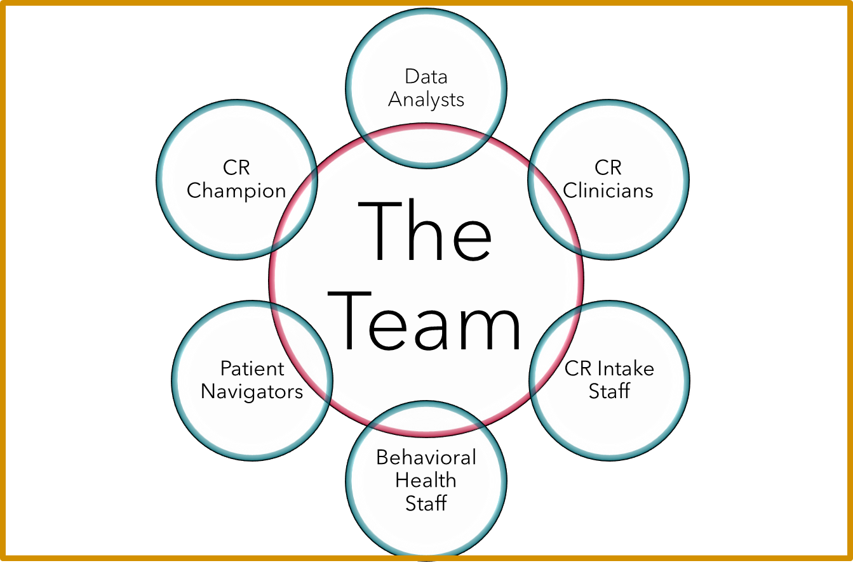
Gather Your Team
Notes:
These are the possible members of a QI team focused on improving CC processes. Each has valuable knowledge or skills that will be helpful in identifying needs, setting achievable goals and executing them.

Slide 15
Aim Statement and Action Plan
Write an aim statement that answers the question: “What are our enhanced CC processes specifically designed to accomplish? “
Create an action plan that:
Describes the tasks that will need to be performed
Assigns each task to a specific individual
Specifies completion dates
Notes:
More guidance about how to conduct each of these steps is included in Chapter 2 of the Enhancing Care Coordination IG and in the Getting Started IG

Slide 16
Identify Areas for Improvement
Use these methods for identifying areas for improvement:
Map your existing processes: engage your team in a workflow mapping activity
Talk to patients
Review baseline data
Then work as a team to identify achievable goals and set priorities.
Notes:
Your Action Plan will focus on implementing solutions to identified problems. Here are some ways for identifying areas needing improvement.

Slide 17
Key Questions for Mapping CC Workflows
Where do patients fall through the cracks?
Are conversations occurring between patients and the referring clinician?
Are patients screened for needs and concerns?
Who is communicating with the patient?
How is health insurance factored in?
Who follows up to make sure the patient enrolls?
What is the wait time?
Notes:
One way to identify areas needing improvement is to map your current workflows and your processes for referring and enrolling patients and transitioning them from the referral to the enrollment phase. Illustrated, step-by-step guidance about how to map your workflows is included in the Getting Started Curriculum.
This slide lists some likely areas for investigation during a workflow mapping exercise focused on identifying ways to improve CC for CR

Slide 18
Talk to Patients
Survey current and past patients, including those who did not enroll or did not complete the program, identifying:
Factors that made the referral and enrollment process easy and/or difficult
Causes of failure to enroll
Reasons for drop-out
This information can be used to inform changes to workflow processes.
Notes:
Patients are another source of information about areas for improvement. Their perception of the referral and enrollment processes is likely to be different than that of the team. Patients can shed light on barriers impacting CR enrollment and participation. Make sure to talk to those who did not enroll or failed to attend even a single session

Slide 19
Chapter 3: Redesigning Processes to Improve CC
Notes:
This chapter discusses recommended care coordination activities for increasing the likelihood that patient who are referred to CR will actually enroll and participate.

Slide 20
Standardizing CC processes
Your workflow mapping exercise (slide 17) should have identified the processes or activities most in need of improvement.
A key element of process improvement is standardization.
Consider standardizing:
Who is responsible for certain tasks
When key activities will occur
How specific activities will be performed
Notes:
Consider standardizing:
Who is responsible for certain tasks:
For example, specify who will conduct the patient screening and who will follow up to make sure the patient has enrolled
When key activities will occur
For example, specify when will the screening occur and when the conversation between the clinician and patient/family will occur
How specific activities will be performed
For example, specify the educational materials that will be provided or the content that will be covered; specify how follow-up with patients will be conducted

Slide 21
CC During Hospitalization is Essential!
CC for CR should start during hospitalization, with
Getting to know the patient and their concerns and priorities
Ensuring they leave knowing that CR is an essential part of their cardiac care
Facilitating clinician conversations about the importance of CR with referred patients
Providing early CR education
Engaging in motivational interviewing
Providing warm handoff to outpatient CR

Slide 22
To Learn More
See Chapter 3 of the Enhancing CC Implementation Guide (IG) for additional guidance about when and how to conduct essential CC activities.
View these two recordings to hear directly from experts and peers about how to enhance CC for CR!
Laying the Groundwork for Care Coordination
Implementing Effective Care Coordination
Notes:
Topics covered in Laying the Groundwork for Care Coordination include:
An overview of care coordination and its application to cardiac rehab.
Defining a completed referral.
Understanding the characteristics of the population to better meet patient needs and concerns.
Assessing current care coordination to identify gaps and opportunities.
Setting priorities and planning for changes in care coordination.
.
Topics covered in Implementing Effective Care Coordination include:
Addressing patient needs and concerns
Changing workflow processes including documenting
Engaging staff in the redesign
Documenting and orienting staff to new procedures and protocols

Slide 23
Chapter 4: Identifying Patient Needs and Reducing Disparities

Slide 24
Addressing Patient Needs and Concerns
Empowering patients to participate in CR means removing barriers to attendance and completion.
This is a core component of effective CC for CR.

Slide 25
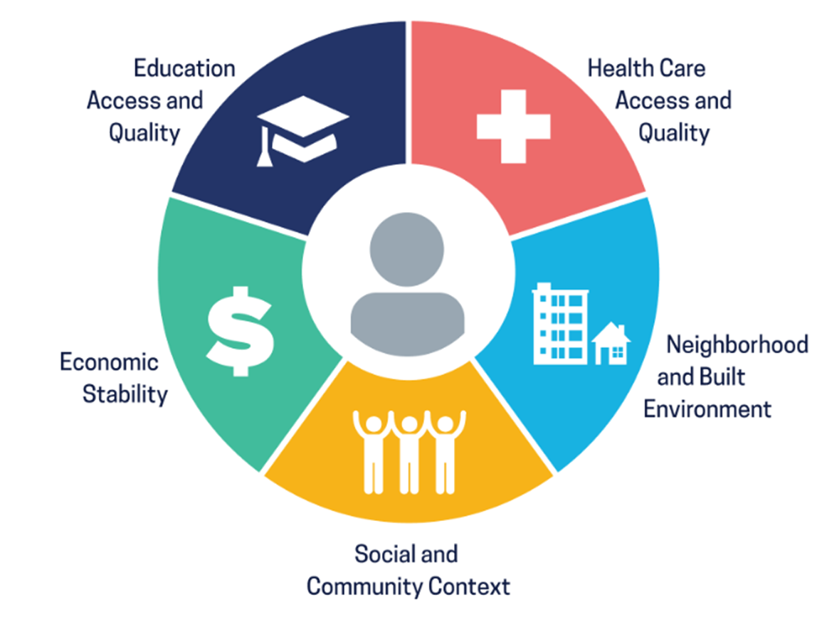
What are the Social Determinants of Health (SDOH)?
Notes:
The Social Determinants of Health (SDOH) are the conditions in the environments where people are born, live, learn, work, play, worship, and age that affect a wide range of health, functioning, and quality-of-life outcomes and risks. Understanding these issues on a population level can complement the work you do on an individual level. We encourage you to take time to develop an understanding of the environment in the catchment area you serve.

Slide 26
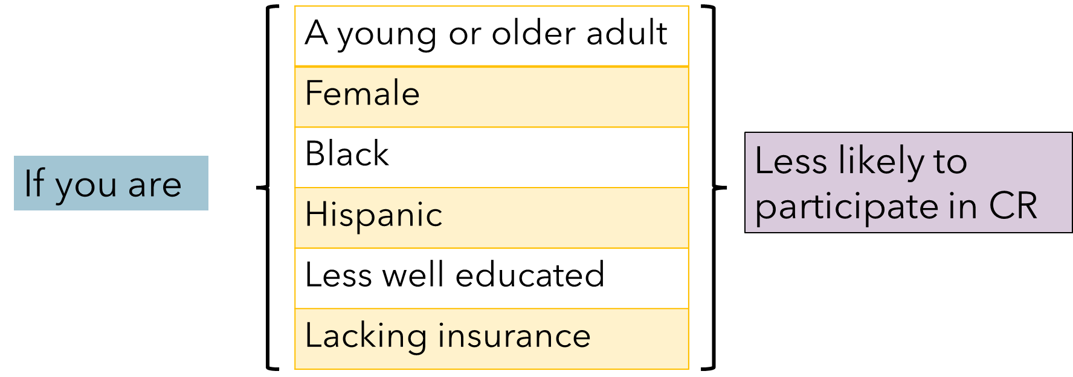
Disparities in Referral & Enrollment
Notes:
There are known disparities in CR participation. An effective CC system helps to reduce these disparities by addressing the specific needs and concerns that may be impeding patients’ enrollment and participation.

Slide 27
Common Barriers to CR
Individual Concerns
Cultural values/beliefs
Need to work
Child or eldercare responsibilities
Financial
Inability to afford co-pay
Limited insurance coverage
Education
Poor health literacy
Failure to believe they can do it
Don’t identify with brochure pictures
Behavioral Health
Pre-existing or new onset anxiety/ depression
Social isolation
Transportation
Distance
Costs
Notes:
There are numerous factors that can impact CR enrollment and participation. Sometimes our patients are forced to make difficult decisions about their own health and wellbeing, especially when the decisions involve choosing between their care and food or housing. Sometimes patients can be labeled as non-compliant without a full understanding of the challenges they face in their living, social, and/or working environments.. Here we have provided you examples to stimulate your thinking and while you are redesigning your CC system.
Talking to your patients is the best way to understand the challenges that are deterring them from enrolling in or completing CR.

Slide 28
Addressing Barriers: Expanded/Flexible Treatment Options
Adjust treatment plans
Offer hybrid versions of CR (virtual/in-person)
Connect with community resources and services
Offer flexible hours (after/before work and weekends)

Slide 29
Addressing Barriers: Finances
Confirm insurance coverage
Be explicit about cost from the start
Set up payment plans
Help patients with insurance issues: approvals, documentation
Set up philanthropic fund to partly underwrite CR costs for those without insurance or those with high copays
Create financial incentives
Adjust treatment plans
Leverage “indigent care” dollars where available
Notes:
Here are some suggestions for addressing financial needs and concerns. This list is by no means exhaustive. Some take more effort, like raising funds to defray costs takes time and resources. Others require changing the way care is delivered, which can also take time and resources. Financial incentives can be effective and may help patients over come challenges to participation. These might include gas or gift cards, parking passes, or co-pay waivers. Incentives should be delivered immediately after desired behavior (e.g., at the end of a completed exercise session) to have the greatest impact. Generally, the higher value the incentive the greater the effect.

Slide 30
Addressing Barriers : Education
Ensure educational brochures and materials appeal to a wide audience, showcasing a variety of ethnicities, languages, and ages
Enlist family and caregivers to reinforce the value of CR
Recruit CR ambassadors: CR graduates who provide peer-to-peer support and encouragement
Train staff in patient engagement techniques
Use plain language in conversations about the benefits of CR
Notes:
Education about CR and its benefits is crucial, yet educational materials for patients often miss the mark. Design materials to appeal to a wide audience, use plain language, and use the languages with which your patients are most comfortable. Use translators when needed and engage family members for verbal conversations about CR. Sometimes patients believe they can change exercise and eating habits without help and support. Explain the science that shows otherwise. Maybe a patient has read inaccurate or confusing information on the internet Help clear up the confusion by creating a list of reputable resources. Develop a patient ambassador program. Former CR graduates can be a low-cost solution and provide valuable peer-to-peer support.

Slide 31
Addressing Barriers: Behavioral Health Issues
Screen for anxiety, depression, and social isolation
Enlist the assistance of hospital behavioral health staff
Establish a patient ambassador program
Connect with community resources and community health workers
Notes:
We can’t stress enough how important it is to understand the patient and the impact of their new health condition on their lives. Depression and anxiety are common, and patients can experience feelings of isolation. It’s important to review medications for possible side-effects. In the spirit of patient-centered care, surrounding these patients with the knowledge and skills of an interprofessional team can lead to increased participation in CR with downstream improved outcomes.

Slide 32
Possible Solutions: Transportation
Hospital-sponsored bus passes
Family and caregivers
Hybrid versions of CR (virtual/in-person)
Flexible hours (before/after work, weekends)
Community resources and services
Parking passes/waivers
Notes:
Patient convenience is a major driver of CR participation. It is important to work as a team to develop strategies to overcome transportation obstacles for patients. This slide lists some possible solutions. Remember that transportation issues may arise because a patient does not own a car or live close to public transportation. Personal preferences might also play a role. Maybe the patient doesn’t want to be seen entering a medical transport van. Getting help from the patient’s family and friends can be a powerful motivator for attendance, especially if the individual makes it known they will do whatever it takes to support the patient’s participation in CR

Slide 33
To Learn More…
View Engaging and Empowering Patients and Families for Success in CR to hear directly from experts and peers about:
patient engagement and activation
how to use geographic and demographic data to understand and address your patients’ needs
using patient ambassadors

Slide 34
Chapter 5: Equipping Staff to Lead and Support Enhanced CC

Slide 35
Equipping Staff to Lead and Support CC
Orient all staff to new roles and responsibilities
Make expectations and performance criteria clear
Create written orientation guidelines
Ensure that all new staff review orientation guidelines
Make written materials easily accessible
Provide mentorship and opportunities for departing staff to train their replacements whenever possible
Notes:
The CC IG and RG include links to valuable training resources and educational materials.
The IG also provides guidance for helping staff adjust to new expectations and responsibilities by providing
Staff Orientation
Staff Training on
How to access patient information from the EMR
Understanding SDOH
Promoting Health Literacy
Other useful skills and knowledge
In some cases, it will be necessary to formalize changes in revised position descriptions.

Slide 36
CHAPTER 6: Using Data to Improve CC and Monitor Progress

Slide 37
Types of Information You Will Need
Information needed to confirm eligibility and to follow up with physicians.
Information needed to contact the patient or to place them in the CR program that they may be the most successful in.
Information that will help your staff develop a CR plan suitable for the patient and to anticipate and address their needs or concerns.
Information about patient participation to reinforce success or rapidly respond to emerging participation barriers.

Slide 38
Use a Tracking Sheet to Track the Status of Eligible Patients
Inpatient ID | SOURCE | DIAGNOSIS | SEEN? | INTERESTED IN CR? | DATE INTEREST ASSESSED | CHARGED/ RECEIVED HOSPITAL BILL? | DISCHARGE DATE | PROPER ORDER MADE? | FOLLOW UP CALL DATE
 | Meditech Referral | MI | Yes | No | 6/20/2016 | Yes |  | N/A
 | Meditech Referral | COPD; CHF | Yes | Yes | 6/20/2016 | Yes
 | Meditech Referral | CHF | No | N/A | 6/22/2016 |  |  | N/A
 | Meditech Referral | PCI/Stent | No | N/A | 6/20/2016 |  | 6/21/2016 | Yes | 6/22/2016
 | Meditech Referral | COPD | Yes | Yes | 6/22/2016 | Yes | 6/22/2016 | Yes
 | Meditech Referral | Symptomatic PVCs | No | N/A | 6/22/2016
 | Meditech Referral | Back Pain/Sciatica | No | N/A | 6/22/2016
 | Meditech Referral | Electrocution | No | N/A | 6/22/2016
 | Meditech Referral | Afib/Flutter cardioversion | No | N/A | 6/22/2016
 | Meditech Referral | Coughing spell & syncope |  |  | 6/22/2016
 | Meditech Referral | CP--ruled musculoskeletal | No | N/A | 6/22/2016
 | Meditech Referral | CP | No | N/A | 6/22/2016
 | Meditech Referral | CAD--PCI at MUSC | No | N/A | 6/22/2016
 | Nursing Census | SOB | Yes | Yes | 6/22/2016 | Yes |  | No
 | Nursing Census | CHF | Yes | yes | 6/22/2016 | Yes |  | Yes
 | Meditech Referral | SOB-Anaphylaxis | No |  | 6/22/2016
 | Nursing Census | Respiratory Infection |  |  | 6/22/2016
 | Nursing Census | COPD ex | Yes | Yes | 6/22/2016 | Yes |  | Yes
 | Nursing Census | Sarcadoisis | Yes | Yes | 6/22/2016 | Yes |  | No
 | Meditech Referral | MI | No |  | 6/10/2016 | No | 6/12/2016 | Yes
 | Meditech Referral | MI | No |  | 6/10/2016 |  | 6/12/2016 | Yes
Notes:
This is a sample of an inpatient tracking form that is included in the CRCP.

Slide 39
Data for Measuring Progress
Performance Measures
CR Patient Referral From an Inpatient Setting
Exercise Training Referral for HF From Inpatient Setting
CR Patient Referral From an Outpatient Setting
Exercise Training Referral for HF From Outpatient Setting
CR Enrollment–Claims Based
CR Enrollment–Registry/Electronic Health Records Based
Quality Measures
CR Time to Enrollment
CR Adherence (≥36 sessions)
CR Communication: Patient Enrollment, Adherence, and Clinical Outcomes
Notes:
These are the performance and quality measures listed in the 2018 report of the ACC/AHA (2018 ACC/AHA Clinical Performance and Quality Measures for Cardiac Rehabilitation: A Report of the American College of Cardiology/American Heart Association Task Force on Performance Measures ), that all CR programs are being encouraged to use. In this report, each measure is described in detail with inclusion and exclusion criteria and other specifications.
Citation: Randal J. Thomas, Gary Balady, et. al., 2018 ACC/AHA Clinical Performance and Quality Measures for Cardiac Rehabilitation: A Report of the American College of Cardiology/American Heart Association Task Force on Performance Measures; J Am Coll Cardiol. 2018 Apr, 71 (16) 1814–1837

Slide 40
Data is NOT a Substitute for Human Feedback
KEYS
Listen to staff & patients
Be open to their ideas for improvement
Solicit feedback on what and how well things are working
Discuss struggles and failures with a focus on learning and improving
MEASURE
PARTICIPANTS
Notes:
An important step in any QI project is taking time to evaluate the changes. Talk to the staff. Talk to patients. Both are key sources of information. Provide open forums to share the things that are working, as well as the things that are not. Stress the theme of learning together.

