Slide 1



Getting Started
Laying the Groundwork for Implementing Automatic Referral & Effective Care Coordination
Notes:
This presentation is designed to help you understand the steps required for laying the necessary foundation for a quality improvement (QI) initiative aimed at implementing automatic referral and enhancing care coordination to increase participation of eligible patients in cardiac rehabilitation (CR).
IMPORTANT NOTE RE: ACCESSING LINKS in the PPT presentation:
Links embedded in SLIDE portion are hyperlinks
Links shown in the NOTES portion must be copied into a browser to be accessed

Slide 2
Acronym List
AACVPR – American Association of Cardiovascular and Pulmonary Rehabilitation
AR – Automatic Referral
CABG - Coronary Artery Bypass Graft
CC – Care Coordination
CR – Cardiac Rehabilitation
CRCP – Cardiac Rehabilitation Change Package
EMR – Electronic Medical Record
IG – Implementation Guide
PCI- Percutaneous Coronary Intervention
PPT – PowerPoint presentation
QI – Quality Improvement
2
Notes:
Here is a list of commonly used acronyms.

Slide 3
Overview of TAKEheart Materials for GETTING STARTED
Consolidated Curriculum for Getting Started
  PPT Slides
  Implementation Guide
  Resource Guide
Original Training Modules
  #1: Welcome to TAKEheart and the Benefits of Improving CR
  #2: Laying the Foundation, Leadership, and Action Plans
  #3: Understanding Your Workflow Processes to Prepare for System Change
  #4: Preparing & Understanding Data to Foster Systems Change
Other Related Webinars
  Maximizing Physician Support for Cardiac Rehab
  Leveraging Data To Enhance Your CR Program
  Please read the notes below for further description of these materials
(
Notes:
There are three components to the Consolidated Curriculum for Getting Started
1. This slide deck:
The slides are focused on broadly describing the recommended activities (“WHAT”) and explaining “WHY” they are being recommended.
The information is presented in a PPT format so that it can easily shared with other staff whose support or involvement may be needed during implementation.
Notes are included for some of the slides -- where the slide is not self-explanatory, or to include additional content
2. This PPT presentation is meant to be used alongside the Getting Started Implementation Guide (IG).
The IG provides actionable, step-by-step guidance about HOW to implement the actions recommended in the slides.
If you are just beginning to plan your QI initiative, you may want to start by reviewing the slide deck alone.
Once you are ready to launch and implement, you may find it helpful to use these two sets of materials side by side, one section (‘step”) at a time.
Chapter (‘step”) titles in slides align with titles in the IG
3. RESOURCE GUIDE: Those wishing to dig even more deeply are encouraged to review the companion Getting Started Resource Guide,
This Guide includes additional information and guidance -- in the form of tools, templates. articles, case studies, videos, slide decks, and more -- for anyone wishing to dig even more deeply into the core topics covered in this presentation.
ORIGINAL TRAINING MODULES: The original training modules are one hour-long training sessions originally presented live to a group of hospitals working in real time in 2020-2021. The consolidated curriculum for Getting Started is a streamlined, restructured synthesis of the information presented during these original trainings. (Links to these sessions and brief descriptions of their contents - are also included in the “ To Learn More” slides in this slide deck for those wishing to drill down further on the topics presented here.)
The TAKEheart WEBINARS are one-hours sessions held between 2020–2022, featuring discussions among CR experts and CR champions from diverse hospitals.

Slide 4
Table of Contents
Project Overview
Step 1: Making the Case
Step 2: Forming a QI Team
Step 3: Project Aim and Action Plan
Step 4: Mapping Workflow Processes
Step 5: Understanding Data
Step 6: Monitoring Improvement
Appendix: Workflow Process Mapping Exercise Slides
4
Notes:
The titles above are hyperlinks, to enable you to skip ahead to any section (step) in the presentation. You can also return to the table of contents using the hyperlink embedded in title slide for each section.
The titles of the sections (Steps) of this PPT presentation match the titles used in the Implementation Guide.

Slide 5
Project Overview
Notes:
The next few slides outline the quality improvement (QI) project for implementing AR with effective CC for CR.

Slide 6
What is TAKEheart?
TAKEheart is an AHRQ initiative to assist hospitals and health systems in implementing evidence-based strategies for increasing patient participation in CR
TAKEheart trainings are based two key change concepts outlined in Million Hearts®/AACVPR Cardiac Rehabilitation Change Package (CRCP), a quality improvement action guide designed to achieve optimal CR participation:
Automatic referral (AR) to ensure that all patients eligible for CR are referred, regardless of provider
Enhanced care coordination (CC) to educate patients and facilitate the enrollment process
6
Notes:
TAKEheart is an initiative funded by the Agency for Healthcare Research and Quality (AHRQ) in collaboration with Million Hearts® to help CR programs implement the evidence-based strategies, AR and effective CC, outlined in the Cardiac Rehabilitation Change Package (CRCP). The goal of the initiative was to help participating hospitals increase CR utilization, especially by underrepresented groups.

Slide 7
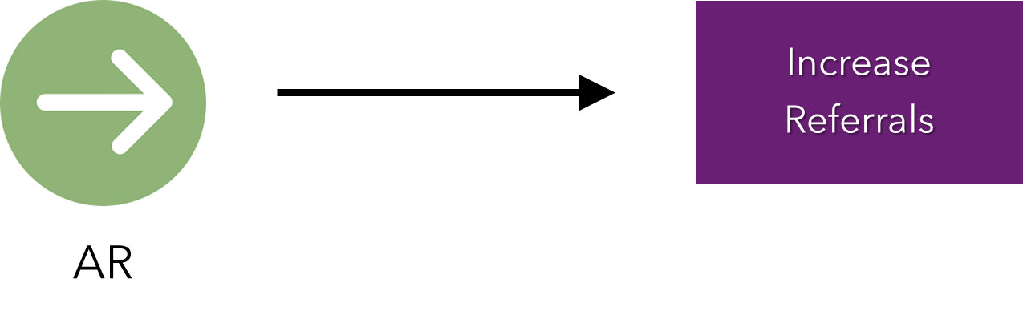
Automating Referrals to CR
Automatic referral (AR) : EMR-based referral built into an order set as the default (opt-out model) in which ALL patients with qualifying diagnoses or procedures are referred
7
Notes:
AR provides an opportunity to close the gap between the number of eligible patients and the number who enroll in and complete CR. AR means: An electronic medical record-based referral, in which an order for CR is generated for patients with designated diagnoses for which outpatient CR is recommended. This order would be generated as a default action in the record for that patient; providers would need to actively “opt-out” to not have the referral move forward. This referral, with appropriate communication to patients and follow-up by clinical professionals, is designed to result in efficient systematic referral to outpatient CR during the hospital discharge process.

Slide 8
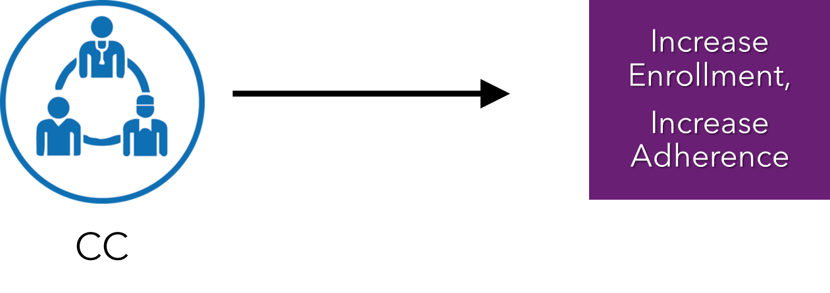
Enhancing Care Coordination for CR
Effective Care Coordination (CC) for CR involves
Introducing or improving processes for systematically ensuring that ALL eligible patients get referred, enroll, and participate fully in CR.
Identifying and addressing the specific barriers that are preventing your patients from participating in highly beneficial services.
8
Notes:
Effective CC support means: a system of processes staffed by individuals who facilitate the patient care journey from referral to enrollment through participation in CR. There are a wide variety of staffing models, including use of navigator support and patient ambassadors. Generally, CC involves workflow processes to improve patient awareness and knowledge about the benefits of cardiac rehabilitation. Effective CC also includes processes to address patient needs and concerns which inhibit their participation in cardiac rehabilitation, including creating or strengthening linkages to outpatient care and community resources.

Slide 9
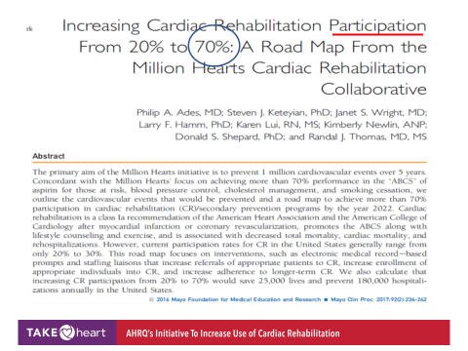
The Purpose of TAKEheart
The purpose of TAKEheart is to close the gap between CR evidence and practice.
"Increasing CR participation from 20% to 70% could save 25,000 lives
and prevent 180,000 hospitalizations annually in the
United States."
9
Notes:
The purpose of TAKEheart is to close the gap between CR evidence and practice.
The peer-reviewed publication cited below demonstrated the importance of pushing for increased referral rates. This evidence laid the foundation for Million Hearts’ work in CR and for the intervention—AR with CC support.
Citations:
Ades PA, Keteyian SJ, Wright JS, et al. Increasing cardiac rehabilitation participation from 20% to 70%: a road map from the Million Hearts Cardiac Rehabilitation Collaborative. Mayo Clin Proc. 2017;92(2):234–42.

Slide 10
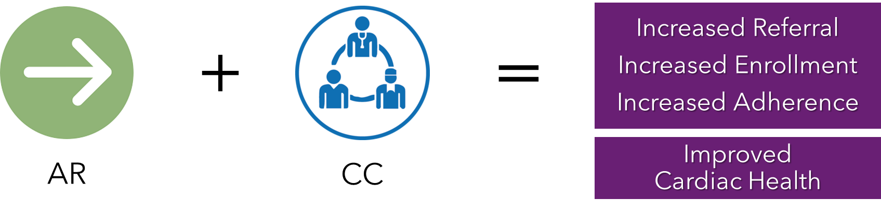
2011 Study: Benefits of CC
Treatment | % Eligible Patients Referred to CR
Control | 32%
AR alone | 70%
AR & effective CC | 86%
Notes:
A 2011 study demonstrated that implementing AR and effective CC are quality improvement steps that hospitals can take to increase CR participation in their health systems and communities.
Citation:
Grace, S.L. et al. Effect of cardiac rehabilitation referral strategies on utilization rates: a prospective, controlled study. Arch Intern Med. 2011 Feb 14;171(3):235-41. doi: 10.1001/archinternmed.2010.501.

Slide 11
Quality Improvement Project Overview
Making the Case/Gaining Leadership support
Form a team with compelling aim
Conduct initial planning
Identify gaps & areas for change
Implement changes/ Redesign workflow processes
Map current workflow processes
Orient staff
Monitor results & refine
Extend & spread
11
Notes:
Implementing AR and enhancing CC will require redesign of existing processes. You can expect to work through all of these steps whether you are planning a QI initiative aimed only at automating referrals or enhancing care coordination -- or at both simultaneously.
This training curriculum discusses the first five steps shown above, as well as how to use data to track your progress.
The remaining four steps are covered in the TAKEheart Implementing AR and Enhancing CC training curricula

Slide 12
REMINDER: Process Redesign Takes Time!
While there is wide variation in the length of time needed to complete the activities described here, most hospitals should expect to invest at least 1-3 months in laying the foundation for their CR QI initiative.

Slide 13
Step 1: Making the Case
Notes:
The first step in any QI project is making the case to leadership to achieve buy-in and support for the improvement effort.
The next few slides discuss the evidence behind boosting CR utilization using AR and effective CC. You can use this information in making the case to your leadership.

Slide 14
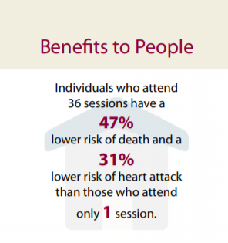
Making the Case for CR
CR reduces mortality. CR participation is associated with a 13-24% reduction in total mortality over 1-3 years.
CR reduces re-hospitalization, up to 30%
CR is clinically effective for people who have or have had:
  A heart attack
  A percutaneous coronary intervention (PCI)
  CABG surgery, heart valve replacement or repair, or a heart or heart-lung transplant
  Chronic stable angina
  Chronic stable heart failure
14
Notes:
This slide reviews evidence about the benefits of CR and can be used to MAKE THE CASE to the team, patients, and leadership to increase CR participation.
Citations from this slide:
Hammill BG et al. Relationship between cardiac rehabilitation and long-term risks of death and myocardial infarction among elderly Medicare beneficiaries. Circulation. 2010 Jan 5;121(1):63-70
Centers for Disease Control and Prevention: Million Hearts. Cardiac Rehabilitation: Saving Lives, Restoring Health, Preventing Disease” 2018. Available at: https://millionhearts.hhs.gov/files/Cardiac_Rehab_Infographic-508.pdf.
American Association of Cardiovascular and Pulmonary Rehabilitation. “Vital Conversations with Medical Teams & Hospital Administrators About Cardiac Rehabilitation Services Delivering Value Based Care: Lower Cost, Higher Quality, Great Value!”

Slide 15

Making the Case for CR (continued)
CR is a low-cost intervention compared to inpatient treatments for acute cardiac conditions, and provides a high return on investment given the impact of its benefits
Referring patients to CR is a class 1a recommendation (AHA/ACC) for MI & CABG
15
Notes:
Overwhelming evidence has led to numerous national guidelines and specialty societies supporting the use of CR.
Citations from this slide:
Centers for Disease Control and Prevention. Million Hearts: Costs & Consequences. Available at: https://millionhearts.hhs.gov/learn-prevent/cost-consequences.html.
Balady, G.J. et al. AHA/AACVPR Scientific Statement: Core Components of Cardiac Rehabilitation/ Secondary Prevention Programs: 2007 Update. Journal of Cardiopulmonary Rehabilitation and Prevention. 2007;27:121/129
Ritchey et al. Cardiac Rehabilitation Use Among Eligible Medicare Fee-For-Service Beneficiaries, 2016-2017. Journal of the American College of Cardiology. 2019. Volume 73, Issue 9.
Additional references:
Chui, P.W. et al. Hospital Performance on Percutaneous Coronary Intervention Process and Outcomes Measures. J Am Heart Assoc. 2017; 6:e004276. DOI: 10.1161/JAHA.116.004276.
Spertus et al. Cardiac Performance Measure Compliance in Outpatients. Journal of the American College or Cardiology. 2010; Vol. 56, No. 1, 2010
Beatty, A. L et al. Geographic Variation in Cardiac Rehabilitation Participation in Medicare and Veterans Affairs Populations Opportunity for Improvement. J Am Heart Assoc. 2018;137:1899–1908. DOI: 10.1161/CIRCULATIONAHA.117.029471
Citations from this slide:
Hammil, B.G. et al. Relationship between cardiac rehabilitation and long-term risks of death and myocardial infarction among elderly Medicare beneficiaries. Circulation 2010 Jan 5;121(1):63-70
Grace, S. L., et al. Cardiac rehabilitation delivery model for low-resource settings. Heart. 2016. https://doi.org/10.1136/heartjnl-2015-309209

Slide 16
CR Services are Underutilized!
Despite proven benefits
  25% of hospitals refer fewer than 20% of eligible patients to CR.*
  ONLY 29% of Medicare beneficiaries eligible for CR participated in at least one session**
16
Notes:
Despite the overwhelming evidence of the benefits of CR , there is a large gap between recommended enrollment and actual participation rates in CR. According to a 2019 study, ONLY 24.4% of patients eligible for CR participated, of whom 24.3% participated in CR within 21 days and 26.9% completed 36 or more sessions.
*Aragam KG, Dai D, Neely ML, et al. Gaps in referral to cardiac rehabilitation of patients undergoing percutaneous coronary intervention in the United States. J Am Coll Cardiol. 2015;65(19):2079-2088. doi:10.1016/j.jacc.2015. 02.063
**Keteyian SJ, Jackson SL, Chang A, et al. Tracking Cardiac Rehabilitation Utilization in Medicare Beneficiaires: 2017 Update. J Cardiopulm Rehabil Prev. 2022;42(4):235-245.

Slide 17
Possible Causes of Underuse of CR
Patients
Providers
Hospitals
  May need help with enrollment
  Are not aware of the importance and benefits of CR
  Lack time, motivation, support, financial resources (for co-payments), transportation
  Fail to promptly and consistently identify and refer patients who are eligible for CR
  Focus on inpatient care
  Do not understand the importance, benefits, and operations of CR
  Leadership not familiar with the evidence on benefits of CR and/or unaware of low participation rates
  Have difficulty identifying eligible patients or coordinating and/or sustaining outpatient CR
  Lack of value-based payment models
17
Notes:
Not everyone is aware of the problem of underuse of CR services by eligible patients.
Underuse occurs when:
Eligible patients don’t make it to CR because they are not referred or there is lack of coordination even if they are referred.
Patients don’t understand what CR is or the benefits, or . experience barriers due to lack of time, support, finances and transportation.
Providers fail to promptly and consistently identify eligible patients, they focus on inpatient care, and don’t understand the importance of CR.
Institutional barriers include lack of coordination between the inpatient and outpatient environments, not seeing CR as a priority, and lack of value-based payment models.

Slide 18
Closing the Gap with AR and CC
A 2011 study examined the impact of implementing
Automatic referral (AR)
+
Enhanced care coordination (CC)
on CR utilization
18
Notes:
Citation: Grace, S.L. et al. Effect of cardiac rehabilitation referral strategies on utilization rates: a prospective, controlled study. Arch Intern Med. 2011 Feb 14;171(3):235-41. doi: 10.1001/archinternmed.2010.501.

Slide 19
2011 Study Results
Treatment | % Eligible Patients Referred to CR
Control | 32%
AR alone | 70%
AR & effective CC | 86%
19
Notes:
As noted earlier, the 2011 study demonstrated that implementing AR and effective CC increases CR participation in their health systems and communities.
Citation:
Grace, S.L. et al. Effect of cardiac rehabilitation referral strategies on utilization rates: a prospective, controlled study. Arch Intern Med. 2011 Feb 14;171(3):235-41. doi: 10.1001/archinternmed.2010.501.

Slide 20
Additional Information on Making the Case
Getting Started Implementation Guide, Step 1, offers:
  Guidance on how to make the case to leadership and peers
  Information on how to prepare an elevator speech
  Tailored messages about the benefits of CR for different audiences
Getting Started Resource Guide includes
  A ready-to-share infographic summarizing the evidence for AR and CC
View the Recording of Welcome to the TAKEheart Initiative and the Benefits of Improving Cardiac Rehabilitation
View the Recording of Maximizing Physician Support for Cardiac Rehab
Notes:
Original Training Module1 -- Welcome to the TAKEheart Initiative and the Benefits of Improving Cardiac Rehabilitation-- provides a more in-depth discussion of how hospitals and health systems can make the case to their teams and leadership that implementing CR is worthwhile from patient, provider, and hospital perspective. This module reviews the strong evidence base for the benefits of this approach to increasing CR, the reasons for current low CR participation and associated low referral rates, and highlights the opportunity and benefits to hospitals/health systems, patients, and payers to closing the gap between evidence and practice in CR.
View the webinar title Maximizing Physician Support for Cardiac Rehab for insights about how to reinforce the value of CR and work collaboratively with physicians to raise referral and retention rates. Successes and challenges in expanding efforts to maximize physician support for CR are also discussed.

Slide 21
Step 2: Forming a QI Team

Slide 22
A Multidisciplinary Implementation Team
Ensures access to the diverse expertise, input, and feedback needed to achieve complex process redesign
Secures buy-in, shared commitment to, and support for, success
Assures ability to draw on established relationships when obstacles occur
22
Notes:
A well-functioning, multidisciplinary team is the necessary foundation for any kind of system change.
A team will help
Maximize the unique perspectives and contributions of all those who shape or impact CR referrals and enrollment and as well as those who deliver or receive CR services
Secure buy-in from people whose support you will need and help them “own” the process and commit to its success.
Have established relationships on which to draw for advice when obstacles occur

Slide 23
Build A Team
A Champion (Team Lead) to advocate for and manage the quality improvement initiative.
Individuals representing all parts of the CR referral and enrollment processes or who deliver or receive CR services
  IT Representatives
  Physicians
  Hospital QI Staff and Managers
  Patients (including CR graduates)
  Relevant CR Staff
TIPS and Reminders
  The team can start small and grow over time.
  Routinely meeting as a team may not always be possible -- but continued engagement of all key stakeholders is essential to success!
23
Notes:
Think broadly about staff members who represent all aspects of the cardiac rehabilitation referral, enrollment and participation process. People involved in different parts of the CR process bring different perspectives to the table. The suggestions listed on the slide are meant to stimulate your thinking.
IT representatives have the expertise needed to set up an automatic or “opt-out” electronic referral of all eligible patients to CR.
Physicians: internal medicine, cardiology, surgeons, and interventionalists, physician assistants, nurses and other allied health professionals can advocate for AR with peers and other clinicians.
Hospital QI staff and managers can bring expertise in leading organizational change.
Patients (including CR graduates), as end users, can bring valuable insights about the process. If the hospital has patient family advisory committee, consider asking them to participate.
Other CR staff (if applicable)
Members will depend on the focus of the project: AR, CC or both. For a focus on CC, remember to plan for coordination across inpatient and outpatient programs. Consider the workflow processes that bridge between inpatient and outpatient services.
Think about including someone who has tried to implement another change process in the hospital, this can provide a “fresh” perspective.

Slide 24

Role of CR Champion
Serves as Team Leader
Engages and collaborates with hospital leadership to obtain support for AR with effective CC
Balances the needs of staff, patients, and management
Manages conflicting interests and scarce resources
Helps to build a culture to support change
Assists team in developing its aim statement and action plan
24
Notes:
The champion is a leader and critical to the success of the project. The champion plays many roles.
disseminates the message about the value of both cardiac rehab and AR with effective CC for increasing cardiac rehabilitation
motivates and provides momentum and advocates for the needs of the team.
helps to build a culture to support the changes being implemented
is often called upon to manage conflicting interests between management and staff..
takes the lead in developing or seeking solutions to challenges as they arise
For these reasons, the champion must have proven leadership skills, credibility in the hospital and with peers, and expert problem-solving skills
Sometimes these responsibilities are shared between two people: a champion and a separate, formal team leader For instance, the champion might be a cardiologist capable of working with his/her peers and explaining the importance of the effort to top management but not available to make sure the whole change process moves forward.
Here is a helpful resource on clinical champions: https://www.health.nsw.gov.au/wohp/Documents/mc3-clinical-champions-mcneil.pdf

Slide 25
Team Member Expectations
Collaborate
to reach consensus on project goals
Work together to create an action plan
Expectations for Team Members
Willing and
actively
engaged
-Accept tasks
-Fulfill tasks
Join forces to create buy-in for the improvement efforts
25
Notes:
The members of the team have roles and responsibilities, too. This slide summarizes the expectations for each person who joins the team. They need work together to create an action plan and be willing and engaged to take on and complete tasks. They need to be able to collaborate to reach consensus on the goal and then join forces to create buy-in from staff.

Slide 26
Learn more about: Forming a Team and Selecting A Champion…
The Getting Started Implementation Guide, Step 2, provides additional practical guidance about HOW to:
  create a team
  choose a project champion
View Recording of Original Training Module 2: Laying the Foundation, Leadership, and Action Plans
26
Notes:
Topics covered in Original Training Module 2 include how to:
Identify a CR champion who takes responsibility for leading the project.
Form a multidisciplinary CR quality improvement (QI) team, including the ideal composition of the team and why each team member is important.
Develop an action plan for CR program implementation. (Developing an action plan is covered here, beginning on next slide.)

Slide 27
Step 3: Project Aim and Action Plan
Notes:
The third step is for the team to develop an aim statement for the project and start to create an action plan for making improvements/changes.

Slide 28

Develop an Aim Statement
An Aim Statement is your team's declaration of the desired outcome of your improvement project.
  Your Aim Statement can
  act as a beacon to guide and focus your team’s efforts
28
Notes:
The aim statement is a unifying statement, written by the team. This is the team’s shared vision for the future and for what the team hopes to achieve. It can serve as a beacon or a compass to guide the efforts of the team. The statement should be a clear and specific declaration of what the team expects to accomplish with the project.

Slide 29
Writing Your Aim Statement (1)
  The aim statement answers the following questions:
  Q: What do you hope to accomplish?
  A: Increase cardiac rehabilitation referrals, enrollment, and participation
  Q: For whom?
  A: Patients with eligible diagnoses*
  Q: Why is it important?
  A: Improves health, saves lives, and reduces hospital readmissions
  Q: What change will you implement to achieve your aim?
  A: AR with effective CC
  Q: How will you measure progress or impact of change?
  A: Assess CR referral rate and/or measure CR enrollment, participation, and adherence.
29
Notes:
The aim statement answers many important questions that drive the future of the project. The answers to these questions will differ based on the focus of the project. The questions in this slide are provided as examples.
The aim statement must also address how the improvement effort will be measured and the goal/impact of the project.
*NOTE: See https://millionhearts.hhs.gov/about-million-hearts/optimizing-care/cardiac-rehabilitation.html for the full list of qualifying diagnoses for CR

Slide 30
Writing Your Aim Statement (2)
  Your aim statement should reflect your organization’s priorities and available resources
  For example, hospitals seeking to increase patient participation in CR will need to decide whether they have the desire, need, support, and resources to tackle both AR and CC simultaneously, or to begin with just one
30
Notes:
The aim statement answers many important questions that drive the future of the project. The answers to these questions will differ based on the focus of the project. The questions in this slide are provided as examples.
The aim statement must also address how the improvement effort will be measured and the goal/impact of the project.

Slide 31
Aim Statement: Include S.M.A.R.T. Goals
Specific: Description of a specific outcome or process
Measurable: How will it be measured, e.g., rate, frequency?
Achievable: Plan to stretch but make sure it is achievable
Relevant: Need to link directly to the Aim statement
Time bound: Need clear start and finish dates
31
Notes:
SMART is a popular acronym and structure to consider when designing and creating goals for your project. The goal for the aim statement needs to reflect the team’s shared vision for the project. As mentioned earlier, every member of the team needs to be involved in developing the project goal so there can be buy-in. Goals can not be dictated; they need to be developed by the team and consensus reached so every member can get behind them.

Slide 32
Examples of S.M.A.R.T. Goals
The percentage of eligible patients referred to cardiac rehabilitation will increase by 10% from Q1 to Q3.
The percentage of referred patients who enroll in a CR program will increase by 5% from Q1 to Q2.
The percentage of enrolled patients who complete a CR program will increase by 15% from Q2 to Q4.
32
Notes:
This slide lists a few examples of S.M.A.R.T. goals that would be appropriate for an Aim Statement for an AR/CC Implementation Team.

Slide 33

Example of an Aim Statement
We aim to increase the number of patients with MI, PCI and CABG who participate in CR by 30%. This is important because we want to improve patient care and outcomes and reduce hospital readmissions. We will accomplish this aim by implementing AR with effective CC by March 31,2022. We intend to see a 30% increase in current participation rates by December 31, 2022.
33
Notes:
Pulling the answers to the questions together forms the aim statement. This slide shows an example of an aim statement. The statement provides clear direction for the project and can be used to spread the message about the importance of the project. Note that the date to implement the change is March 2022 and the date by which participation rates are expected to reach their goal is nine months later. The measure of progress is participation rates.

Slide 34

Develop an Action Plan
The Action Plan operationalizes the project.
The Action Plan is comprised of the tasks needed to achieve the goals articulated in your Aim Statement
The Action Plan identifies the people assigned to complete each task Remember to consider resource needs and priorities.
34
Notes:
The action plan operationalizes the project. In developing the action plan, the team must work together to convert identify the specific tasks that will be necessary to accomplish their specified aims.

Slide 35
Action Plan Template
Hospital Name:
Team Members, Role:
Aim Statement:
Example: We aim to increase the number of patients with MI, PCI and CABG who participate in cardiac rehabilitation by 30%. This is important because we want to improve patient care and outcomes and reduce hospital readmissions. We will accomplish this aim by implementing automatic referral with care coordination by March 31, 2022. We intend to see a 30% increase in current participation rates by December 31, 2022.
Task | Task Lead | S.M.A.R.T. Goal (Specific, Measurable, Achievable, Relevant, Timebound) | Status | Finish Date | Comments (challenges / facilitators)
Develop specifications for the automatic referral in the EHR system. | Luna Patel | Beginning 6/4/2021, the CR QI team will meet with IT representatives each Tuesday and Thursday at noon for a half hour to define the changes necessary for automatic referral and will complete the task by 7/28/2021. | Completed | 8/13/2021 | Took longer because IT staff had limited ability to attend meetings
Choose a task or enter your own. | Enter name. | Click here to enter a goal. | Choose or add one. | Click to enter a date. | Click to enter comments.
Choose a task or enter your own. | Enter name. | Click here to enter a goal. | Choose or add one. | Click to enter a date. | Click to enter comments.
35
Notes:
Here is a picture of the action plan template available in the Tools and Resource Guide https://www.ahrq.gov/sites/default/files/wysiwyg/takeheart/training/getting-started-resource-guide.pdf
This template was developed with input from national CR experts who have successfully implemented AR with CC in their own hospitals. The tasks listed in the template were tasks they identified as critical. As shown in this template, you will need to assign a task lead for each task and a timeline for completion.
Step 3 of the Implementation Guide https://www.ahrq.gov/sites/default/files/wysiwyg/takeheart/training/getting-started-implementation-guide.pdf
provides additional information about how to use this template to develop your own Action Plan.

Slide 36
Action Plans Evolve Over Time
Completed tasks will be removed.
New tasks will be added as you learn more and move across the phases of planning, testing, implementing, and fine-tuning.
All tasks should align with and support the aim statement.
36
Notes:
Your action plan will evolve over the life of your project. Throughout the life of the project, some tasks will be accomplished while others will be added as you learn about the specific steps you will need to take to design and implement AR or enhance CC. Remember that any tasks added to the action plan should always align with the aim statement.

Slide 37
Tasks Need S.M.A.R.T. Goals Too
EXAMPLE
Beginning 6/4/2021, the CR QI team will meet with IT representatives each Tuesday and Thursday at noon for a half hour to define the changes necessary for AR and will complete the task by 7/28/2021.
37
Notes:
Don’t forget that tasks need S.M.A.R.T. goals too. Here is an example of incorporating a S.M.A.R.T. goal for a task. This level of specificity will help the team truly get the work done. Some tasks may be carried out by the entire team, or committees while others will be individual tasks.

Slide 38
Learn More About: The Aim Statement and Action Plan
The Getting Started Implementation Guide Step 3,
provides additional information about HOW to:
  Create an aim statement
  Develop an action plan
The Getting Started Implementation Guide, Appendix, includes the Action Plan Template
38

Slide 39
Step 4: Mapping Workflow Processes
Notes:
In step 4, the team reaches consensus on the current state of workflow processes and begins to identify necessary changes.

Slide 40

CR Workflow Process Mapping
Workflow process mapping:
Is a tool used to understand and visualize the steps involved in CR referral, enrollment, participation, and completion.
Provides a picture of the patient journey from the time of referral to completion.
Demonstrates gaps and opportunities for improvement.
Shows what data is collected and how and where it is stored.
40
Notes:
It is important to understand current workflow processes in order to understand what steps are needed to implement AR with effective CC. Workflow process mapping is a tool that helps uncover needed changes by providing a picture of the patient journey. Mapping also allows the team to identify strengths and successful strategies. Identifying successes both recognizes the efforts of those involved and highlights models that can be crossed-over or applied to other areas.

Slide 41

Purpose of Workflow Process Mapping
CR Workflow Process Maps:
Reveal how your current patient referral and CC processes work.
Identify the problems and process failures your team will need to solve.
41
Notes:
The purpose of process mapping is to reveal how things really work. It can help the team understand how current patient referral and CC processes work. This step helps the team members slow down and take time to thoroughly understand what is and is not working so that they are aware of the problems the changes need to solve.
THE APPENDIX at the end of this slide deck is a set of slides providing illustrated guidance on how to conduct the workflow mapping exercise. You may find these slides helpful in preparing the team members for this phase of the project.

Slide 42
Paths to CR: Where Should You Focus
Inpatient CR
Procedures
Outpatient CR
Outpatient / Ambulatory Care
Physician practices & Patient self referrals
42
Notes:
Patients take many paths to reach outpatient cardiac rehabilitation. While mapping all the roads patients take to CR is a relevant exercise, TAKEheart materials are focused on implementing an automatic referral with effective care coordination system from the inpatient/procedural environment to outpatient CR.

Slide 43
Workflow Processes to Map
Designation of Eligible Patients
How Referrals Currently Happen
How Data is Collected
How CC Currently Works
43
Notes:
There are four processes that should be the focus of improvement efforts aimed at increasing referrals to and enrollment in CR for eligible patients. In order to improve, you need to start by knowing how these following processes currently work:
The process for determining eligibility for CR
The process for referring eligible patients to CR
Current processes for collecting data
Current CC processes for helping patients enroll in CR services

Slide 44



Capturing Key Insights From Workflow Process Maps
Use process maps to identify process gaps and failures that you’ll need to address as you design and implement AR with effective CC.
Capture staff insights about what is working and what is not.
Use Fishbone diagrams to group failures into categories that your redesigned processes will address
(See next slide for an example)
44
Notes:
As you study the workflow process map, identify process gaps and failures you will need to address as you design and implement automatic referral with effective CC. Don’t forget to acknowledge processes that are working well. Discuss the workflow process maps during staff meetings to capture staff insights. Then use a fishbone diagram to categorize process failures that need to be addressed. See the final slide in the APPENDIX for a more complete description and example of a fishbone diagram.

Slide 45


Sample Fishbone Diagram
Eligibility not identified
Referral process failures
Confusion over eligibility criteria
Confusion over who is responsible for referral
Exclusive reliance on admission codes
CR program unaware of referral so no follow-up
Failure to refer all patients eligible for CR
Ownership of eligibility determinations unclear
Delayed follow-up due to CR program wait list
Belief that CR is not beneficial
Belief that CR is not beneficial
Perception that patient won’t enroll anyway
Concerns about cost and time required
Lost track of paperwork
Depression or belief they cannot succeed
Cardiologist failure to refer
Patient objection to referral
See the following slide for an accessible version of “Sample Fishbone Diagram”
45
Notes:
This example fishbone diagram captures common causes eligible patients fail to be referred to CR. The Implementation Guide contains a more complete discussion of how to use this tool. Fishbone diagrams are a useful way to identify major causes of process failures as well as specific failures that fall into these general categories.
Be sure to include the team and patients in this process to ensure that you fully understand underlying causes of process failures and can address them as you redesign your processes.

Slide 46
Accessible Sample Fishbone Diagram
Failure to refer all patients eligible for CR
Eligibility not identified
Confusion over eligibility criteria
Exclusive reliance on admission codes
Ownership of eligibility determinations unclear
Referral process failures
Confusion over who is responsible for referral
CR program unaware of referral so no follow-up
Delayed follow-up due to CR program wait list
Cardiologist failure to refer
Belief that CR is not beneficial
Perception that patient won’t enroll anyway
Lost track of paperwork
Patient objection to referral
Belief that CR is not beneficial
Concerns about cost and time required
Depression or belief they cannot succeed
46
Notes:
This example fishbone diagram captures common causes eligible patients fail to be referred to CR. The Implementation Guide contains a more complete discussion of how to use this tool. Fishbone diagrams are a useful way to identify major causes of process failures as well as specific failures that fall into these general categories.
Be sure to include the team and patients in this process to ensure that you fully understand underlying causes of process failures and can address them as you redesign your processes.

Slide 47


Redesigning Workflow Processes
Collaborate and involve key stakeholders, including front line workers, to redesign workflow processes.
Begin to think about ways to streamline activities and make workflow processes more efficient.
47
Notes:
Once process failures and root causes are identified, the team can begin to brainstorm ways to streamline activities and make workflow processes more efficient. The redesign will take time.

Slide 48
Learn More about: Workflow Process Mapping
See the Appendix at the end of this slide deck for a set of a slides with detailed, step-by-step guidance for conducting the process mapping exercise
View Recording of Original Training Module 3: Understanding Your Workflow Processes to Prepare for System Change
48
Notes:
Training Module 3 was designed to help participants map and study their current referral and care coordination workflow processes to understand what is working and what needs to be addressed. Topics covered in this module include:
Understanding workflow process mapping, including what should be mapped and who should be involved.
Learning how to create a workflow process map, with a focus on automatic referral and care coordination.
Capturing insights from the process maps to identify problems in key processes.
Beginning process redesign.

Slide 49
Step 5: Understanding Data
Notes:
The next few slides will discuss the role of data in supporting implementation of automatic referral with effective care coordination.

Slide 50

The Role of Data
Data are used to:
Establish the need for the project and the starting point.
Identify gaps, errors, discrepancies, and areas for improvement.
Help set targets for the future.
Inform the implementation of a workable AR system as well as the structuring and monitoring of CC activities.
Provide objective evidence.
Track improvement progress and identify continuing needs.
50
Notes:
For any quality improvement project, data provide crucial information for establishing the need for the project setting targets for where you want to go, and tracking progress toward your goals. Data help to highlight gaps and needs and areas for improvement. Baseline data are essential for assessing whether improvements are having the desired effect. Data can provide objective evidence which support and motivate further change efforts.
A common misconception is that data alone will fix things. Data can help people fix things but data measures by themselves are useless.

Slide 51

Build a Data Team
Who should be involved?
People to include on the QI team for their data needs or data expertise:
  IT Department Staff
  CR Staff Responsible for Patient Tracking
  Care Coordinators
  Unit Managers
  Unit- or System-level Leadership
  Other CR Staff
  Others with Data Expertise
Periodically, you’ll need input from:
  Cardiologists
  Nurses
  Other Clinicians
51
Notes:
In general, regardless of department, involve anyone who:
Knows how to use the data
Knows where data are stored and how to extract them
Understands what the data mean, why they’re important, and where they come from
A common error is to leave the “data people” in charge of the data task. If the IT staff are solely responsible for data tasks, they will fail. They don’t know enough to succeed on their own. So, make them a key PART of your data team, supported by others.
Remember,
It is not necessary to have a perfect team with exactly the right people to get started.
It’s better to get the process started and then fill in gaps as quickly as possible.
If people see that the data group is really doing something tangible and already includes some people they respect, they’ll be more likely to agree to participate.

Slide 52

Data: Determine Who, What & Where
Mapping the data collection process helps the team understand what reports and program information can be generated and who has access to it.
Know:
Where your data reside
What it takes to capture the data you need
Whether new data capture processes are needed
Who oversees different aspects of data collection
Use the Data Planning Tool in the Tool and Resource Guide
to help determine missing and available data to support AR with CC.
52
Notes:
Data are important to evaluate and monitor the changes being implemented. Work with your data experts to understand what data you already collect and where they live. Mapping the processes related to data collection helps the team understand what reports and program information can be generated and who has access to the data needed to produce them. It also helps to identify gaps in data needed to support AR and CC improvement. Talk to IT, department analysts or whomever is the right staff about changes that might need to be made. Decide who on your team will be responsible for capturing data. There are also resources in the Million Hearts Cardiac Rehab Change Package (CRCP) to help with this. Use the Data Planning Tool in the Tool and Resource Guide https://www.ahrq.gov/sites/default/files/wysiwyg/takeheart/training/getting-started-resource-guide.pdf to help determine missing and available data to support AR with effective CC.

Slide 53
Types of Data
Patient-level Data:
Patient Specific
Aggregate Data:
Population Specific
  Age
  Gender
  Race/ethnicity
  Zip code
  CR-qualifying diagnosis and/or procedure
  CR referral, enrollment, and participation
  # of patients eligible for CR
  # of patients referred to CR
  # of patients enrolled in CR
  CR referral, enrollment and participation overall and in underrepresented groups
53
Notes:
Data fall into two main categories: patient-level and aggregate data. Patient-level data are specific to the patient and provide valuable information about possible underserved populations. Aggregate data groups data elements together to produce a global view.

Slide 54
Questions Data Can Answer By Data Type
Data type | What do the data show?
Patient-level: age, gender, etc. | Show the characteristics of patients who enroll or don’t enroll
Patient-level | Show which specific patients were (or were not) referred or enrolled
Patient-level: referral source | Show which providers are referring or not referring
Aggregate | Can show where in the workflow process patients are dropping out
Aggregate | Can be used to show what portion of eligible patients were or were not referred or enrolled
Aggregate: referral source | Can be used to show which providers are referring a smaller proportion of eligible patients
54
Notes:
Patient-specific data combined with aggregate data can be used to answer many questions.

Slide 55
Sample Questions to Explore with Data
Which clinicians are/are not referring patients?
  Several providers
  One or two providers
What is the referral profile?
  Majority of referred patients come from one or two providers
  Equal distribution from a variety of providers
What is the profile of the primary participant?
  E.g., 68 y.o., Caucasian male w/ CABG
What is the profile of the common non-participant?
  E.g., 57 y.o. Hispanic working woman w/ AMI
55
Notes:
Are your referrals coming from 1 or 2 providers? Are you getting 1 or 2 patients from several providers? Knowing this information can help you define a plan of action. Work together with your team to absorb the data and ask some questions:
Was this what you were expecting?
Do the reports make sense, or might there be a problem with data entry or collection?
Using your patient demographic data, find the profile of your primary participant. Then find the profiles of your common non-participant. Then look for other types of patients who are less likely to participate.

Slide 56
Future Data Capture Plan
GOAL: Create capacity to track changes and manage eligible patients as you implement AR and enhance CC
Questions to Consider as You Create a Data Capture Plan:
  Are new processes required?
  How will you plan for increase in referrals and enrollment?
  Are additional resources required, software?
  Who will handle monitoring and reporting?
  How will you fill the roles?
  How will missing data to support AR and CC be recovered?
  When will you have roles and responsibilities assigned?
  When will you start using the new processes?
56
Notes:
Establishing your baseline data lays the foundation for correctly assessing if those patients who are eligible have been referred, enrolled, and participated in CR. Now its time to develop a data capture plan and create measures to support the project. As a team, you need to create a plan to track changes and manage eligible patients. It is during the planning process you will decide what if any new processes are required. Will you require additional resources, for example, software? Roles and responsibilities need to be assigned. If you identified gaps in data to support AR and CC, include a way to obtain it. Don’t forget to include when planned actions will occur. Deadlines help provide structure and accountability to the plan.

Slide 57
Learn More about: Data
The Getting Started Implementation Guide, Step 5, includes additional information about HOW to:
  Establish baseline data
  Create a future data capture plan
View recording of Preparing and Understanding Your Data to Foster Systems Change
View recording of Leveraging Data To Enhance Your CR Program
57
Notes:
Training Module 4 -- Preparing and Understanding Your Data to Foster Systems Change -- was designed to help implementers learn to prepare data needed to support implementing automatic referrals, how to create a data collection plan, and the value of monitoring data so it can be used to make system refinements and promote further improvement efforts. Topics covered in this module include:
Explaining data and the value they bring to planned improvement or system change projects.
Reviewing how to collect and establish baseline data to identify missing data elements necessary for supporting the implementation of automatic referral with effective care coordination.
Creating a future data collection plan to support the project.
Creating measures to monitor the changes being made.
Examples from the field to tie all the concepts together.
View recording of Leveraging Data To Enhance Your CR Program for further exploration by three seasoned experts of the collection and use of data within CR programs.

Slide 58
Step 6: Monitoring Improvement
Notes:
The next few slides will outline the steps necessary for monitoring your changes and assessing improvement.

Slide 59



Measure Change
Increasingly, CR metrics (referral, enrollment, adherence rates; time to refer, etc.) are being incorporated into quality performance programs
Measuring results over time lets the team know if the changes are working or whether adjustments are needed, informing decisions and actions.
Progress can be tracked and communicated throughout the organization to drive continued improvement efforts.
Measuring results can maintain accountability and promote sustainability of change efforts.
59
Notes:
As you implement AR and make changes to enhance CC, the team must decide how to track and monitor the changes. You need to measure the effects of those changes to understand if the actions you are taking are working or whether adjustments are needed. You can use this information to spread the word about project performance. This can also help create a business case for hospital leadership to support the improvement effort. Results can also inform future decisions and actions.

Slide 60
Tips For Success
Start small and expand over time
Create measures that allow monitoring of highest priority changes
Keep data collection simple, maybe join a registry to manage/track patients
Measure frequently to assess progress over time
Discuss progress and celebrate success
If no success, revisit the process workflows, adjust and try again
60
Notes:
This slide offers some tips for success.

Slide 61
Sample Inpatient Referral Measure
Numerator = Number of eligible inpatients referred to outpatient CR program
Denominator = Number of inpatients discharged with appropriate ICD-10 codes MINUS Exclusions
(Recommended time period is monthly)
61
Notes:
Create basic measures to track referrals. This slide breaks down a measure used to track referrals from the inpatient environment to outpatient CR.
Numerator:
Number of eligible patients with a qualifying event/diagnosis who have been referred to an outpatient CR program prior to hospital discharge or have a documented medical or patient-centered reason why such a referral was not made.
Denominator:
Number of hospitalized patients in the reporting period hospitalized with a qualifying event/diagnosis who do not meet any of the exclusion criteria mentioned in the Numerator section
For any measure, the patient population or subpopulation needs to be defined first; subtract the exclusions then include only those patients in the numerator for the population defined by the denominator.
Consider these resources in generating your performance measures:
2018 ACC/AHA Clinical Performance and Quality Measures for Cardiac Rehabilitation: A Report of the American College of Cardiology/American Heart Association Task Force on Performance Measures;
AACVPR’s Enrollment in CR Measure Specification and Data Definitions and Algorithm

Slide 62
Sample Enrollment Measure
Numerator = Number of referred inpatients attending initial visit*
Denominator = Number of inpatient referrals received by the CR program MINUS Exclusions
(Recommended time period is monthly)
62
Notes:
*NOTE: AACVPR defines initial visit as one for which a patient has been completed the registration and attended the index visit
Consider these resources in generating your performance measures:
2018 ACC/AHA Clinical Performance and Quality Measures for Cardiac Rehabilitation: A Report of the American College of Cardiology/American Heart Association Task Force on Performance Measures;
AACVPR’s Enrollment in CR Measure Specification and Data Definitions and Algorithm
NOTE: Beginning in 2023, all AACVPR-certified programs will be required to report their enrollment and adherence data to AACVPR.

Slide 63



Tell a Story: Data Visualization
Provides a clear idea of what the information means by giving it a visual context (charts or graphs)
Makes data easier to comprehend and makes it easier to identify trends, patterns, and outliers
Helps users pay attention to areas that indicate red flags or progress
63
Notes:
Data visualization helps to tell stories by compiling data into a form easier to understand, highlighting patterns, trends and outliers. Data visualization helps the team to pay attention to areas that indicate red flags or progress.
Graphing your data over time gives a real time picture of the team’s efforts and provides momentum for the project

Slide 64
Example of Data Visualization
64
Notes:
This slide provides an example of data visualization. With just a quick glance, the graphs make it clear age/frailty is the top reason physicians opt eligible patients out of CR.

Slide 65
Learn More about: Monitoring Improvement
See Getting Started Implementation Guide, Step 6, for
additional information about HOW to:
Create measures
Monitor improvement
See Getting Started Resource Guide for materials to assist with
Creating data dashboards
Data visualization
65

Slide 66
Appendix: Workflow Process Mapping Exercise Slides
Notes:
Use the slides in this appendix to help conduct a workflow process mapping exercise with the team.

Slide 67

Prepare for Mapping CR Workflow Processes
Download the following two documents from the Getting Started Resource Guide :
  Guide to Mapping the Cardiac Rehabilitation Process
  Suggested Workflow Process Questions for Mapping
Use the following slides to guide the team through the mapping exercise
67
Notes:
The following 12 slides provide an in-depth, stand-alone, presentation of Mapping the CR Workflow Processes which can be used to orient all team members who will be participating in the process.
Prior to conducting the mapping exercise with the team, review the Guide to Mapping the CR Process document included in the Getting Started Resource Guide https://www.ahrq.gov/sites/default/files/wysiwyg/takeheart/training/getting-started-resource-guide.pdf.
Use the document entitled Suggested Workflow Process Questions to help guide the discussions during the team mapping exercise.

Slide 68
Who to Involve in Understanding Key Processes
Core team
Referral & CC Staff
IT, Billing, Coding, Analytics, Scheduling Staff
Patients
68
Notes:
Mapping will require the involvement of representatives across multiple departments. Each individual possesses their own lens on the workflow process which can be very enlightening.
Step 4 of the Implementation Guide https://www.ahrq.gov/sites/default/files/wysiwyg/takeheart/training/getting-started-implementation-guide.pdf provides detailed guidance on whom to include and how in the mapping process.

Slide 69
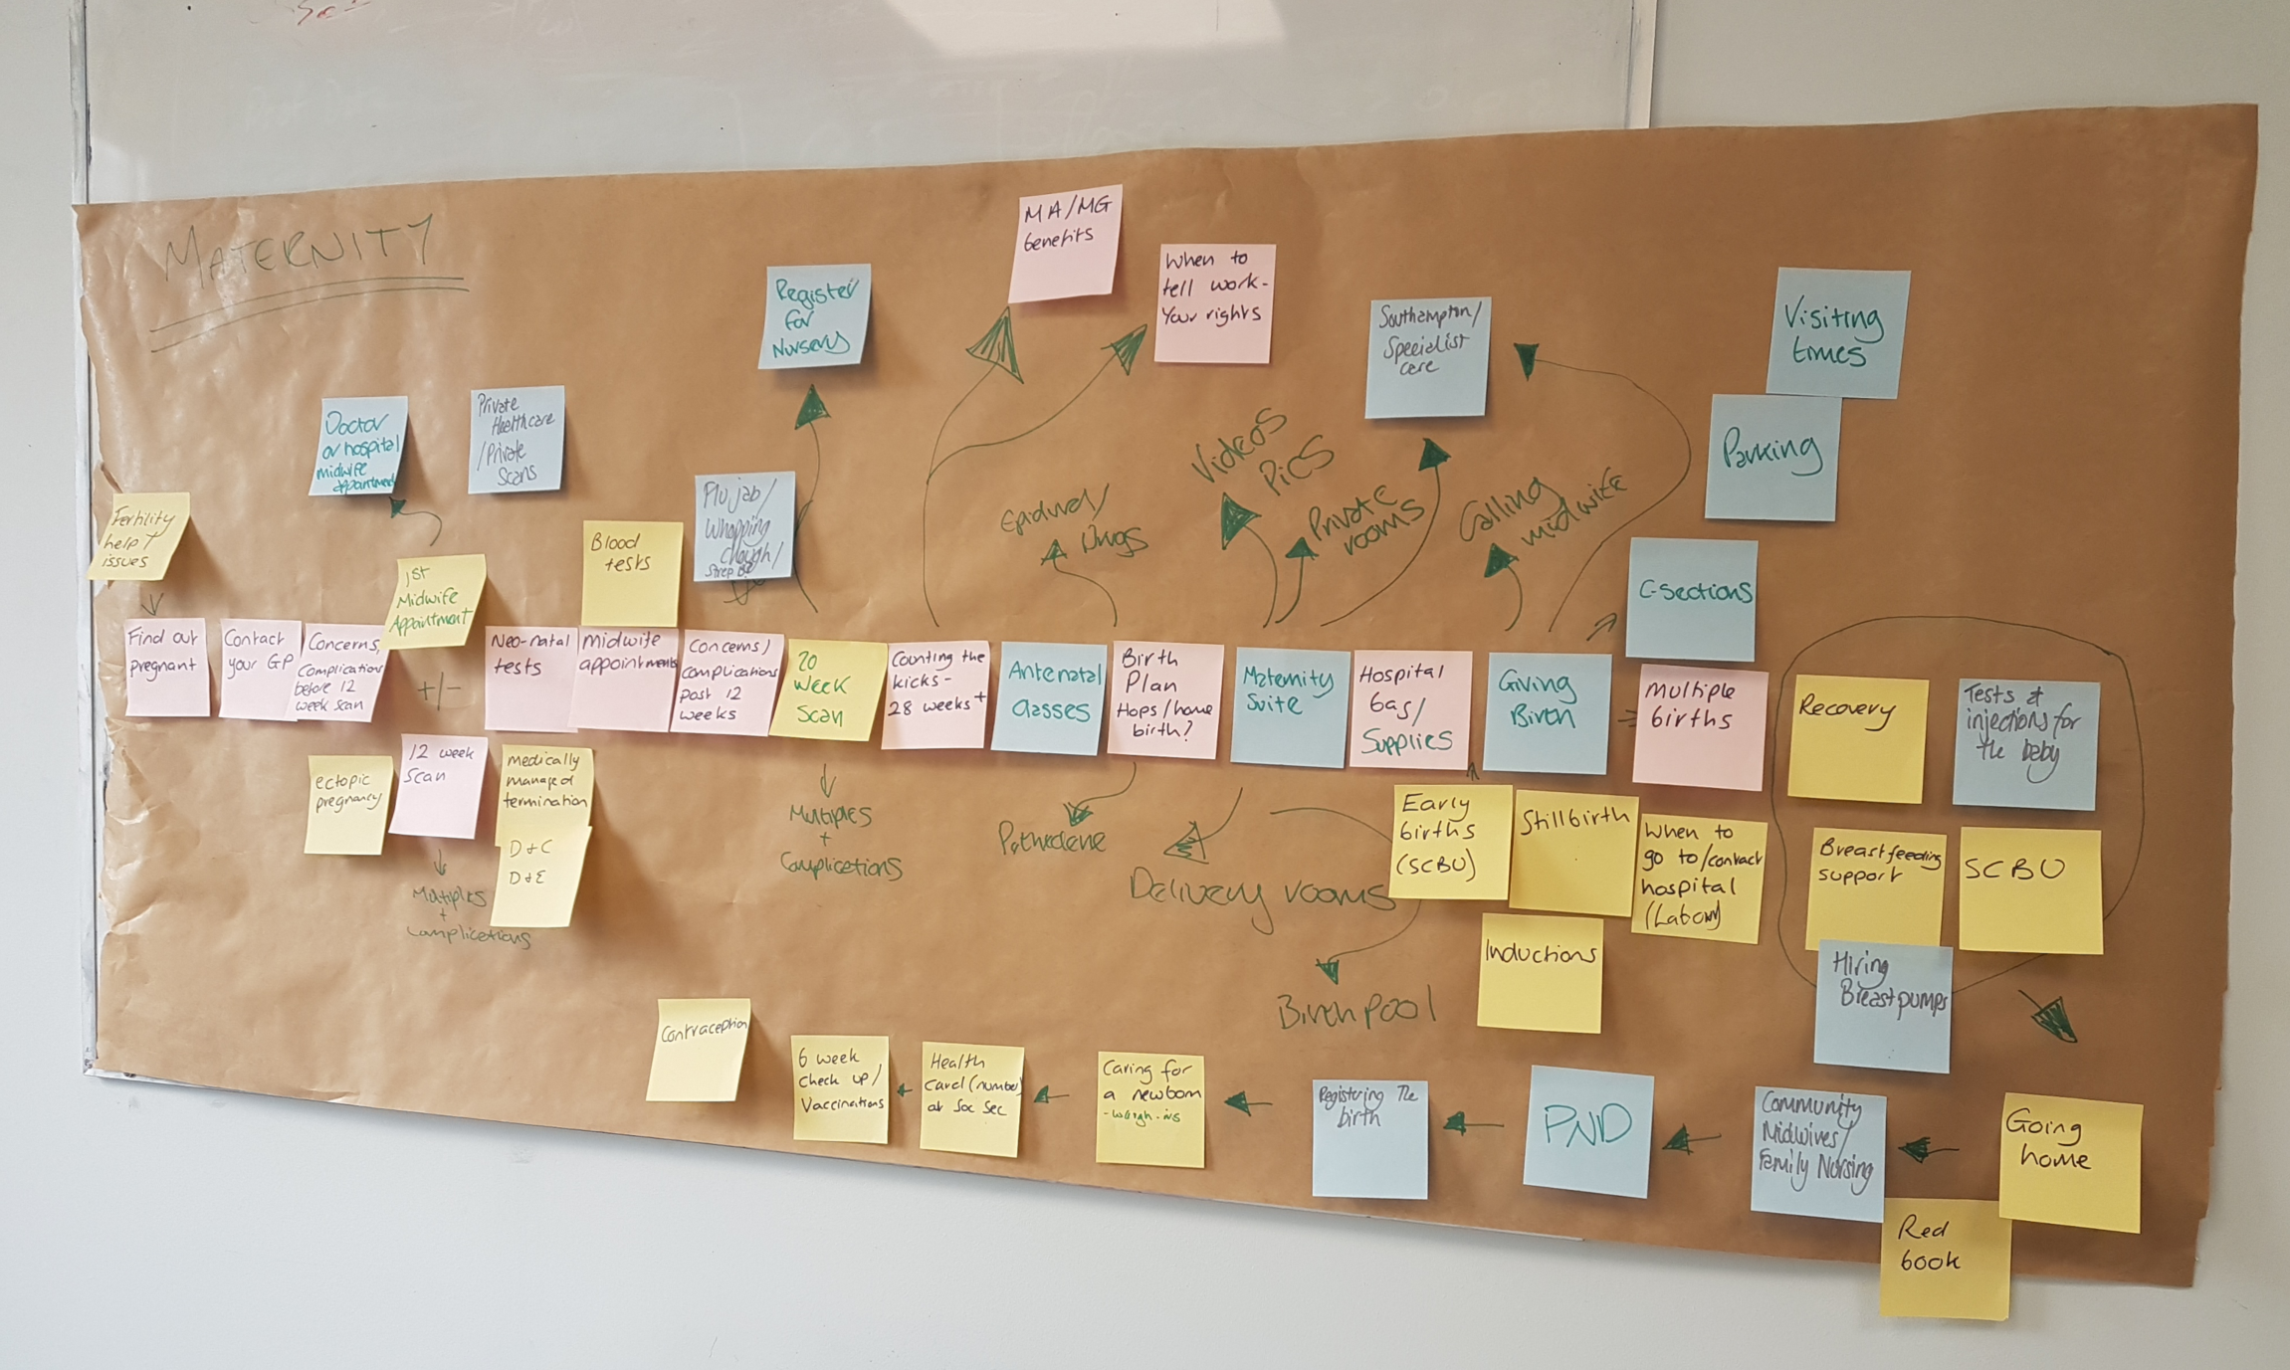
How to Map Key Processes
Many ways to map workflow, one technique uses different colored “sticky” notes to represent the flow chart elements.
Follow the process from starting point determined by the team, documenting major:
  Activities
  Tasks
  Decision Points
  Roles
69
Notes:
There are many ways to map workflow; using “sticky” notes is one example. Use different colored notes to represent major activities, tasks, and decision points for your current CR process. You can move the sticky notes around to refine and modify the process. More detailed guidance for the mapping process can be found in the Tools and Resource Guide https://www.ahrq.gov/sites/default/files/wysiwyg/takeheart/training/getting-started-resource-guide.pdf

Slide 70
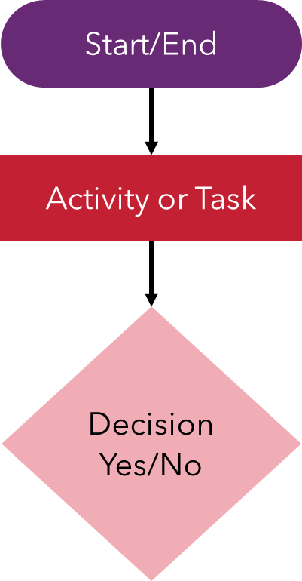
Flowchart
A flowchart is the picture created by mapping the CR workflow processes.
Symbols represent different parts of the process.
70
Notes:
Mapping creates a picture called a flow chart which depicts all the major tasks, activities and decision points in the current cardiac rehabilitation process. A flow chart can help visualize the process. The implementation guide https://www.ahrq.gov/sites/default/files/wysiwyg/takeheart/training/getting-started-implementation-guide.pdf provides a link to a free flowchart template.

Slide 71
Workflow Maps: Whole vs. Part
WHOLE PROCESS
Part 1: Referral
Patient with eligible diagnosis/ procedure
Patient presents with eligible diagnosis/ procedure
Ambulatory Care follow up
CR intake visit orientation
PARTICIPANTS
NO
Patient agrees to enroll
NO
Ambulatory Care Follow Up
Coordinator decides best match and makes referral
YES
Individualized treatment plan established
YES
Diagnosis/procedure entered into EMR
Coordinator discusses CR w/ patient & explores patient factors: transportation, work hrs. etc.
NO
Enrollment and subsequent visits scheduled
YES
Document reason
Diagnosis/procedure entered into EMR
EMR triggers order prompt for CR
Individualized treatment plan updated monthly
Provider determines eligibility (opt out)
YES
Order lands on care coordinator queue
EMR triggers order prompt for CR
Graduation after completion of program
Ambulatory care
follow up
NO
71
Notes:
On the left of the slide is an example an entire workflow process map. On the right, is a part of the workflow process (referral). For the purpose of the project, spend time focusing on part/s of the process that you are trying to improve (e.g., referrals, care coordination, data collection).

Slide 72
Workflow Maps: Whole vs. Part (alternate)
WHOLE PROCESS
Patient presents with eligible diagnosis/ procedure. No.
Ambulatory Care follow up
Patient presents with eligible diagnosis/ procedure. Yes.
Diagnosis/procedure entered into EMR
EMR triggers order prompt for CR
Provider determines eligibility (opt out)? No.
Ambulatory care follow up
Provider determines eligibility (opt out)? Yes.
Order lands on care coordinator queue
Coordinator discusses CR w/ patient & explores patient factors: transportation, work hrs. etc.
Coordinator decides best match and makes referral
Patient agrees to enroll? No.
Document reason
Patient agrees to enroll? Yes.
CR intake visit orientation
Individualized treatment plan established
Enrollment and subsequent visits scheduled
Individualized treatment plan updated monthly
Graduation after completion of program
Part 1: Referral
Patient with eligible diagnosis/ procedure. No.
Ambulatory Care follow up
Patient with eligible diagnosis/ procedure. Yes.
Diagnosis/procedure entered into EMR
EMR triggers order prompt for CR
72
Notes:
On the left of the slide is an example an entire workflow process map. On the right, is a part of the workflow process (referral). For the purpose of the project, spend time focusing on parts of the process that you are trying to improve: referrals, care coordination, and data collection.

Slide 73
Current Workflow Processes: Referrals
Patient with eligible diagnosis/ procedure
NO
Ambulatory Care Follow Up
?
- Which patients currently referred?
- Are some diagnoses missing?
- Who decides which patients are referred?
- Does the referral process vary for surgical vs. non-surgical patients?
YES
Diagnosis/procedure entered into EMR
EMR triggers order prompt for CR
Note: An Accessible version of “Current Workflow Processes: Referrals” is below
73
Notes:
Start by breaking down the referral process.
Here are some sample questions that relate to the current processes for REFERRING patients to CR to explore during the workflow mapping process.
Start by exploring the patients involved in the process.
Who is referred to cardiac rehabilitation and why?
Which patients are currently referred for cardiac rehabilitation, i.e. what diagnoses?
Are some diagnoses missing?
Is the process different for surgical vs. non-surgical patients?
Who decides which patients are referred?
Make sure to examine the how, when and where for the referral process. Here are some additional questions.
What is the current trigger for a CR referral, e.g. patient diagnosis, physician initiated, etc.?
What happens to patients admitted to general medical floor rather than a cardiology floor?
Where does the referral get made, i.e. in hospital or outpatient follow up visit with physician?
Do some surgeons require the patient to wait 6 weeks?

Slide 74
Current Workflow Processes: CC
Workflow process from Referral to Completion of Program
Who communicates with the patient?
Are patient factors discussed: finances, transportation, work?
How is health insurance factored in?
How is the CR program selected?
Who follows up to make sure the patient enrolls?
How do we know the # of sessions attended or if patients complete?
74
Notes:
Next, look at the processes that cover the time from referral to enrollment, this slide provides examples of the types of questions you will want to ask and answer about existing processes for coordinating care for patients who are referred to CR.
What is your CR enrollment process?
Who communicates with the patient?
How is type of health insurance factored in?
How is the CR program selected?
Who follows up with the patient to see if they enrolled?

Slide 75
Current Workflow Mapping: Example
Patient presents with eligible diagnosis/ procedure
Ambulatory Care follow up
CR intake visit orientation
PARTICIPANTS
NO
Patient agrees to enroll
Coordinator decides best match and makes referral
YES
Individualized treatment plan established
YES
Diagnosis/procedure entered into EMR
Coordinator discusses CR w/ patient & explores patient factors: transportation, work hrs. etc.
NO
Enrollment and subsequent visits scheduled
Document reason
EMR triggers order prompt for CR
Individualized treatment plan updated monthly
Provider determines eligibility (opt out)
YES
Order lands on care coordinator queue
Graduation after completion of program
Ambulatory care
follow up
NO
75
Notes:
When you complete the mapping exercise, the map might look like the one pictured here. This example is meant to provide a high-level view of the referral to completion process for cardiac rehabilitation. Now you can begin to use the map to identify workflow processes that need to be addressed to accommodate AR with effective CC.

Slide 76
Current Workflow Mapping: Example (alternate)
Patient presents with eligible diagnosis/ procedure. No.
Ambulatory Care follow up
Patient presents with eligible diagnosis/ procedure. Yes.
Diagnosis/procedure entered into EMR
EMR triggers order prompt for CR
Provider determines eligibility (opt out)? No.
Ambulatory care follow up
Provider determines eligibility (opt out)? Yes.
Order lands on care coordinator queue
Coordinator discusses CR w/ patient & explores patient factors: transportation, work hrs. etc.
Coordinator decides best match and makes referral
Patient agrees to enroll? No.
Document reason
Patient agrees to enroll? Yes.
CR intake visit orientation
Individualized treatment plan established
Enrollment and subsequent visits scheduled
Individualized treatment plan updated monthly
Graduation after completion of program
76
Notes:
When you complete the mapping exercise, the map might look like the one pictured here. This example is meant to provide a high-level view of the referral to completion process for cardiac rehabilitation. Now you can begin to use the map to identify workflow processes that need to be addressed to accommodate AR with effective CC.

Slide 77
Current Workflow Map: A Tool
Patient presents with eligible diagnosis/ procedure
Ambulatory Care follow up
CR intake visit orientation
What dx is missing?
NO
Patient agrees to enroll
PARTICIPANTS
Coordinator decides best match and makes referral
YES
Individualized treatment plan established
YES
Diagnosis/procedure entered into EMR
Coordinator discusses CR w/ patient & explores patient factors: transportation, work hrs. etc.
NO
Enrollment and subsequent visits scheduled
Are new/different education materials about CR needed?
Document reason
EMR triggers order prompt for CR
Individualized treatment plan updated monthly
Provider determines eligibility (opt out)
YES
Order lands on care coordinator queue
What data need to be monitored? How will progress be communicated?
Graduation after completion of program
Ambulatory care
follow up
NO
77
Notes:
Your workflow map should become a working document. It is a tool to identify areas of change, improvement, or potential barriers. It can also be used to identify successes and processes that lead to success which can be duplicated elsewhere. Work together to analyze workflow process failures.

Slide 78
Sample Fishbone Diagram
Eligibility not identified
Referral process failures
Confusion over eligibility criteria
Confusion over who is responsible for referral
Exclusive reliance on admission codes
CR program unaware of referral so no follow-up
Failure to refer all patients eligible for CR
Ownership of eligibility determinations unclear
Delayed follow-up due to CR program wait list
Belief that CR is not beneficial
Belief that CR is not beneficial
Perception that patient won’t enroll anyway
Concerns about cost and time required
Lost track of paperwork
Depression or belief they cannot succeed
Cardiologist failure to refer
Patient objection to referral
See the following slide for an accessible version of “Sample Fishbone Diagram”
78
Notes:
To capture the underlying reasons specific problems identified during the mapping process, use Fishbone Diagrams
This example fishbone diagram captures common causes eligible patients fail to be referred to CR. The Implementation Guide contains a more complete discussion of how to use this tool. Fishbone diagrams are a useful way to identify major causes of process failures as well as specific failures that fall into these general categories.
Be sure to include the team and patients in this process to ensure that you fully understand underlying causes of process failures and can address them as you redesign your processes.

Slide 79
Accessible Sample Fishbone Diagram
Failure to refer all patients eligible for CR
Eligibility not identified
Confusion over eligibility criteria
Exclusive reliance on admission codes
Ownership of eligibility determinations unclear
Referral process failures
Confusion over who is responsible for referral
CR program unaware of referral so no follow-up
Delayed follow-up due to CR program wait list
Cardiologist failure to refer
Belief that CR is not beneficial
Perception that patient won’t enroll anyway
Lost track of paperwork
Patient objection to referral
Belief that CR is not beneficial
Concerns about cost and time required
Depression or belief they cannot succeed
79
Notes:
This example fishbone diagram captures common causes eligible patients fail to be referred to CR. The Implementation Guide contains a more complete discussion of how to use this tool. Fishbone diagrams are a useful way to identify major causes of process failures as well as specific failures that fall into these general categories.
Be sure to include the team and patients in this process to ensure that you fully understand underlying causes of process failures and can address them as you redesign your processes.

