Slide 1
Communication
Module 1

Slide 2
Objectives
Communication
Describe how communication affects team processes and outcomes.
Define effective communication.
Identify communication challenges.
Identify TeamSTEPPS tools and strategies that can improve a team’s communication.

Slide 3
Communication Exercise
Communication
Activity:
Round 1: Interpersonal information sharing
Round 2: Smart phone information sharing
Discussion:
Which worked better (was faster, more accurate, easier, etc.)?
What worked better or worse using interpersonal and smart phone sharing?

Slide 4
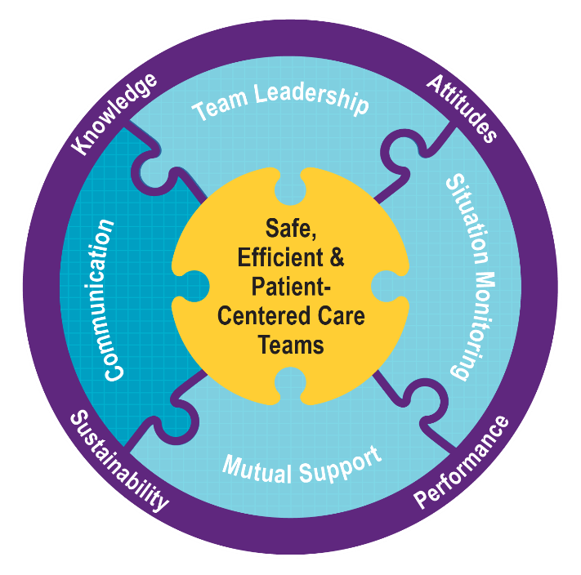
Effective Communication
Communication
Effective communication skills:
Are vital for patient safety.
Enable team members to effectively relay information, build trust, and provide reassurance and emotional support.
Are the mechanism by which most TeamSTEPPS strategies and tools are executed.

Slide 5
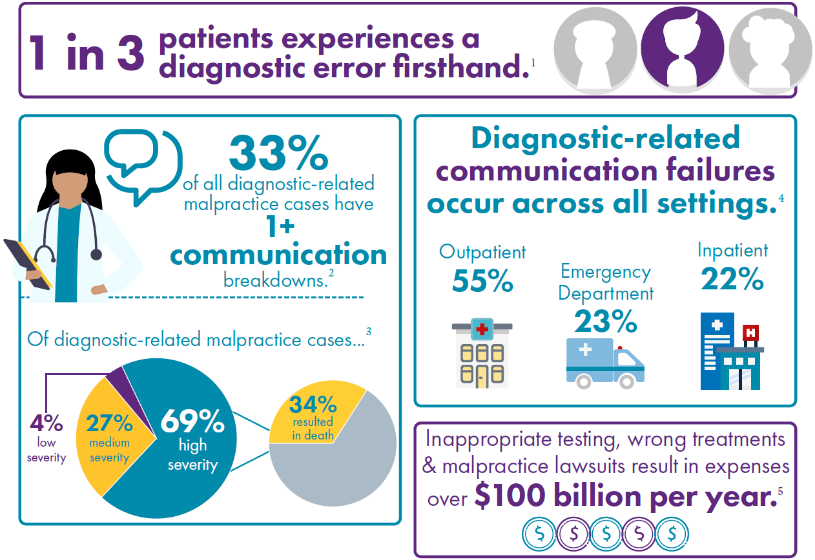
Importance of Communication
Communication
Joint Commission data identify communication failures as a common cause of sentinel events.
AHRQ-funded research identifies communication and inadequate information transfer as the top two causes of medical errors.
Diagnostic errors are common, harmful, and often the result of communication breakdowns.
Notes:
Source for infographics: https://www.ahrq.gov/sites/default/files/wysiwyg/teamstepps/diagnosis-improvement/dxsafety-infographic.pdf.

Slide 6
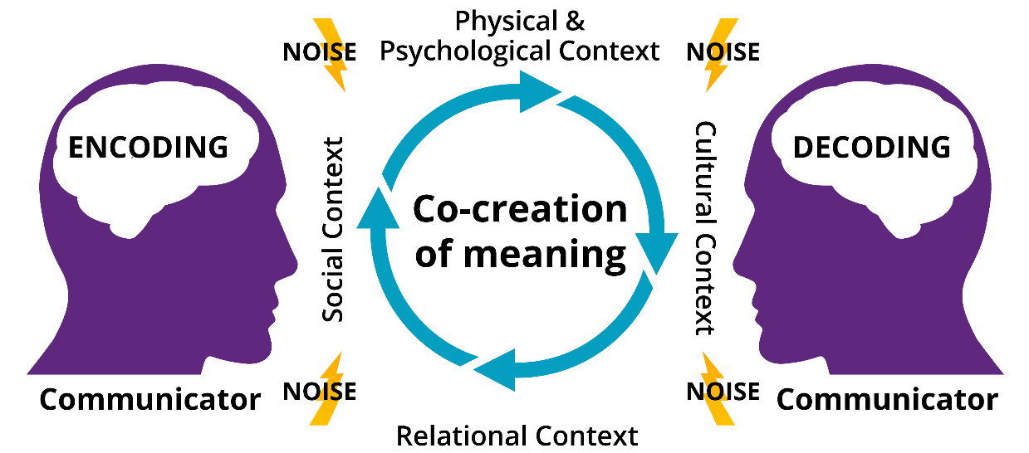
Communication Is…
Communication
Both sending and receiving messages.
The co-creation of meaning that may differ from the intended meaning.
Affected by noise, context, and communicator assumptions.
The mode by which most TeamSTEPPS strategies and tools are executed.

Slide 7
Standards of Effective Communication
Communication

Slide 8
Communication Challenges
Communication
Language barriers
Distractions, stress, and fatigue
Physical proximity
Personalities
Workload
Differing backgrounds, vocabularies, and priorities
Varying communication styles
Conflict
Lack of information verification
Shift changes

Slide 9
Information Exchange Tools
Communication
Situation – Background – Assessment – Recommendation or Request (SBAR)
Call-Out
Check-Back
Teach-Back
Handoffs (including I-PASS)

Slide 10
SBAR Provides…
Communication
A framework for team members to effectively communicate information to one another.
Notes:
Example:
Situation:
Several specialties within the Health System provide highly specialized/rare consultation services and second opinions that are highly sought after by patients and providers from across the country.
Background:
During the PHE, all 50 states and DC used their emergency authority to facilitate patient care across state lines regardless of state licensure. As of August 3, 2022, only 14 states have licensure flexibility in place and phase-outs are scheduled. ¹
In July 2021, providers were notified the OOS waiver flexibilities no longer exist and that telehealth may only be practiced when both the patient and provider are located in state.
While there is currently investigation of OOS practice for patients located in adjoining states, that project does not provide sufficient guidance for the situation involving highly specialized care that is needed for patients.
There are many considerations that must be taken into account when providing OOS care which include, but are not limited to each state’s licensure, the practice of medicine, data security, and retention, reporting requirements, corporate practice of medicine, APP supervision, DEA controlled substance requirements, etc.
Assessment
There is no process for approval and denials for OOS practice. Providers need guidance on care out of state.
Recommendation
Identify all components/criteria necessary to address for providers to practice OOS.
Develop a process for physician leadership to approve/deny physicians for OOS practice; create an oversight committee to review/sign-off on physicians practicing OOS.
Develop a process for tracking licensure, DEA requirements, malpractice coverage, etc. for those providers who are approved to practice OOS.

Slide 11
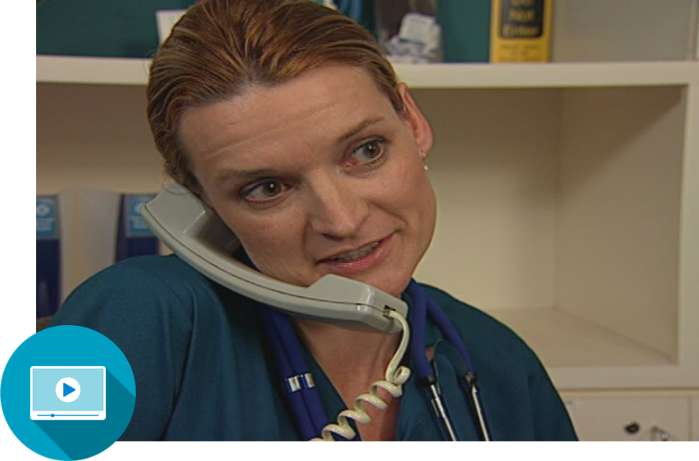
SBAR Video
Communication
Notes:
For SBAR video, go to: https://youtu.be/nbJPAumzJrc

Slide 12
SBAR Exercise
Communication
Create an SBAR example based on your role.
How would you adjust your message for a physician versus a patient with no medical background?

Slide 13
Call-Out Is…
Communication
A strategy used to communicate important or critical information:
It informs all team members simultaneously during emerging situations.
It helps team members anticipate next steps.

Slide 14
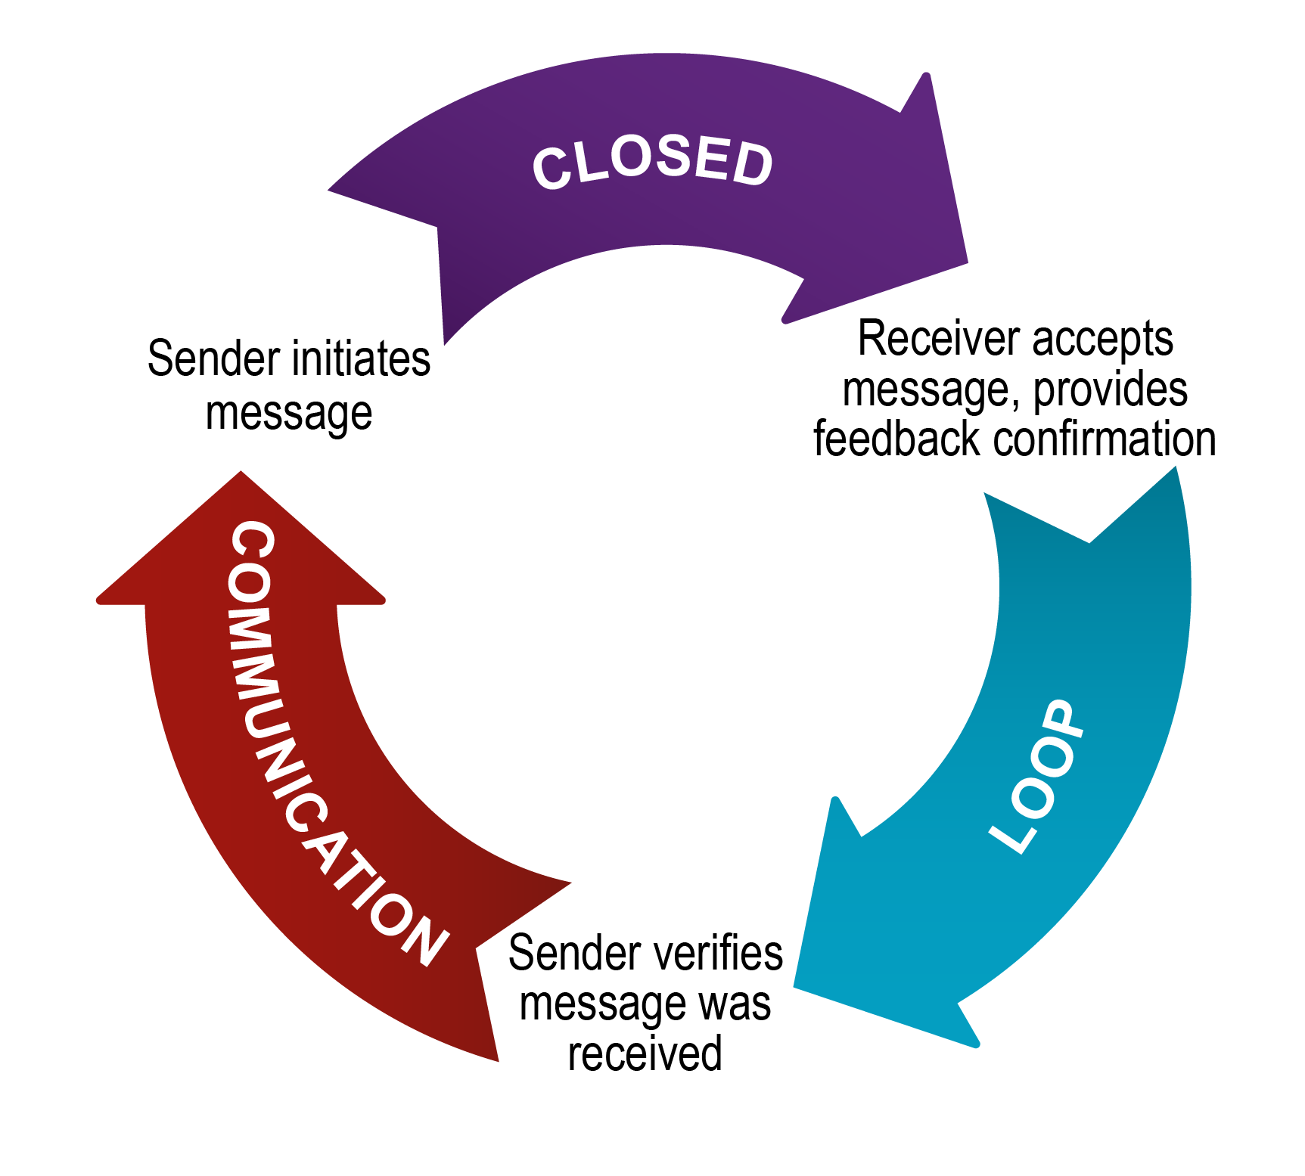
Check-Back Is…
Communication
Sometimes also called a Repeat-Back.
TeamSTEPPS also includes a Teach-Back tool, which can be used with patients and family caregivers.

Slide 15
Handoff Is…
Communication
The transfer of information during transitions in care across the continuum:
Includes an opportunity to ask questions, clarify, and confirm.
Is relevant during shift changes, transfers between departments, and care team transitions.
Is sometimes done virtually or with e-handoff functions within an electronic health record.
Handoffs include:
Transfer of responsibility and accountability.
Clarity of information.
Verbal communication of information.
Acknowledgment by receiver.
Opportunity to review.

Slide 16
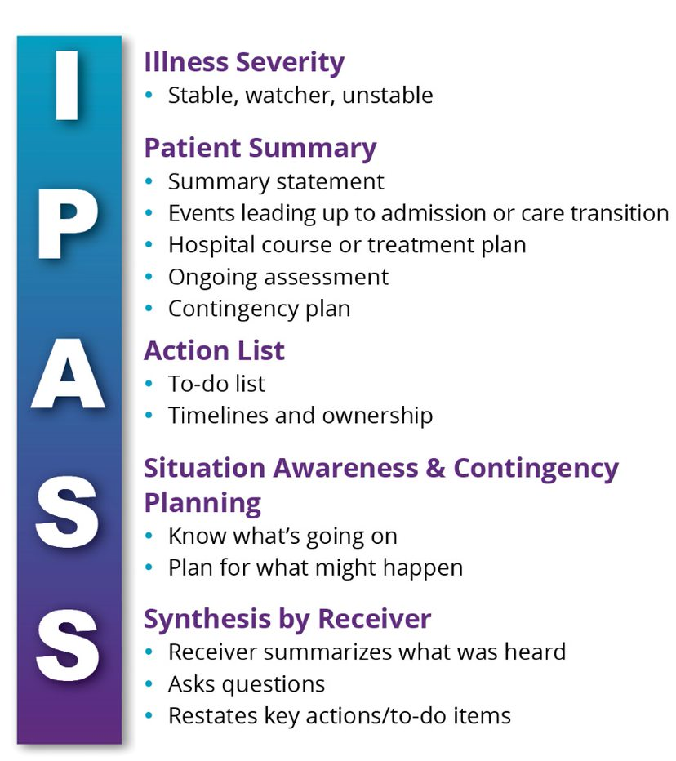
I-PASS: A Common Handoff Tool
Communication

Slide 17
Other Handoff Tools
Communication
ANTICipate
Administrative Data; New clinical information; Tasks to be performed; Illness severity; Contingency plans for changes
SHARQ
Situation; History; Assessment; Recommendations/Result; Questions

Slide 18
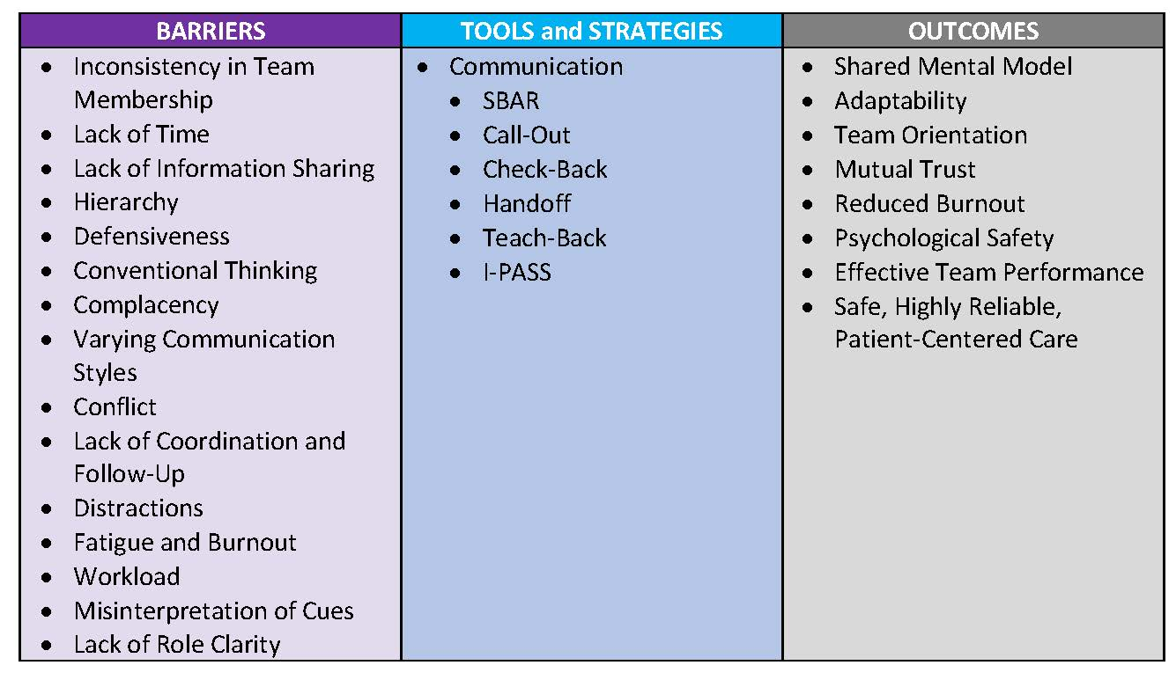
Tools and Strategies Summary
Communication

Slide 19
Applying TeamSTEPPS Exercise
Communication
Is your teamwork issue related to communication?
If yes, what is the communication issue?
Which TeamSTEPPS tools or strategies might you consider implementing to address the issue?

