Slide 1

Team Leadership
Module 2

Slide 2
Understanding Teams and Team Structure

Slide 3
Objectives: Team Structure
Team Leadership
Understand the benefits of teamwork and clear team structure.
Define a “team.”
Identify the roles of patients and family caregivers within the care team.
Describe the components and composition of a multi-team system.

Slide 4
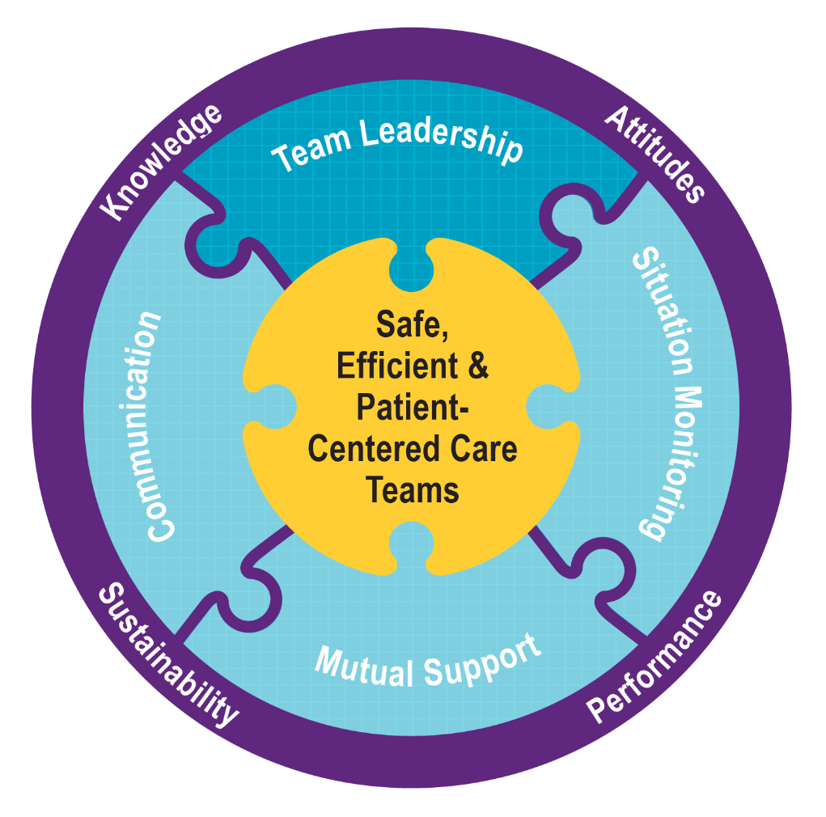
Team Structure
Team Leadership
Teamwork cannot occur in the absence of a clearly defined team.
Understanding a team’s structure and how multiple teams interact is critical for implementation planning.

Slide 5
What Defines a Team?
Team Leadership
Two or more people who interact dynamically, interdependently, and adaptively toward a common and valued goal, have specific roles or functions, and have a time-limited membership
Teams can be:
  In-person or virtual.
  Temporary or permanent.
  Frequently changing due to staff schedules
  and assignments.

Slide 6

Team Exercise
Team Leadership
Identify a patient type that you frequently support.
List all the people (names or positions) responsible for directly or indirectly supporting the care of this patient.
Are they all on one team or parts of separate teams supporting the patient?
Report out on your conclusions.

Slide 7
Partnering With the Patient
Team Leadership
Patients are members of the core team; a family caregiver may also be.
Strategies for involving patients and family caregivers in teams:
  Include patients in bedside rounds.
  Conduct handoffs at the patient’s bedside.
  Provide patients and family caregivers with tools for communicating with their care team (e.g., phone numbers, email, patient portal).
  Involve patients on key committees.
  Actively encourage patient and family caregiver participation.

Slide 8
How Teams Can Foster Patient and Family Caregiver Involvement
Team Leadership
Embrace patients and family caregivers as separate, valuable, and contributing partners:
  Listen and elicit feedback from both patients and family caregivers.
  Assess patients’ preference regarding involvement.
  Ask patients about their concerns.
  Speak to them in lay terms.
  Allow time for patients and family caregivers to ask questions.
  Treat patients and family caregivers as distinct, with different information, preferences, and concerns.
  Help them access relevant information on a patient portal.

Slide 9
Patients and Family Caregivers Can
Function Effectively in Their Teams by:
Team Leadership
Providing accurate patient information.
Collaborating to create a care plan that they will follow (e.g., taking medications, scheduling and attending appointments).
Asking questions and voicing any concerns regarding their care.
Monitoring and reporting changes in the patient’s condition.
Coordinating and communicating with other family members.
Encouraging and showing appreciation to other team members.

Slide 10
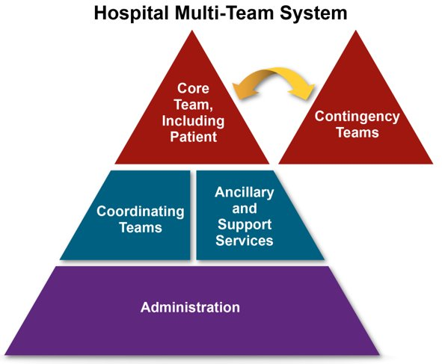
Multi-Team System (MTS) for
Patient Care
Team Leadership

Slide 11
A Core Team Is…
Team Leadership
A group of care providers who work interdependently to manage a set of assigned patients from point of assessment to disposition.
Core Team members have
the closest
contact with
the patient.

Slide 12
A Contingency Team Is…
Team Leadership
A time-limited team formed for emergent or specific events and composed of members from various teams.

Slide 13
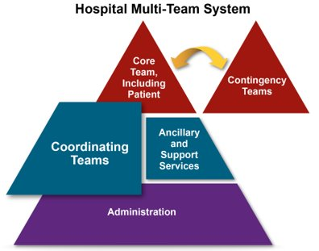
A Coordinating Team Is…
Team Leadership
A team comprising those work area members who are responsible for managing the operational environment that supports the Core Team.

Slide 14
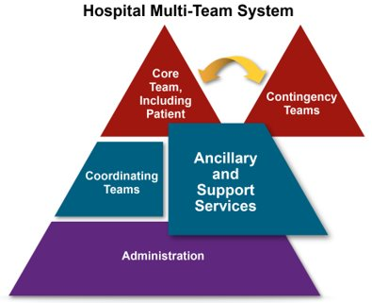
Ancillary and Support Services
Team Leadership
Ancillary Services provide direct, task-specific, time-limited care to patients.
Support Services provide indirect service-focused tasks that help facilitate the optimal healthcare experience for patients and their families.

Slide 15
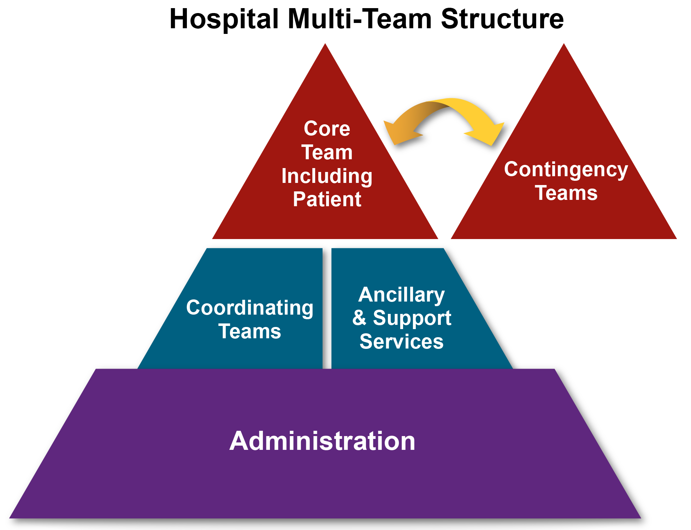
The Role of Administration Is To…
Team Leadership
Establish and communicate vision.
Develop policies and set expectations for staff related to teamwork.
Support and encourage
staff during implementation
and culture change.
Hold teams accountable
for team performance.
Define the culture of
the organization.

Slide 16
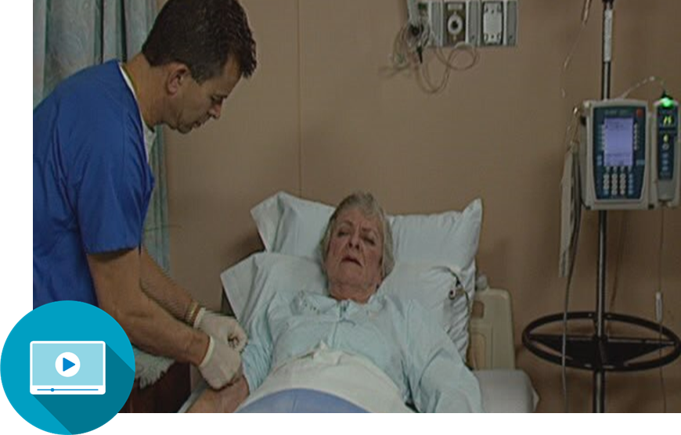
Team Structure Video
Team Leadership

Slide 17
Team Structure Discussion
Team Leadership
What types of teams were involved in the scenario?
Where did the breakdowns occur between the components of this multi-team system?
What could the individuals involved in this scenario have done differently to produce a better outcome?

Slide 18
Applying TeamSTEPPS Exercise
Team Leadership
Who are the members of the team experiencing a teamwork issue?
Which team or teams within your multi-team system are experiencing the teamwork issue? Which team or teams interact with or are otherwise affected by the team(s) experiencing the issue?

Slide 19
Leading Teams

Slide 20
Exercise: Leadership
Team Leadership
Instructions:
Begin by selecting a leader and scribe for your group.
Create two lists:
  What makes an effective team leader?
  What makes a team leader ineffective?
Be prepared to report your answers out to the
entire group.

Slide 21
Objectives
Team Leadership
Describe how leadership affects team processes and outcomes.
Identify different types of team leaders.
Describe the activities involved in successfully leading teams.
Describe the tools for leading teams, including briefs, huddles, and debriefs.
Apply the tools for leading teams to specific clinical scenarios.

Slide 22
Leadership
Team Leadership
Ensures the patient remains the focus for all team decisions
Holds a teamwork system together
Ensures a plan is conveyed, reviewed, and updated
Is facilitated by communicating, continuously monitoring the situation, and fostering an environment of mutual support

Slide 23
Types of Team Leaders
Team Leadership
Designated: The person assigned to lead and organize a team, establish clear goals, and facilitate open communication and teamwork among team members
Situational: Any team member with the skills to manage the situation at hand

Slide 24
Effective Team Leaders
Team Leadership
Ensure the patient’s needs and preferences are understood and prioritized.
Define, assign, share, monitor, and modify a plan.
Review the team’s performance.
Establish “rules of engagement.”
Manage and allocate resources effectively.
Provide feedback regarding assigned responsibilities and progress toward the goal.
Facilitate information sharing.
Encourage team members to assist one another.
Facilitate conflict resolution.
Model effective teamwork.

Slide 25
Defining the Plan
Team Leadership
When developing a plan, team leaders should consider:
  Patient: What does the patient need and how can the team best provide it?
  Time: How much time is available to complete all the necessary tasks and activities?
  People: Do available staff have the necessary knowledge and skills to perform their roles?
  Equipment: Is the needed equipment available and working?
  Information: Has all the needed information been collected and reviewed?

Slide 26
Case Study Discussion
Team Leadership
After attending TeamSTEPPS Master Training, a physician and nurse leader in a Level I Trauma Center decide that trauma resuscitations could be conducted more effectively.
Currently, when a trauma alert is called to indicate the pending arrival of a severely injured patient, more staff show up to the trauma bay than needed, necessary equipment is sometimes missing or not functioning properly, and the lead trauma physician often shows up just as EMS is bringing the patient into the trauma bay.
You observe that these practices have led to confusion that puts patients at risk and results in valuable time being lost. How can principles of effective leadership and planning guide what you should do?

Slide 27
Assigning Tasks and
Responsibilities
Team Leadership
Determine the tasks and roles to be assigned.
Determine which roles must be filled and allocate tasks appropriately.
Communicate clear expectations of what team members need to do.
Request feedback.

Slide 28

Sharing the Plan: Briefs
Team Leadership
A team brief is an effective strategy for sharing the plan.
Briefs should help:
  Form the team.
  Designate team roles and responsibilities.
  Establish climate and goals.
  Engage team in short- and long-term planning.
How did the video illustrate each recommended phase of a team brief?
Which elements of the brief are most commonly omitted in teams you are part of?

Slide 29
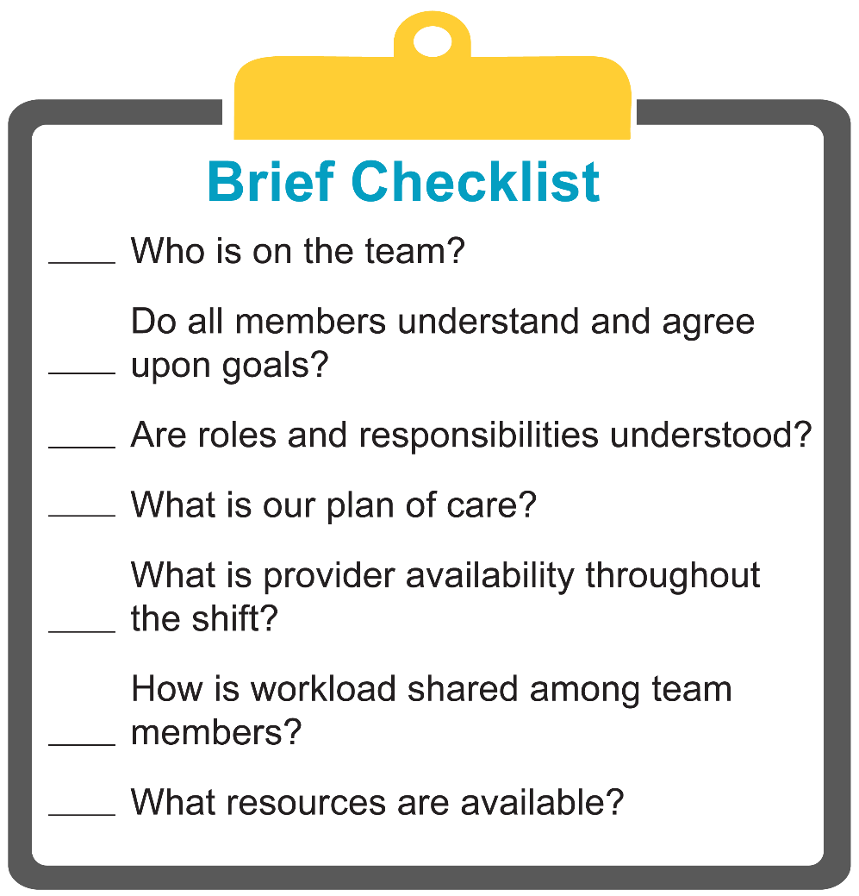

Brief Checklist Tool
Team Leadership

Slide 30
Exercise: Brief
Team Leadership
Instructions:
In your small group, identify a type of healthcare team everyone in the group can relate to.
For this team, identify when, why, and where briefs might be conducted. Note who should lead the brief and who should participate.
List up to four items you would include on a checklist
for one of the briefs you’ve identified.
Discuss what outcomes you expect to see as a result of
implementing briefs.
At the end of the exercise, present and discuss your
plans with the class.

Slide 31

Monitoring and Modifying the Plan: Huddle
Team Leadership
Problem solving:
  Hold ad hoc, “touch base” meetings to regain situation awareness.
  Discuss critical issues and emerging events.
  Anticipate outcomes and likely contingencies.
  Assign resources.
  Express concerns.
  Elicit input and answer patient questions when appropriate.
How did the video illustrate the effective use of a huddle?
What one change would make huddles of your team more effective?

Slide 32
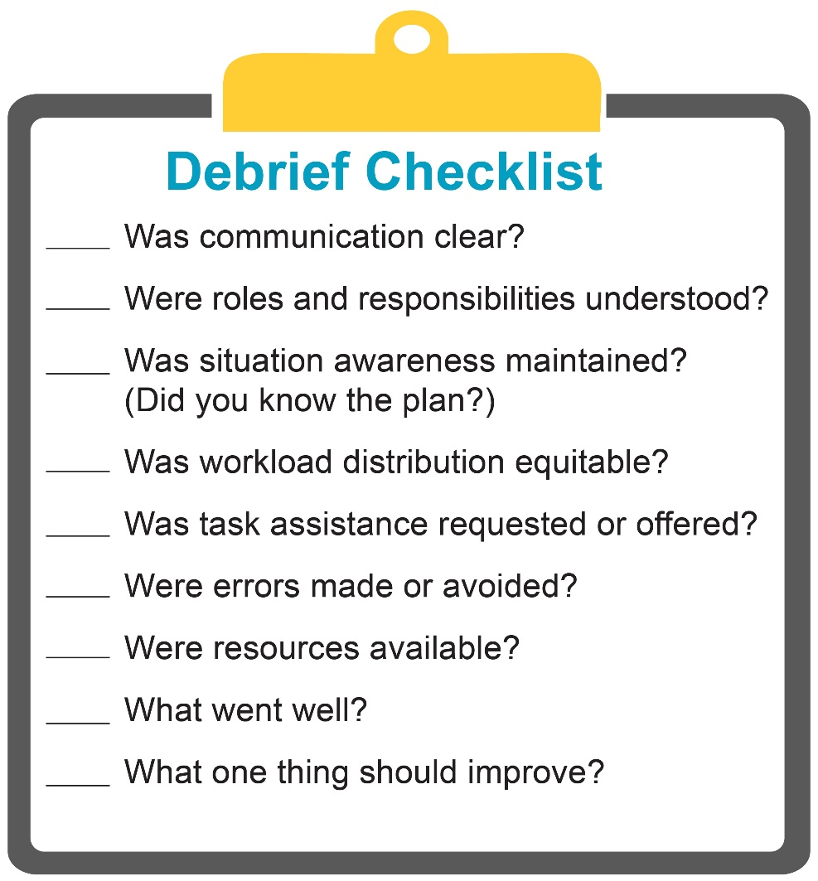
Reviewing the Team’s
Performance: Debrief
Team Leadership
Debriefs foster process improvement:
  Brief, informal information exchange and feedback sessions
  Occur after an event or shift
  Designed to improve teamwork skills
  Designed to improve outcomes:
    An accurate recounting of key events
    Analysis of why the event occurred
    Discussion of lessons learned and reinforcement of successes
    Revised plan to incorporate lessons learned

Slide 33
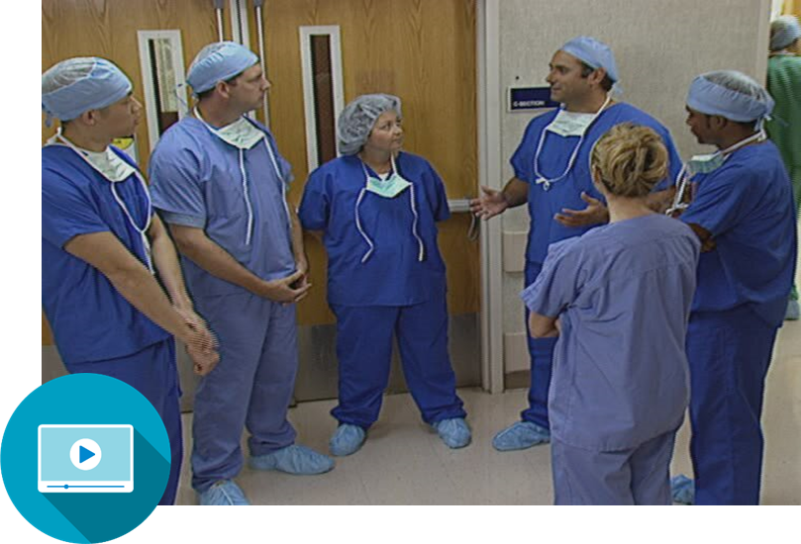
Debrief Video
Team Leadership
Why is it important to debrief after processes that went well AND those that didn’t?
What made this debrief effective and what might have made it even better?
What one change would make debriefs in your team work more effectively?

Slide 34
Facilitating Conflict Resolution
Team Leadership
Effective leaders:
  Facilitate conflict resolution to avoid compromising patient safety and quality of care.
  Do not allow interpersonal or irrelevant issues to negatively affect the team.
  Help team members master conflict resolution techniques.

Slide 35
Promoting and Modeling
Teamwork
Team Leadership
Effective leaders cultivate desired team behaviors and skills through:
  Open sharing of information.
  Role modeling and effective cuing of team members to use prescribed teamwork behaviors and skills.
  Constructive and timely feedback.
  Facilitation of briefs, huddles, debriefs, and conflict resolution.
  Mitigation of conflict within the team.

Slide 36

Team Leadership Video
Team Leadership
What leadership tools and strategies were used by
Drs. Dean and Upton?
How did the nurses demonstrate leadership?

Slide 37
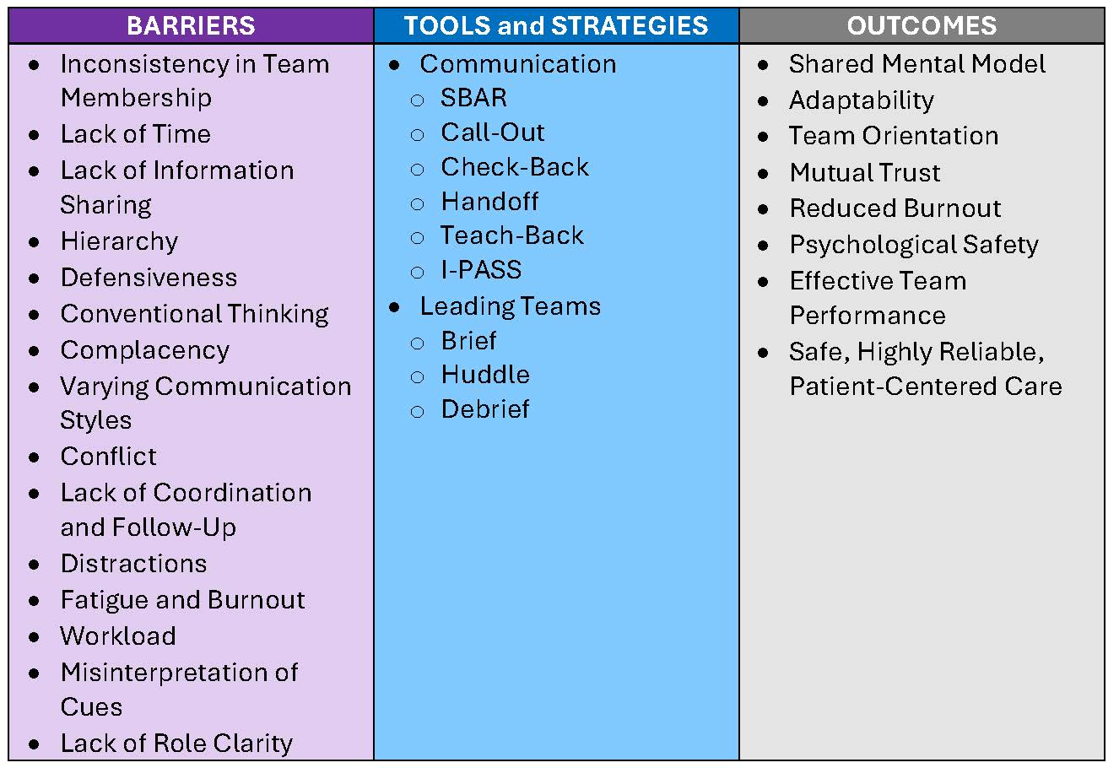
Tools and Strategies Summary
Team Leadership

Slide 38
Applying TeamSTEPPS Exercise
Team Leadership
Who is the designated leader on the team that is at the center of your TeamSTEPPS implementation?
Do you have teamwork issues that this leader must work with you to address?
If so, what are the issues and can any of the tools or strategies learned in this module be used to address them?

