Slide 1
Mutual Support
Module 4

Slide 2
Objectives
Mutual Support
Describe how mutual support affects team processes and outcomes.
Discuss specific strategies to foster mutual support (e.g., task assistance, feedback).
Identify specific tools to facilitate mutual support.
Describe conflict resolution strategies.

Slide 3
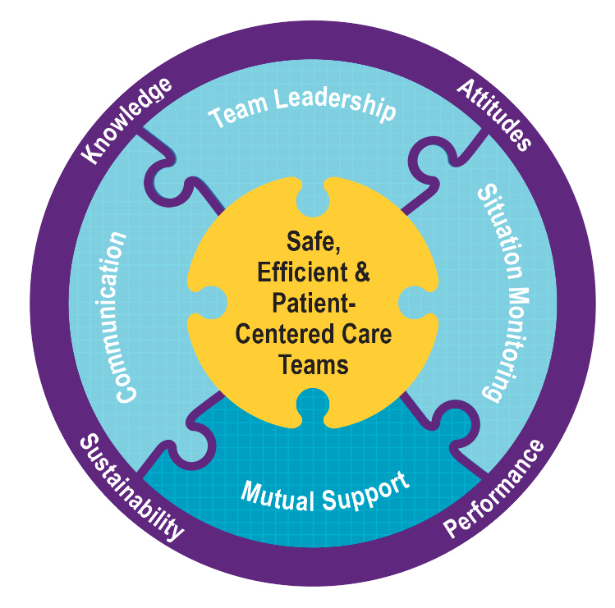
Mutual Support Is…
Mutual Support
Dependent on information gathered through situation monitoring.
Facilitated by the communication of information.
Enhanced by leaders who encourage and model mutually supportive behaviors.
Vital to supporting both patients and other care providers.

Slide 4
Mutual Support Involves…
Mutual Support
Team members who:
Assist each other.
Provide and receive feedback.
Exert assertive advocacy behaviors when patient safety is threatened.
Respond to conflict promptly and constructively.

Slide 5
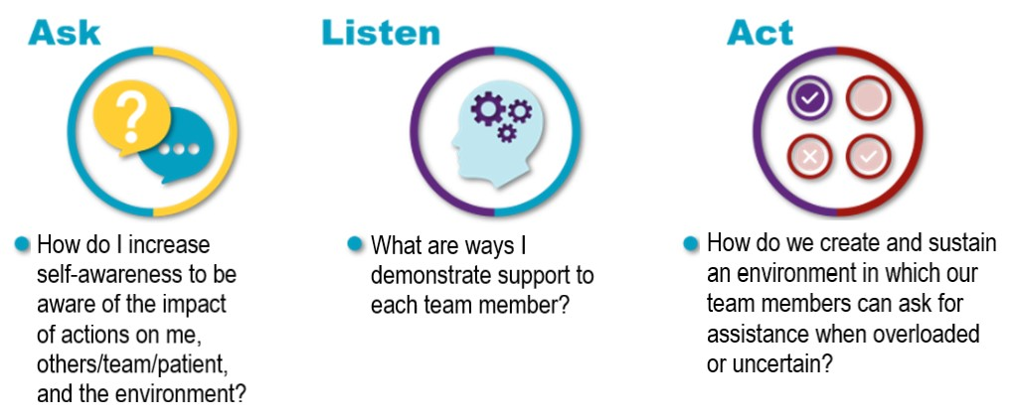
Mutual Support Discussion
Mutual Support

Slide 6
Task Assistance
Mutual Support
Team members foster a climate in which it is expected that assistance will be actively sought and offered as a method for reducing error risks and workplace stress and burnout.

Slide 7
Task Assistance Example
Mutual Support
Two staff of the GI Lab are assessing an older patient who has just had conscious sedation for a colonoscopy. The monitor shows an elevated heart rate of 150 beats per minute and blood pressure of 76/48. The nurse calls out the vital signs while the physician continues to monitor the rhythm. A nurse passing by the room hears the call-out.
How would you offer task assistance?
How would you request task assistance?
How well would your team handle a scenario like this one?

Slide 8
What Is Feedback?
Mutual Support
Feedback is information provided that can positively or negatively impact team performance.
It may be:
Nonverbal (not paying attention, looking upset, smiling and affirming what’s being said).
Verbal (making a suggestion, agreeing, or disagreeing).
Intentional (a message you were deliberately sending).
Unintentional (a reaction you were not trying to communicate).

Slide 9
Types of Formative Feedback
Mutual Support
Formal
Retrospective and typically scheduled in advance
Has an evaluative quality
Examples: collaborative discussions, case conferences, individual performance reviews
Informal
Typically in real time
Provided on an ongoing basis
Focuses on knowledge and practical skills development
Examples: huddles, debriefs

Slide 10
Characteristics of Effective Formative Feedback
Mutual Support
Effective formative feedback is:
Appreciative.
Timely.
Respectful.
Specific.
Directed toward improvement:
Helps prevent the same problem from occurring in the future.
Considerate.
Patient focused.

Slide 11
Providing Effective Formative Feedback Video
Mutual Support
Was the formative feedback:
Appreciative
Timely?
Respectful?
Specific?
Directed toward improvement?
Considerate?
Patient focused?

Slide 12
Advocacy and Assertion
Mutual Support
Advocate for the patient:
Invoked when team members’ viewpoints don’t coincide with that of a decision maker and patient safety is at risk.
Assert a corrective action in a firm and respectful manner.
How would members of your team react to advocacy and assertion from a patient or family caregiver on the team?

Slide 13
The Assertive Statement
Mutual Support
Respects and supports authority.
Clearly asserts concerns and suggestions.
Is nonthreatening and ensures critical information is addressed.
Five-Step Process:
Open the discussion.
State the concern.
State the problem—real or perceived.
Offer a solution.
Obtain an agreement on next steps.

Slide 14
Two-Challenge Rule
Mutual Support
Empowers any team member to “stop the line” if they sense or discover a breach of safety.
This action should never be taken lightly, because it requires immediate cessation of the process and resolution of the safety issue.

Slide 15
Two-Challenge Rule (continued)
Mutual Support
Invoked when an initial assertion is ignored…
It is your responsibility to assertively restate the concern.
The team member being challenged must acknowledge that they heard and understood your concern.
If the response does not clarify and alleviate concern, rephrase the anticipated danger.
If the outcome is still not acceptable:
Take a stronger course of action.
Engage other team members.
Use supervisor or chain of command.

Slide 16
Please Use CUS Words but only when appropriate!
Mutual Support

Slide 17
Advocacy and Assertion Scenario
Mutual Support
A medical floor nurse is assigned to a patient who has had a myocardial infarction. The attending physician provides the final treatment, reviews the clinical situation, and determines that the patient is well enough to be discharged.
Before the patient is discharged, the nurse checks the patient’s vitals one last time. The nurse finds it unusual that the blood pressure and heart rate are substantially elevated.

Slide 18
Conflict in Teams
Mutual Support
Informational Conflict
(We have different information.)
Interpersonal Conflict
(Hostile and harassing behavior)
Two-Challenge Rule
DESC Script

Slide 19
Conflict Resolution: DESC Script
Mutual Support
A constructive approach for managing and resolving conflict
Describe the specific situation or behavior; provide concrete data.
Express how the situation makes you feel/what your concerns are.
Suggest alternatives and seek agreement.
Consequences should be stated in terms of impact on the patient and established team goals; strive for consensus.

Slide 20
DESC It
Mutual Support
How to “DESC It!”
Have timely discussion.
Work on win-win.
Frame problem in terms of your own experience.
Choose a private location.
Use “I” statements; avoid blaming statements.
Remember: Critique is not criticism.
Focus on what is right, not who is right.

Slide 21
A DESC Scenario
Mutual Support
A nurse feels that a patient has abdominal distension and pain secondary to a distended bladder and needs a Foley catheter. The nurse receives the order from the resident on call. When the attending later realizes that the order was given without his consent, he raises his voice to the resident in front of staff and the patient.

Slide 22
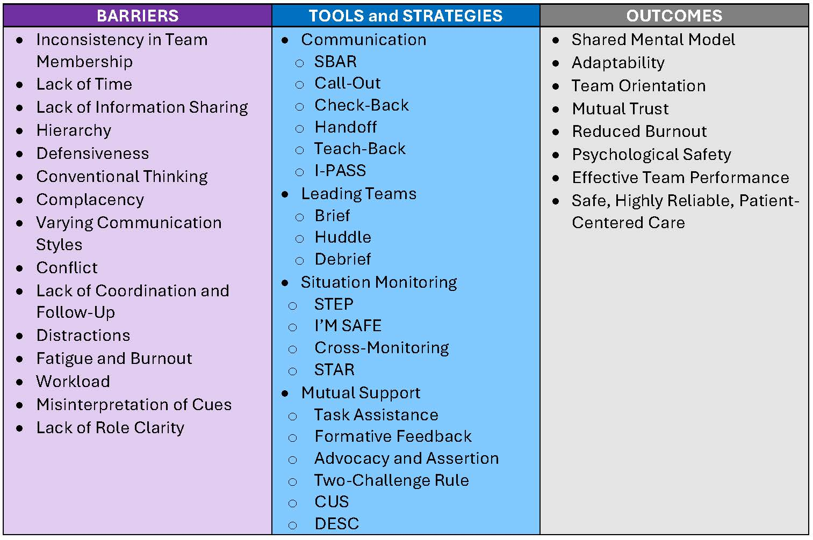
Tools and Strategies Summary
Mutual Support

Slide 23
Applying TeamSTEPPS Exercise
Mutual Support
Is your teamwork issue related to mutual support?
If yes, what is the mutual support issue?
Which mutual support tools or strategies might you consider implementing to address the issue?

