Slide 1

Module 2
Diagnostic Team Structure
TeamSTEPPS® for Diagnosis Improvement
Notes:
Welcome to the TeamSTEPPS for Diagnosis Improvement Course. This presentation will cover Module 2, Diagnostic Team Structure, that you will review as the facilitator.
Individuals who plan to take the course but will not complete it as part of a team should follow the Self-Paced Learner’s Roadmap found on the TeamSTEPPS for Diagnosis Improvement Course web page. The roadmap provides step-by-step instructions to maximize the value of time spent on the course and ways to leverage core principles and tools. Throughout the presenter’s notes, you will also find Self-Paced Learner Tips.
Estimated Time to complete this module: 45 minutes (15 slides)

Slide 2
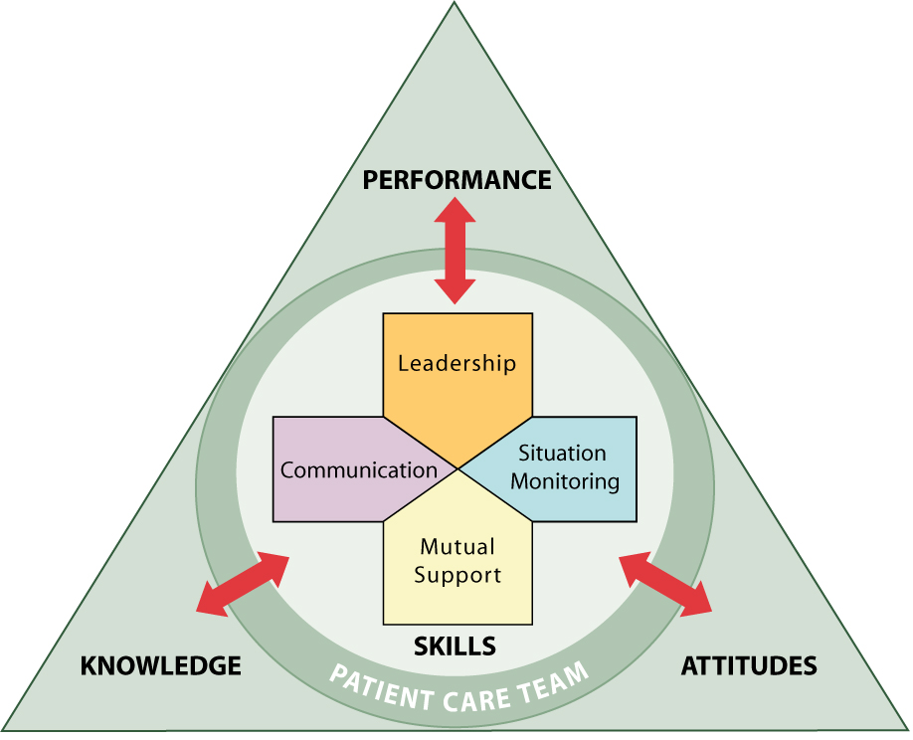
Module 2 Objectives
Define the diagnostic team.
Discuss benefits of teamwork and structure.
Describe behaviors, structures, and processes that affect diagnosis.
Empower all diagnostic team members to be active participants in the patient's diagnostic journey.
Discuss barriers to effective teamwork.
Notes:
After completing this module, participants will be able to:
Define the diagnostic team.
Discuss benefits of teamwork and structure.
Describe behaviors, structures, and processes that affect diagnosis.
Empower all diagnostic team members to be active participants in the patient's diagnostic journey.
Discuss barriers to effective teamwork.

Slide 3
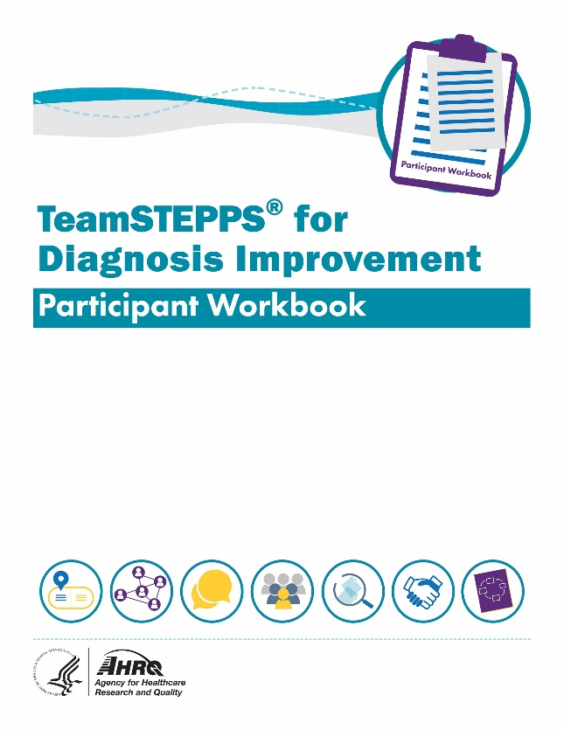
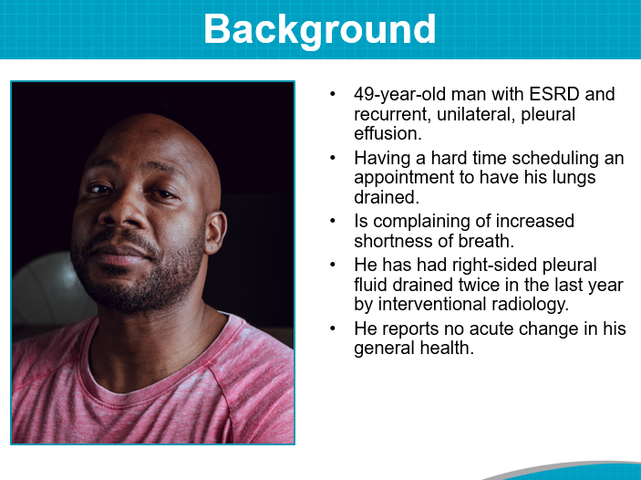
Materials for This Module
Participant Workbook
Team Assessment for Diagnostic Team Structure
What Is My Role in Diagnosis?
Who Is on Our Diagnostic Team?
Mr. Kane: Reflection on Team Structure
The Diagnostic Journey of Mr. Kane
Facilitator’s Guide
Notes:
During this course, the Participant Workbook is the primary tool for learners to complete the course activities, such as exercises, case‐based scenarios, and reflective practices. In addition to engaging with the content, tools, discussion questions, and other activities, participants can use results from these activities to help shape local improvement implementation plans.
A separate Facilitator’s Guide is provided for use by the course facilitator. The guide includes detailed instructions pertaining to the administration and implementation of course activities.
This module will also refer to The Diagnostic Journey of Mr. Kane.

Slide 4
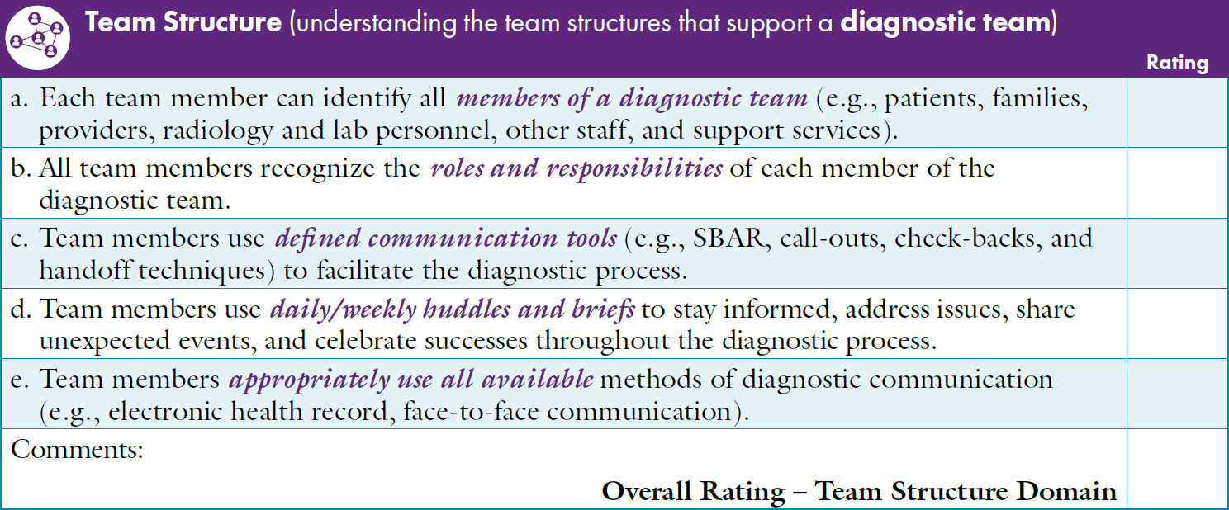

Team Assessment for Diagnostic Team Structure
Notes:
The Participant Workbook includes the Team Assessment Tool for Improving Diagnosis. Participants should have completed the assessment at the beginning of the course after finishing Module 1, Introduction, and the course facilitator should have created an average summary score using the team’s results.
As a team, discuss the scores for each characteristic under the Team Structure dimension. Invite the team to consider the average summary score compared with how they individually ranked the Team Structure characteristics.
How does the average Summary Score on Team Structure compare with the other TeamSTEPPS dimensions (Communication, Leadership, Situation Monitoring, and Mutual Support)?
What are the highest scoring Team Structure characteristics?
What are the lowest scoring Team Structure characteristics?
How do team members at your site rate these characteristics?
After discussing the scores, ask participants to identify together where the site has the most effective Team Structure methods to support improved diagnosis and where the site has opportunities to improve.
[Facilitator’s Tip: You can customize the slide to provide a summary of your site's results. Detailed instructions for completing the Team Assessment can be found in the Facilitator’s Guide.]
[Self-Paced Learner Tip: Take some time to reflect on your results using the same strengths and opportunities for improvement questions above.]

Slide 5
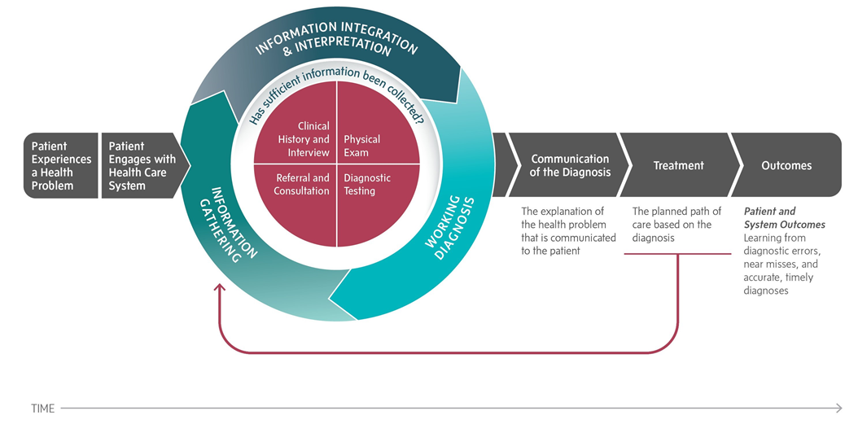
Navigating the Diagnostic Process Together
Notes:
The role of the diagnostic team is to promote collaboration among all the interrelated individuals working toward the goal of establishing and communicating an accurate and timely explanation of a patient's health problem (Salas, Cooke, & Rosen, 2008).
The task of integrating relevant information and communicating a diagnosis to a patient is often the responsibility of an individual clinician. However, the diagnostic process involves and benefits from collaboration among multiple healthcare professionals, the patient, and the patient's family members. Arriving at accurate and timely diagnoses involves teamwork (National Academies of Sciences, Engineering, and Medicine, 2015).
Image Source: National Academy of Medicine conceptualization of the diagnostic process, 2015.

Slide 6

The Diagnostic Team
All members of the diagnostic team play a critical role in the patient’s journey:
Patients and family members
Physicians and other clinical providers
Healthcare professionals who support the diagnostic process
Notes:
A team is a group of people with complementary skills who are committed to a common purpose, set of performance goals, and approach for which they hold themselves mutually accountable (Katzenbach & Smith, 1993). The essence of a team is common commitment, in this case to reach the correct diagnosis in a timely manner.
Teamwork in the diagnostic process involves the collaboration of a clinician with a patient and the patient’s family members, as well as many other healthcare professionals. At times, some members of the diagnostic team may not be aware of their own role or may not see other members as part of the team. Facilitating teamwork among these individuals is critical to avoiding the failures in the healthcare process that lead to diagnostic errors.
Team members must recognize the importance of each team member. For example, a front desk clerk may notice that a patient in the waiting room is becoming confused. The clerk’s quick action as a member of the diagnostic team to ask whether the patient is OK and to alert a provider could prompt recognition of low blood sugar or expedite assessment of an evolving neurologic event. When team members understand they are part of the diagnostic team, it is easier for them to share observations and information they gather that might be important to the diagnosis.

Slide 7


What Is My Role in Diagnosis?
Notes:
Using the Reflective Practice Tool in the Participant Workbook, discuss with participants what their individual roles are as part of the diagnostic team.
ASK: What are MY contributions to the diagnostic team? How and where do I interact and exchange information? How does my communication affect diagnosis?
LISTEN: How do your colleagues describe their roles and contributions to the diagnostic team? Reflect on how you work together.
ACT: How might your understanding of your role within the diagnostic team now change your actions? What might you do individually to contribute to safe diagnostic communication?
[Self-Paced Learners Tip: Take some time to reflect on your role in diagnosis by asking yourself the same questions above.]

Slide 8




Contributions of Diagnostic Team Members
Patient:
“I can provide you with key information if you Ask, Listen, and Act.”
Front Desk Personnel: “The patient’s speech seems slurred compared to when she was here last time.”
Nurse: “The patient was telling me about new pets at home. This could be an explanation for his asthma exacerbation.”
Pharmacist:
“The patient’s low heart rate may be the result of his taking two different beta blockers prescribed by different providers.”
Notes:
It is important for everyone within the diagnostic process to feel like part of the diagnostic team and contribute to improving diagnosis.
Contribution is about recognizing that we all have a role in the process and appreciating each other and ourselves. Take, for example, the patient and family members. How do they contribute to the diagnostic process? Front desk personnel? Clinic nurse? Pharmacist?
Each person has a different role in the diagnostic process and a different perspective to contribute. Even “small” tasks that may seem insignificant can help lead to the correct diagnosis or prevent a diagnostic error.

Slide 9
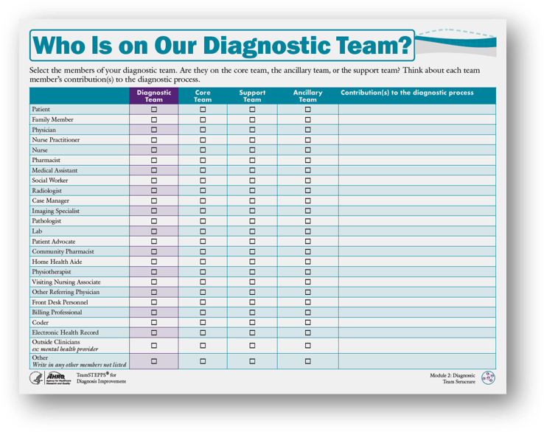
Exercise:
Who Is on Our Diagnostic Team?
Core Team
Support Team
Ancillary Team
Notes:
It is important to understand the types of teams participating in the diagnostic process. Using the instructions in the Facilitator’s Guide and the Participant Workbook, we will discuss Who Is on Our Diagnostic Team. The following is a description of the diagnostic core team, support team, and ancillary team.
The Diagnostic Core Team consists of team leaders and team members involved in direct care of the patient. The Core Team is based on where the patient receives care. The patient and family are a critical part of the Core Team.
Core Teams should be small enough to ensure situation monitoring, development of situation awareness, and direct, unfiltered communication between members. Core Teams should be large enough to include skill overlap between members to allow workload sharing and redistribution when necessary. Every Core Team has a leader who is readily identified by all members of the team.
Core Team leadership is dynamic. Core Team leaders are required to take on different roles at various points in the care plan. Often these may be nonleadership roles, such as supporting medical assistants who help with the physical exam.
The Diagnostic Support Team is the group responsible for day‐to‐day diagnostic process management and coordination functions in support of the Core Team. Direct patient care may be a secondary function for the Support Team. Support Teams frequently include experienced personnel with a strong clinical background. This combination enhances the ability of the Support Team members to rapidly assess the overall picture, anticipate needs or potential needs between and across teams, and make priority‐based decisions.
The Ancillary Diagnostic Team is primarily a service‐focused team whose mission is to create efficient, safe, comfortable, and clean healthcare environments, which affect the patient care team, market perception, operational efficiency, and patient safety.
Most important, everyone who touches the patient plays a role on the diagnostic team.
[Self-Paced Learners Tip: Using this checklist, reflect on who all of the members of the diagnostic team are and how they connect to your role.]
(TeamSTEPPS Fundamentals Course: Module 2. Team Structure, 2014)

Slide 10
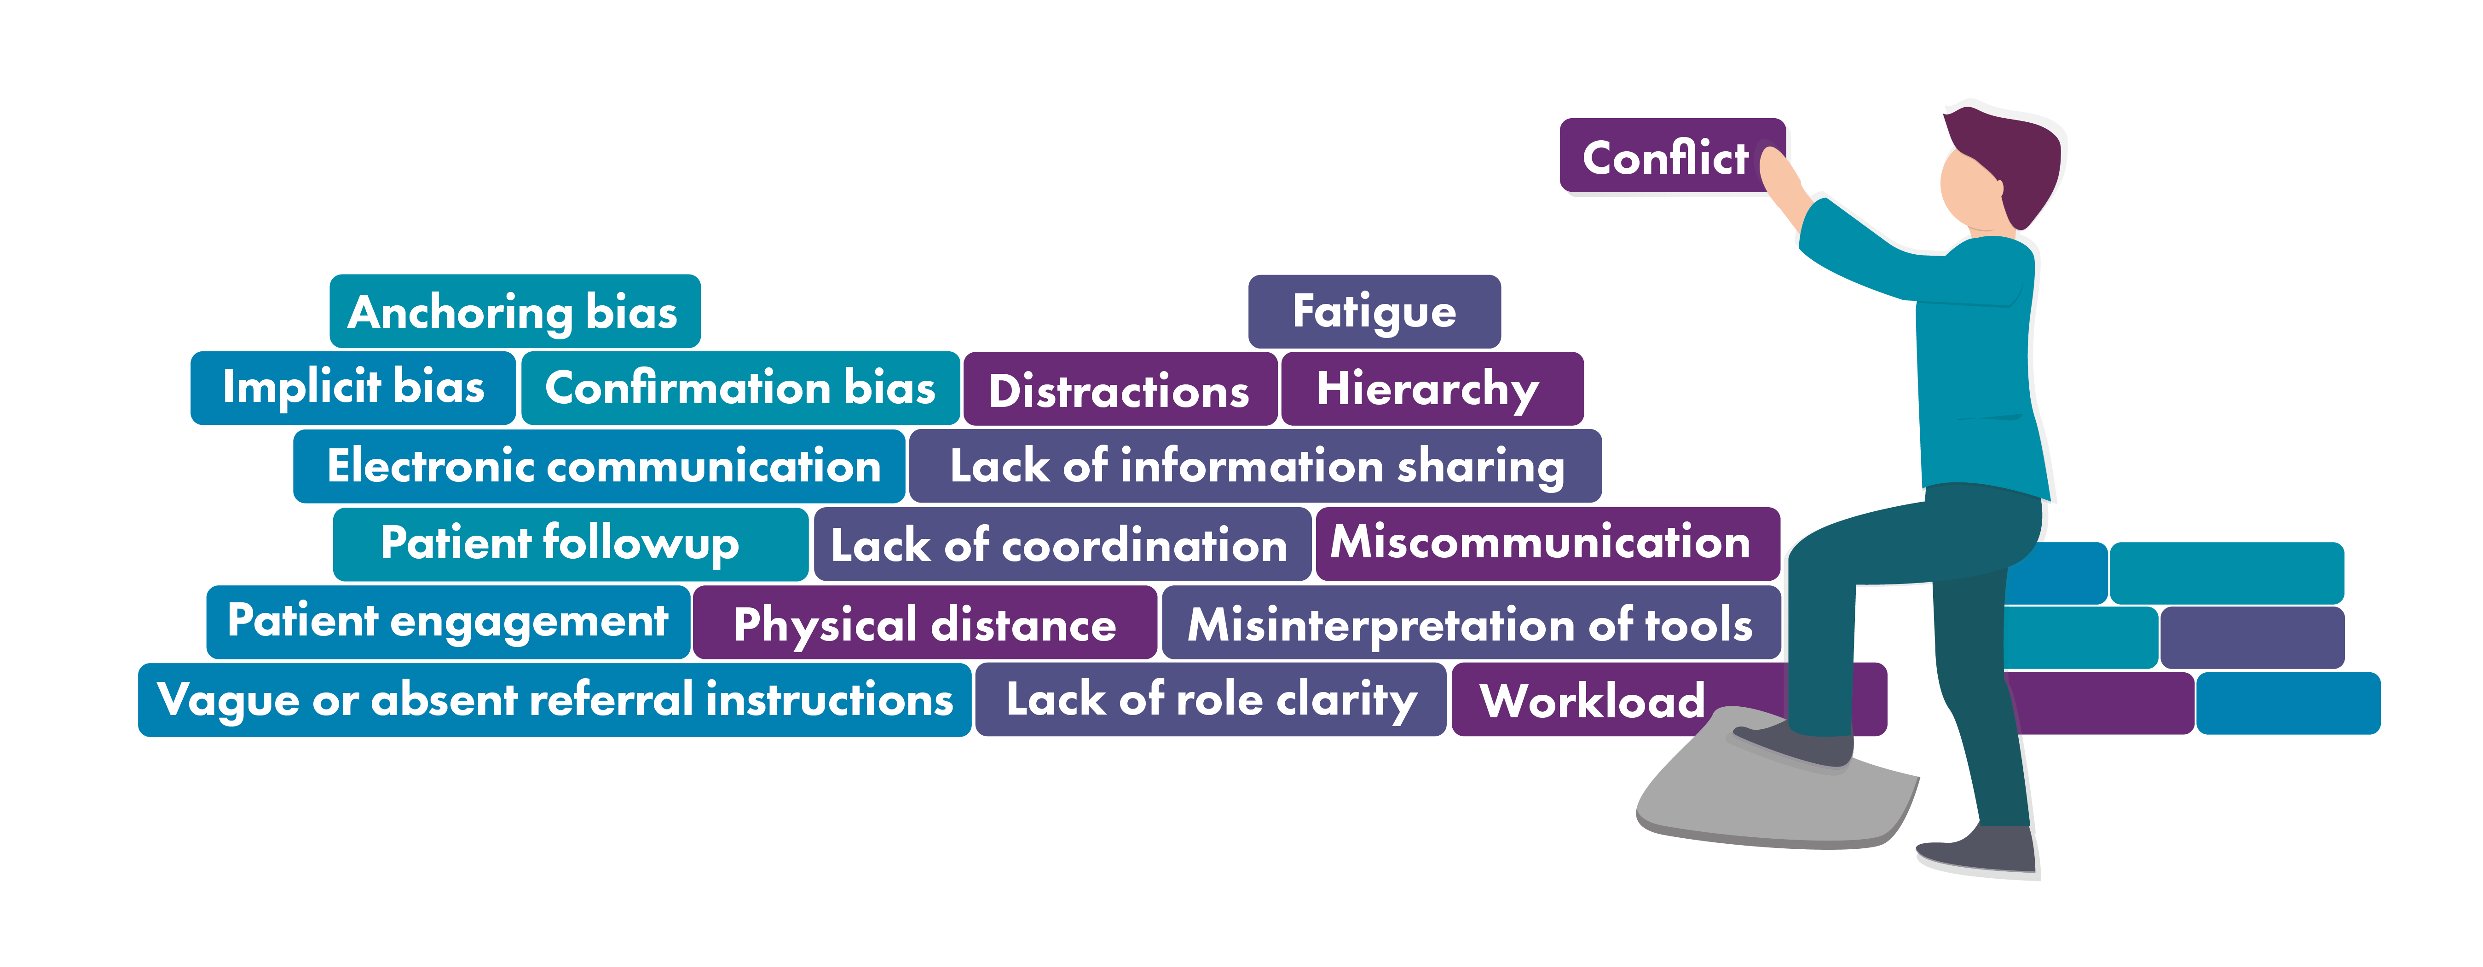
Obstacles to High-Functioning
Diagnostic Teams
Notes:
Teamwork can be hindered by various interpersonal or work-related obstacles that arise in the work environment. Identifying these obstacles will help teams choose effective tools and strategies to optimize teamwork.
Obstacles can include conflict among team members, lack of coordination, distraction, fatigue, lack of role definition, miscommunication, physical distance between team members, and ineffective or incomplete sharing of information (TeamSTEPPS for Office‐Based Care: Team Structure, 2015).
Diagnosis is especially vulnerable to communication breakdowns within the team. These can be breakdowns in communication with the patient, such as not engaging the patient and family members or being unclear on expectations for patients and families on when to follow up, what to do next, or what symptoms might suggest a treatment failure. Other team communication breakdowns within the team can include missed diagnostic tests, missed electronically communicated test results, or vague or absent referral instructions (Singh, Giardina, & Meyer, 2013).
Dangers to good team communication include:
Lack of role clarity: Some members of the team may not have a clearly defined role or may not be aware of their role. Ask participants to reflect on the Diagnostic Team Checklist that they completed as an exercise. Does everyone on that list consider themselves part of the team? Do they know their role in the process? Do they know whom to raise issues to when they see a problem?
Physical distance of team members: Some members of the diagnostic team, such as consulting physicians or members of the diagnostic testing team, may not be in the same location that care is happening. Some might be in an office setting and others in different states or regions of the country. Discuss with participants how they engage in virtual communication and teamwork. Do they have the technology to work as a team? Ask them to consider breakdowns in test results and referrals within their own practice. How might each team member play a role (in the past or in the future) to help mitigate these issues to improve diagnosis?
(TeamSTEPPS for Office-Based Care: Team Structure, 2015)

Slide 11
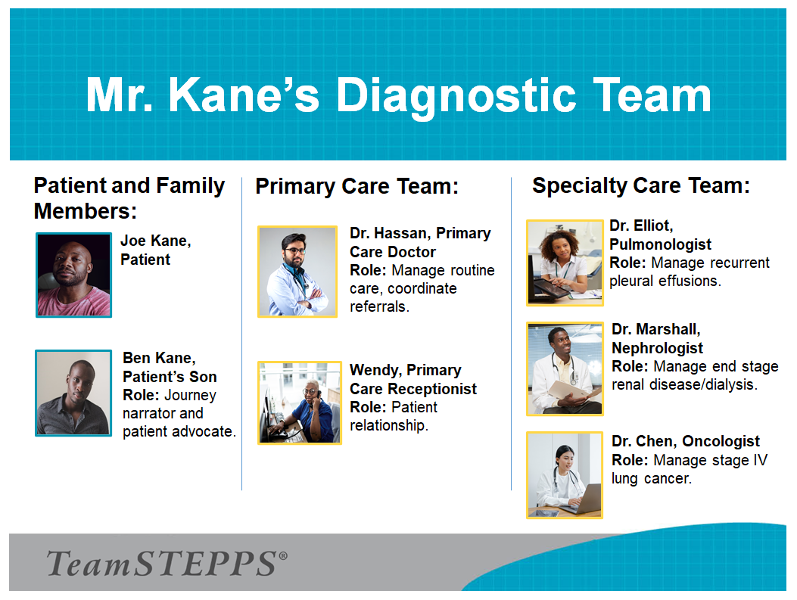
Mr. Kane: Reflection on Team Structure
Notes:
One of the key goals of reflection is to consider the impact of explicit (cognitive) or implicit (affective, emotional) bias. Bias is unbalanced weight in favor of or against an idea or thing, usually in a way that is closed‐minded, prejudicial, or unfair. Specific forms of bias include:
Anchoring bias, which is the tendency to rely too heavily on the very first piece of information you learn.
Confirmation bias, which is favoring information that conforms to your existing beliefs and discounting evidence that does not conform.
Implicit bias, which refers to the brain’s automatic, instant association of stereotypes or attitudes toward particular groups, often without your conscious awareness.
Review The Diagnostic Journey of Mr. Kane with participants and discuss the following questions from the Participant Workbook:
What elements of Mr. Kane’s journey demonstrated good team behavior?
Did you see opportunities for better ways the team could support diagnosis? If yes, what were they?
How might those methods become common practice?
What tools might be useful to achieve improved support?
What type of biases may have affected Mr. Kane’s diagnostic journey?
Describe ways to overcome those biases.
[Self-Paced Learners Tip: Take some time to reflect on the Diagnostic Journey of Mr. Kane by asking yourself the same questions.]

Slide 12


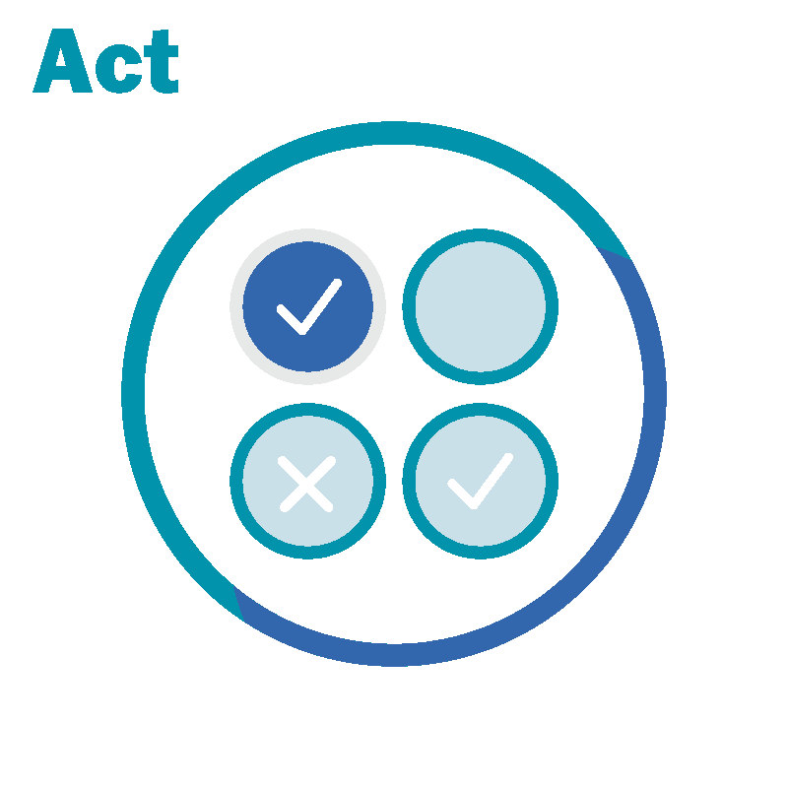
Module 2 Reflection
Ask yourself, what is my role in helping achieve a safe diagnosis?
Listen to your team and their unique perspectives.
Act in ways that can contribute to the diagnostic process.
Notes:
Encourage participants to practice the following reflective practice questions in considering their roles on the diagnostic team:
ASK: (yourself) what is my role in helping achieve a safe diagnosis?
LISTEN: to your team and their unique perspectives.
ACT: in ways that can contribute to the diagnostic process. Point out information that might be missing, try to detect cognitive or affective bias, look for facts that do not fit, and think about what else it could be.
Remind participants that if they see something (unusual), they should say something.

Slide 13
Module 2 Summary
Diagnostic teams are diverse.
Team structure and team behavior may affect diagnosis.
Empowering diagnostic team members to be active participants in the process improves the patient's diagnostic journey.
Identifying various interpersonal or work-related obstacles can help teams choose effective tools and strategies to optimize teamwork.
Notes:
In this module, participants learned that:
Diagnostic teams are diverse.
Team structure and team behavior may affect diagnosis (e.g., other team members may be able to provide valuable input when there is lack of clarity about specific issues regarding the patient).
Empowering diagnostic team members to be active participants in the process improves the patient's diagnostic journey.
Identifying various interpersonal or work-related obstacles can help teams choose effective tools and strategies to optimize teamwork.

Slide 14







Course Modules
Module 1: Introduction
Module 2:
Diagnostic Team Structure
Module 3: Communication
Module 4: Leadership
Module 5: Situation Monitoring
Module 6: Mutual Support
Module 7: Putting It All Together
Notes:
TeamSTEPPS for Diagnosis Improvement has seven modules dedicated to improving diagnostic communication and teamwork. Communication strategies and tools to overcome some of the breakdowns in teamwork and team communication are available in each module and the accompanying Participant Workbook.
The TeamSTEPPS for Diagnosis Improvement modules are:
Introduction.
Diagnostic Team Structure.
Communication.
Leadership.
Situation Monitoring.
Mutual Support.
Putting It All Together.

Slide 15
Module 2 References
Katzenbach JR, Smith DK. The discipline of teams. Harv Bus Rev. 1993 Mar- Apr;71(2):111-20. PMID: 10124632.
National Academies of Sciences, Engineering, and Medicine. Improving Diagnosis in Health Care. Balogh EP, Miller BT, Ball JR, eds. Washington, DC: The National Academies Press; 2015. https://www.ncbi.nlm.nih.gov/books/NBK338596/. Accessed January 12, 2022.
Salas E, Cooke NJ, Rosen MA. On teams, teamwork, and team performance: discoveries and developments. Hum Factors. 2008 Jun;50(3):540-7. https://pubmed.ncbi.nlm.nih.gov/18689065/. Accessed January 12, 2022.
Singh H, Giardina TD, Meyer AN, Forjuoh SN, Reis MD, Thomas EJ. Types and origins of diagnostic errors in primary care settings. JAMA Intern Med. 2013 Mar 25;173(6):418-25. https://www.ncbi.nlm.nih.gov/pmc/articles/PMC3690001/. . Accessed January 12, 2022.
TeamSTEPPS Fundamentals Course: Module 2. Team Structure. Content last reviewed March 2014. Rockville, MD: Agency for Healthcare Research and Quality. https://www.ahrq.gov/teamstepps/instructor/fundamentals/module2/igteamstruct.html. Accessed January 12, 2022.
TeamSTEPPS for Office-Based Care: Team Structure. Content last reviewed September 2015. Rockville, MD: Agency for Healthcare Research and Quality. https://www.ahrq.gov/teamstepps/officebasedcare/module2/office_structure-ig.html. Accessed January 12, 2022.
Notes:
The following are the list of references from this module.

