Slide 1

Module 3
Communication To Improve Diagnosis
TeamSTEPPS® for Diagnosis Improvement
Notes:
Welcome to the TeamSTEPPS for Diagnosis Improvement Course. This presentation will cover Module 3, Communication To Improve Diagnosis, that you will review as the facilitator.
Individuals who plan to take the course but will not complete it as part of a team should follow the Self-Paced Learner’s Roadmap found on the TeamSTEPPS for Diagnosis Improvement Course web page. The roadmap provides step-by-step instructions to maximize the value of time spent on the course and ways to leverage core principles and tools. Throughout the presenter’s notes, you will also find Self-Paced Learner Tips.
Estimated Time to complete this module: 30 minutes (18 slides)

Slide 2
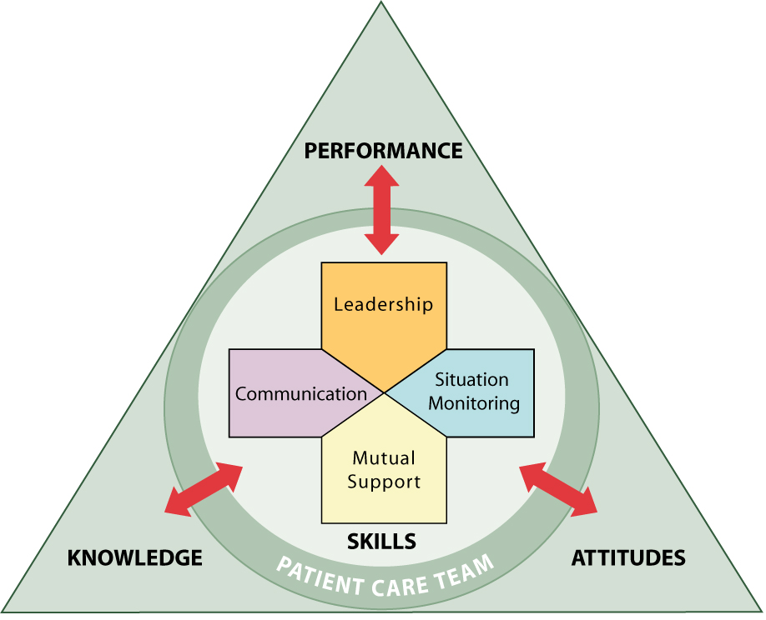
Module 3 Objectives
Define what makes communication effective for diagnosis.
Describe structured communication methods that can increase diagnostic safety.
Describe diagnostic uncertainty and strategies for communicating uncertainty.
Notes:
After completing this module, participants will be able to:
Define what makes communication effective for diagnosis.
Describe structured communication methods that can increase diagnostic safety.
Describe diagnostic uncertainty and strategies for communicating uncertainty.

Slide 3
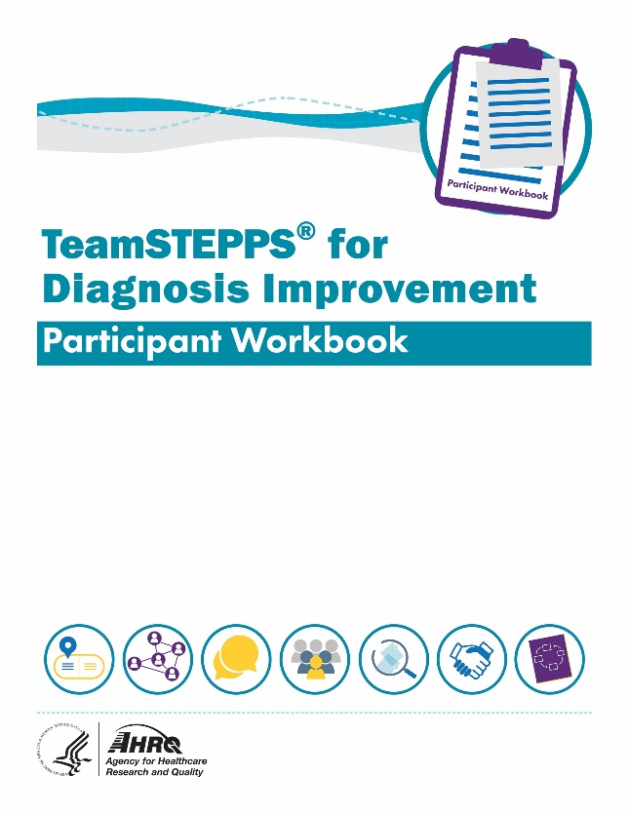
Materials for This Module
Participant Workbook
Team Assessment for Communication
Diagnostic-Focused Referral Form
Communication With Patients: Sample SBAR
Be The Expert On You Patient Note Sheet
Facilitator’s Guide
Notes:
During this course, the Participant Workbook is the primary tool for learners to complete the course activities, such as exercises, case‐based scenarios, and reflective practices. In addition to engaging with the content, tools, discussion questions, and other activities, participants can use results from these activities to help shape local improvement implementation plans.
A separate Facilitator’s Guide is provided for use by the course facilitator. The guide includes detailed instructions pertaining to the administration and implementation of course activities.

Slide 4
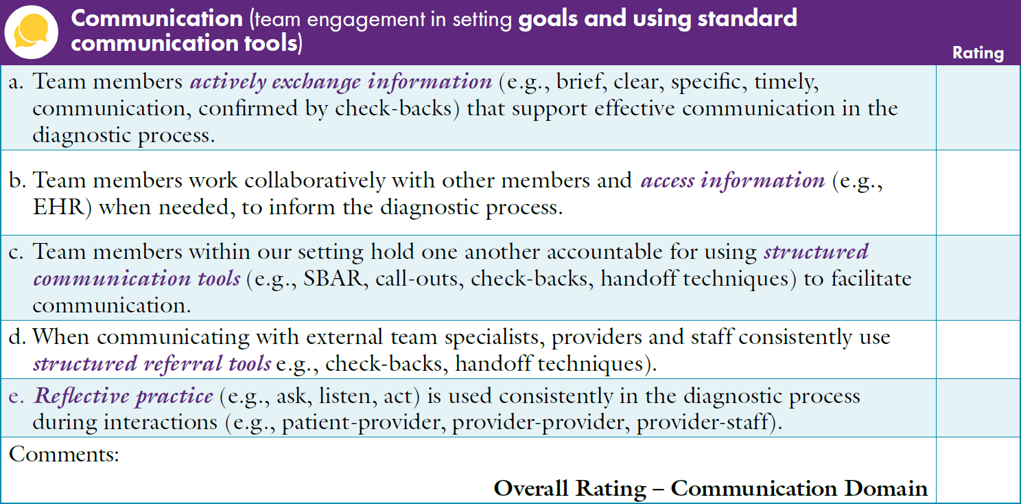

Team Assessment for Communication To Improve Diagnosis
Notes:
The Participant Workbook includes the Team Assessment Tool for Improving Diagnosis. Participants should have completed the assessment at the beginning of the course after finishing Module 1, Introduction, and the course facilitator should have created an average summary score using the team’s results.
As a team, discuss the scores for each characteristic under the Communication dimension. Invite the team to consider the average summary score compared with how they individually ranked Communication characteristics.
How does the average Summary Score on Communication compare with the other TeamSTEPPS dimensions (Team Structure, Leadership, Situation Monitoring, and Mutual Support)?
What are the highest scoring Communication characteristics?
What are the lowest scoring Communication characteristics?
How do team members at your site rate these characteristics?
After discussing the scores, ask participants to identify together where the site has the most effective Communication methods to support improved diagnosis and where the site has opportunities to improve.
[Facilitator’s Tip: You can customize the slide to provide a summary of your site's results. Detailed instructions for completing the Team Assessment can be found in the Facilitator’s Guide.]
[Self-Paced Learner Tip: Take some time to reflect on your results using the same strengths and opportunities for improvement questions above.]

Slide 5



Why Communication?
Nearly 79% of all breakdowns in the diagnostic process occur during the patient-practitioner encounter.
About 35% of breakdowns in the diagnostic process are attributed to referrals or followup of diagnostic information.
Because of these breakdowns, 1 out of every 3 people has firsthand experience of diagnostic error.
References:
Singh, Giardina, Meyer, et al., 2013.
Society to Improve Diagnosis in Medicine, 2020.
Notes:
Effective communication with patients and their family members is extremely important in the diagnostic process. According to the literature, effective communication skills are associated with stronger patient-doctor relationships, greater patient satisfaction, and better patient adherence to medical treatments and their care plan (Ha & Longnecker, 2010).
Reaching the correct diagnosis starts with obtaining a complete medical history, and the history is the most important element of the diagnostic process; the diagnosis can be made accurately from the history alone in many patients. While intuitively we know that the patient’s history is important, evidence suggests that clinicians interrupt patients within 11 to 18 seconds of their beginning to share the history of their present illness, their story (Singh Ospina, Phillips, Rodriguez‐Gutierrez, et al., 2018; Phillips & Singh Ospina, 2017).
These interruptions may result in a breakdown in communication, leading patients to feel unheard and uncared for or rushed. They may feel their thoughts and perspectives on their health are unimportant and irrelevant to the care team. If patients do not share their full story, clinicians may be left without key information about the patients’ illness trajectory and contributing factors, which in turn may lead to premature closure and the wrong diagnosis.
We need effective interventions to overcome communication breakdowns in clinician‐patient encounters. One intervention that can be effective in improving patient history taking is giving patients the first full minute of each clinic visit to tell their illness story.

Slide 6
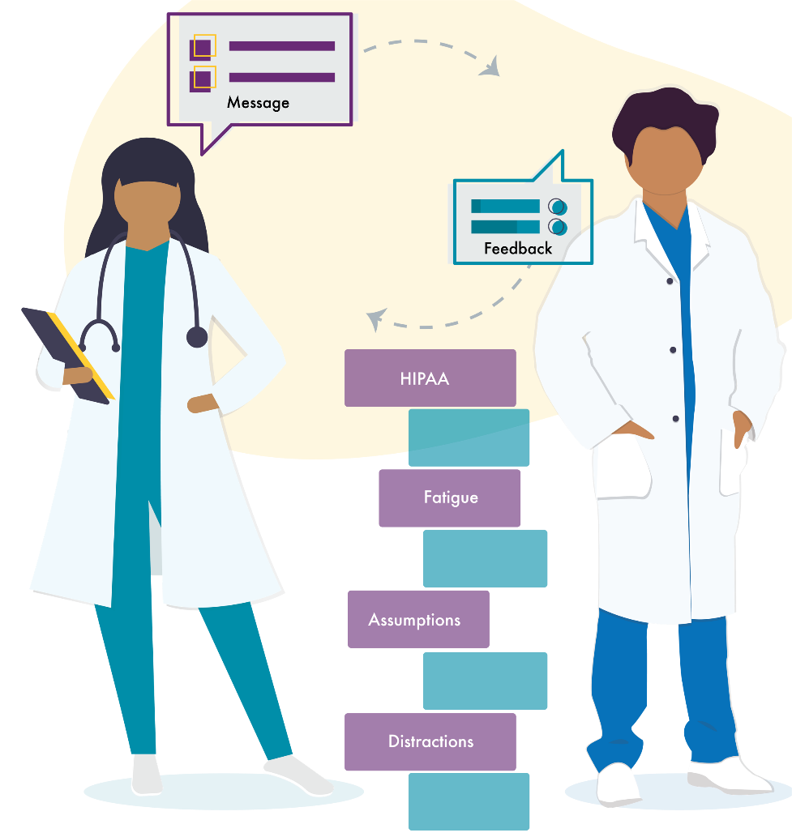
Considerations for Diagnostic Communication
Audience
Mode of communication
Standards associated with the specific mode of communication
Power of nonverbal communication
Notes:
Some things to consider when communicating during the diagnostic process include:
The audience: How might an interaction with the receptionist be different from that with a clinician or colleague? Consider patient/family cultural norms and the potential for language barriers.
The mode of communication: How do communication standards change between verbal vs. nonverbal, written, or email communication? For example, nonverbal communication requires verbal clarification to avoid making assumptions that can lead to error. The simple rule is, when in doubt, check it out. Offer information or ask a question.
The power of nonverbal communication: Eye contact and body language during a conversation are signals that can be picked up. For example, nonverbal cues, such as eye contact between a physician and a medical assistant when looking at an ECG, may convey concern that might lead to specific actions.
Common nonverbal cues by patients may communicate pain during a physical exam or confusion during instructions for followup. Although powerful, nonverbal communication is not an acceptable mode to verify, validate, or acknowledge information. For safety to exist, the information must be verified orally or in writing.

Slide 7
Standards for Effective Communication
Complete
Communicate all relevant information.
Clear
Convey information in plain language.
Brief
Timely
Communicate information in a concise manner.
Offer and request information in an appropriate timeframe.
Notes:
When sharing information with the diagnostic team, which may include other clinicians, staff, patients, or family members, communication must meet four standards to be effective.
It must be complete, clear, brief, and timely.
To ensure communication is complete, communicate all relevant information and avoid unnecessary details that may lead to confusion. Leave enough time for questions, and answer questions thoroughly.
Clear communication uses language that is easily understood. When communicating with patients and their families, use lay terms. When communicating with team members, use standard healthcare terms and verify that the message was understood.
Communication should be brief. Communicate information as concisely as possible without compromising accuracy or completeness.
Timely communication means all necessary information is conveyed as soon as possible, to those who need it for purposes of understanding and decision making. Offer and request information in an appropriate timeframe.

Slide 8
Structured Communication
Situation
Background
Assessment
Recommendation or Requests
What is going on with the patient?
What is the clinical background and context?
What do I think the problem is?
What would I recommend?
What do I need from you?
Notes:
Structured communication tools are useful to enhance effective communication between members of the diagnostic team.
Approximately 79 percent of diagnostic errors within practices occur during the patient‐practitioner encounter. Therefore, structured tools to enhance communication between caregivers during referrals and clinic consults and with patients and their families when delivering a diagnosis, are crucial to avoiding pitfalls in the diagnostic process (Singh, Giardina, Meyer, et al., 2013).
SBAR, which stands for Situation, Background, Assessment, and Recommendation (or Requests), is a structured communication framework that can help teams share information about a diagnosis or the diagnostic process. It is a good approach for communicating concerns among the clinician members of the diagnostic team. SBAR is useful for framing any conversation, especially critical ones, requiring a clinician’s immediate attention and action, such as when a patient’s condition is recognized as rapidly deteriorating. It may also be especially useful with providers who are not part of the local team, such as remote consultants or mental health providers.
The SBAR format is an approach for individuals to share information in a clear and concise manner OR to speak up and express concern.
Situation: what is happening with the patient?
Background: what is the clinical background or context?
Assessment: what do I think the problem is?
Recommendation: what would I recommend? What do I need from you?
Different team members may have different approaches to using SBAR in communicating with patients, with the local team, and with remote consultants.
[Facilitator’s Tip: To learn more about SBAR and watch a video demonstrating the SBAR technique, visit the AHRQ TeamSTEPPS® website [SBAR Tool: https://www.ahrq.gov/patient-safety/settings/long-term-care/resource/facilities/ltc/mod2sess2.html; video: https://www.ahrq.gov/teamstepps/instructor/videos/ts_SBAR_NurseToPhysician/SBAR_NurseToPhysician-400-300.html]. Additional structured communication tools and resources are also included in the Facilitator's Guide.]
(TeamSTEPPS Fundamentals Course: Module 3. Communication, 2019)
(TeamSTEPPS for Office‐Based Care: Communication, 2015)

Slide 9
SBAR and Reflective Practice
Assessment
Repeat Back
Recommendation
Request
Identify patient, age, gender, problem, history, and results of recent interventions.
Assess other possibilities and consider worst scenario.
What INFORMATION would help?
What are the next STEPS?
Situation &
Background
What do I KNOW?
What are the ALTERNATIVES?
Seek signs, symptoms of presenting complaint, and lab and imaging results.
What are the CONSEQUENCEs?
Assess consequences of the situation to consider alternatives.
Obtain clarity on actions to take, assessment plan, urgency, and communication to patient and family.
Seek patient and family perspective.
Notes:
An effective SBAR begins with reflection on the patient situation and reason for the visit in light of past history and therapeutic treatments, to consider what is new or different. SBAR can be used to communicate a quickly deteriorating situation as well as to organize information for a patient handoff from one provider to another. Here, SBAR is presented in a way that guides diagnostic reflection.
Situation states what is happening with the patient. It usually begins with the identity of the person communicating the SBAR, patient identifiers such as age and gender, and a brief statement of the current problem or situation.
Background covers clinical background such as patient history, signs and symptoms of the presenting complaint, and any test results, such as lab or imaging reports.
Assessment reports what the person communicating the SBAR thinks the problem is. It states what the nurse or other provider has assessed based on the background information, patient history, and observations. Assessment asks what else it can be, provides sense making, considers sources of other information to provide clarity, and relates actions to consequences.
Repeat Back Recommendations and Requests states an initial recommendation, what is needed and when, and repeats back the stated response from the other provider or patient to ensure accuracy.
Communication is complex. The message sent and the message received may not match. Reflecting on the patient and the situation using SBAR clarifies what is known based on the presenting information, background, history, and assessments, ending with the recommendation for action. Repeating back the plan puts all providers and the patient on the same page.

Slide 10
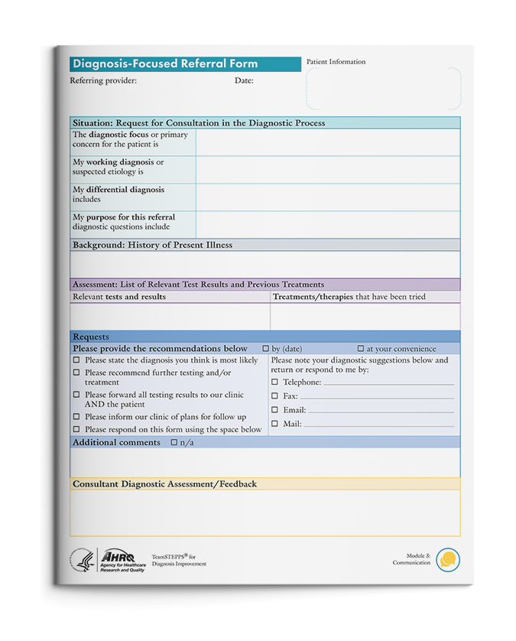
A Diagnosis-Focused Referral
Remember SBAR
Situation
Background
Assessment
Recommendations and Requests
Notes:
SBAR can be applied in several ways that are specific to diagnosis to overcome pitfalls in the diagnostic process. For this module, we will apply SBAR to frame the need for a diagnostic referral.
Steps in the diagnostic process often include referrals – referring patients directly to other clinicians for a second physical assessment and workup or facilitating clinician-to-clinician consultation. Clinician-to-clinician consultations are often sought between specialists and general practitioners to discuss interpretation of existing test results and physical exam findings, to consider additional tests and procedures that may be appropriate, and to review potential diagnoses.
Based on specific recommendations from patient experts, AHRQ has developed a new tool, the Diagnostic-Focused Referral Form. The tool can be used to facilitate provider and patient alignment on the reasons for a diagnosis-focused referral and expected outcomes from the referral. It helps structure communication from the referring provider to the consulting provider in a way that specifically elicits information to aid in diagnostic reasoning. The referral form follows the general structured communication principles of SBAR and was designed with input from patients to be patient friendly.
The Situation section is used to describe for the consultant why the referring provider is sending the patient to see them, to share the working diagnosis, and to delineate possible alternative diagnoses. In addition, it allows the referring provider to ask for input on reasoning, what may have been missed, or what working diagnoses they would consider given the case details and copies of electronic health records.
The Background section is used to provide a short summary of the history of present illness, signs and symptoms the patient is presenting, and all pertinent health history that contributed to the working diagnosis. For example, therapies or treatments independently tried by the patient (e.g., rest, ice, ibuprofen) or prescribed by the referring provider or another licensed independent practitioner (e.g., physical therapy) should be included.
The Assessment section is used to list any relevant test results in addition to intuitive sense given the patient’s physical and social‐emotional condition and the referring provider’s previous experience with similar cases.
The Requests section is used to define the preferred timeline for completion of the consultation, to list other information (if any) sought from the consultant, and to delineate how the referring provider would like to be contacted to discuss the consultation.
Similarly, providers may use this tool to communicate with patients about next steps in their treatment plan.
The Participant Workbook has two examples of the “Diagnostic‐Focused Referral Form” and a blank copy of the form. Review the form and the examples with the course participants, and discuss the following:
When and how could this referral process, tool, or approach be implemented or integrated into our workflow?
When would it be most helpful and for what patients should we use this process?
How might the form be used to address breakdowns in the diagnostic referral process?
Can you provide an example of when use of the diagnosis-focused referral process would be a challenge or problem?
How might the challenge be mitigated by using the four TeamSTEPPS principles?
Team Structure
Communication
Leadership
Situation Monitoring

Slide 11

Communicating Uncertainty
Uncertainty
Probability
Notes:
Diagnosing human illness is difficult. Roughly 200 symptoms have been seen, but over 10,000 diseases, and each patient is unique. Sir William Osler, who is considered the father of modern medicine, was reported to have said in 1909 that “Medicine is a science of uncertainty and an art of probability” (Osler, Bean, & Bean, 1950). It is this act of balancing uncertainty and probability that makes confirming a diagnosis a challenging, complex, and iterative process. One of the key challenges is how to effectively maintain a therapeutic and trusting patient‐clinician relationship when a diagnosis is elusive.
Studies suggest that when communicating diagnostic uncertainty to patients, it is important to weigh the diagnostic accuracy and the diagnostic certainty and share your understanding clearly and concisely. This transparency helps patients understand the need for followup, the importance of timely completion of diagnostic tests or procedures, and the potential need to see additional providers (Meyer, Giardina, Khanna, et al., 2020). Providers should also consider:
Patient (or parent) characteristics, including education, socioeconomic status, emotional response, and culture.
Strength of the patient‐clinician relationship.
Content of the communication, including setting expectations, explaining the diagnostic process, discussing relevant differential diagnoses or alternative diagnoses, and providing reassurance.
When discussing diagnostic uncertainty, complete, clear, brief, and timely communication is key. Simple active listening skills, such as making eye contact, listening without interruption, using plain language, and prioritizing what needs to be discussed, can enhance clarity of communication and strengthen the patient‐clinician relationship.

Slide 12
Communicating With Patients: Sample SBAR
 | Desired Message | Starter Phrases
Situation | Confirm understanding of the symptoms. | “I am glad you came to the clinic. I want to confirm my understanding of your symptoms…[list symptoms]. Is there something I missed?”
Background | Acknowledge the impact of the symptoms. | “From what you have explained, your symptoms are affecting you…[describe how symptoms are affecting the patient]. Is there anything else I should know?”
Assessment | State your initial thinking about the working diagnosis. | “My initial thinking is that your symptoms are consistent with XXX [name the diagnosis].”
 | Note uncertainty about the diagnosis. | “I believe that something is going on, but I do not yet know what it is” “You have some symptoms that are not typical of this diagnosis and we need to follow them up.”
 | Invite patient’s concerns. | “What is most concerning for you about the initial diagnosis?”
Recommendations and Requests | What should the patient do next? | “I would like you to have some additional tests.” “I would like to have you seen by a [consulting clinician] to help us get to the bottom of this.
 | How will doing this next step affect the diagnosis? | “This test/consult will allow us to start to pinpoint the cause of your symptoms and help us achieve the diagnosis.”
 | What should the patient expect from any treatment or test? | “I would like you to have the test/start this treatment.” “You should complete the test within 2 weeks and come back to see me so we can talk about the results and any next steps.”
 | When should the patient followup? | “If you experience X or Y new symptoms, please come back in or call the office.”
Notes:
When a clinician communicates with a patient about a diagnosis, things can sometimes be misunderstood. The way information is communicated can be as important as the information itself, and the message received (the impact) is not always the same as the message sent (the intent). Differences between intent and impact are not uncommon in human interaction. To achieve the desired impact, it is important to think about the intent and align it with the phrases used.
The Participant Workbook has an SBAR example for communicating with patients. Highlight to participants that all of the questions are open ended and acknowledge the patient’s experience.

Slide 13


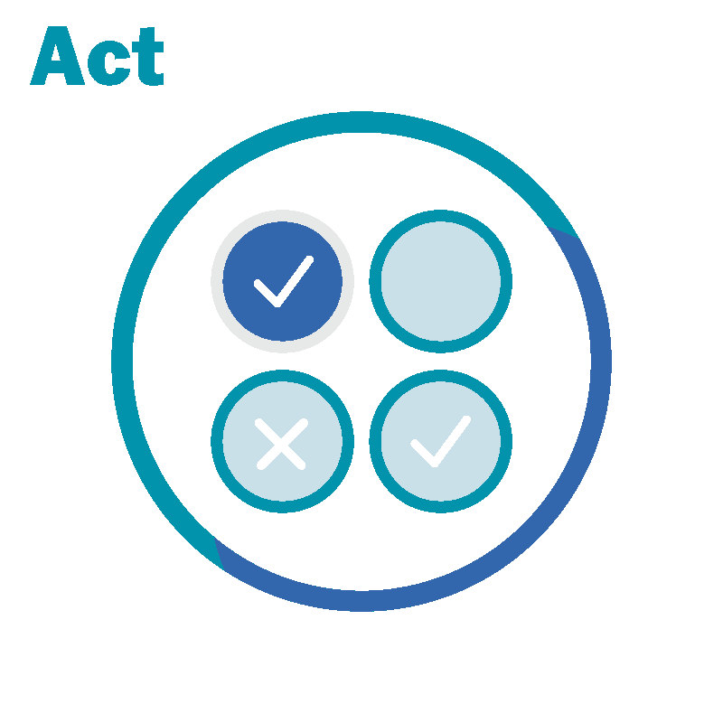
Communicating Diagnostic Uncertainty With Patients
Acknowledge uncertainty.
Ask for emotional reaction.
Listen and respond empathetically.
Discuss next steps and actions.
Notes:
Ask, Listen, Act can be useful in communicating diagnostic uncertainty with patients.
Explicitly acknowledge uncertainty of the clinical situation, but list a differential diagnosis, including the current most likely diagnosis; avoid euphemisms. “I’m sorry to tell you that it’s not clear what’s causing your chest pain.”
ASK: for the emotional reaction of the patient/family in the face of this uncertainty. “Hearing about uncertainty can bring up different feelings for many people. I’d like to hear about yours.”
LISTEN: and respond using empathy; convey a therapeutic alliance; mirror shared goals with the patient. “I am hearing your frustration about the lack of clarity, and I share your desire to do what is necessary to figure things out.”
ACT: Discuss next steps for how you may work together to continue to understand the patient’s problem, using absolute risks and balanced framing (e.g., X out of 100 patients like you… and 100 − X will not) if they are available, and a clear followup plan. “I will refer you for some additional testing. I can say that for every 100 patients that come in with symptoms like yours, only 15 of them turn out to have heart problems, while most, the other 85, turn out to have less serious problems, such as indigestion or muscular pain.”
“We’ll do everything we can to figure out if you are in the first group with heart problems, or the second group with something less serious. Please try to get the test scheduled within the next 2 weeks. I need to see you again no later than 2 weeks after your test to discuss the results and plan our next steps. If the test results show that I need to see you sooner than that, we will call you.”
The “teach‐back” method, which is described on the next slide, can also be used to make sure the healthcare provider explains the information clearly and the patient understands next steps.

Slide 14
What Is “Teach-Back?”
Ask patients or family members to explain in their own words what they need to know or do.
Teach-back can be used when you explain:
  A new diagnosis.
  Next steps for followup testing.
  Recommended behavior changes.
  Treatment options.
  Treatment plan.
“I want to make sure we are on the same page. Can you tell me…”
Notes:
Teach-back is an evidence-based health literacy intervention that promotes patient engagement, patient safety, adherence, and quality. With teach-back, you ask patients or family members to explain in their own words what they need to know or do. You ask them to teach it back to you.
Teach-back is a way to confirm that you have explained information clearly and that patients or family members have a clear understanding of what you have told them.
When you ask patients, “Do you understand?” they generally nod their heads, whether or not they understand. Sometimes they think they understand, and sometimes they are embarrassed to admit they are confused. The only way to know for sure that they understand is to hear them teach the information back to you in their own words.
Teach-back can be used when you explain:
A new diagnosis.
Next steps for followup testing.
Recommended behavior changes.
Treatment options.
Treatment plan.
Teach-back may take longer initially as you learn to adopt it into your standard workflow. Until it begins to come easy to you, you may want to focus on a specific population. For example:
Patients with a specific chronic condition, such as asthma or diabetes.
First and last patient of the day.
Patients with a new medication.
Situations with a lot of people in the room to clarify concepts in a potentially chaotic environment and to involve family members.
(TeamSTEPPS Fundamentals Course: Module 3. Communication, 2019)
(TeamSTEPPS for Office‐Based Care: Communication, 2015)

Slide 15
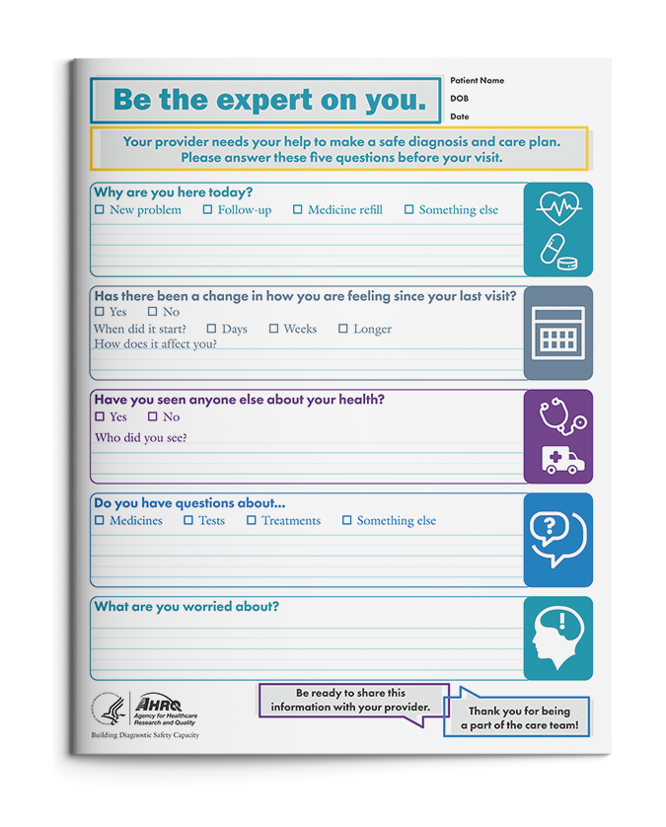
Facilitating Communication With Patients in the Diagnostic Process
What can patients do?
“Be the expert on you”
What can providers do?
Give patients 1 minute to share their story.
Confirm your understanding of the symptoms.
Acknowledge the patient’s experience.
State your working diagnosis.
Communicate uncertainty.
Invite the patient’s concerns.
Provide clear recommendations and instructions for followup/further testing.
Notes:
AHRQ has created a resource – the “Be the Expert on You” patient note sheet. The goal of the patient note sheet is to facilitate communication in the diagnostic process by helping patients share their story and helping clinicians receive the full story of the patient's health problem.
The tool encourages patients to prepare for their appointments by writing down their symptoms, when those symptoms started, treatments that have been tried, and anything that is worrying them. While patients are sharing their story, providers can use skills in reflective practice to help integrate the patients’ health information into their working diagnosis and to promote diagnostic thinking.
After patients have shared their story, providers should confirm and acknowledge the patients’ symptoms; communicate the working diagnosis and any uncertainty around that diagnosis; and provide recommendations and needed followup steps. It is also important to ask patients about their concerns to ensure that nothing has been missed.
A copy of the “Be the Expert on You” patient note sheet can be found in the Participant Workbook and on the AHRQ website (English version: https://www.ahrq.gov/sites/default/files/wysiwyg/patient-safety/resources/diagnostic-toolkit/10-diagnostic-safety-tool-patient-note-sheet.pdf, Spanish version: https://www.ahrq.gov/sites/default/files/wysiwyg/patient-safety/resources/diagnostic-toolkit/10-diagnostic-safety-tool-patient-note-sheet-spanish.pdf).
(Toolkit for Engaging Patients To Improve Diagnostic Safety, 2021)

Slide 16
Module 3 Summary
Effective communication is complete, clear, brief, and timely.
There are multiple effective ways for the team to communicate to improve diagnostic safety.
You can use SBAR approaches to communicate critical diagnostic activities in a structured way.
You can use reflective practice (ask, listen, act) to help navigate through diagnostic uncertainty.
Notes:
In this module, participants learned that:
Effective communication is complete, clear, brief, and timely.
There are multiple effective ways for the team to communicate to improve diagnostic safety.
You can use SBAR approaches to communicate critical diagnostic activities in a structured way.
You can use reflective practice (ask, listen, act) to help navigate through diagnostic uncertainty.

Slide 17







Course Modules
Module 1: Introduction
Module 2:
Diagnostic Team Structure
Module 3: Communication
Module 4: Leadership
Module 5: Situation Monitoring
Module 6: Mutual Support
Module 7: Putting It All Together
Notes:
TeamSTEPPS for Diagnosis Improvement has seven modules dedicated to improving diagnostic communication and teamwork. Communication strategies and tools to overcome some of the breakdowns in teamwork and team communication are available in each module and the accompanying Participant Workbook.
The TeamSTEPPS for Diagnosis Improvement modules are:
Introduction.
Diagnostic Team Structure.
Communication.
Leadership.
Situation Monitoring.
Mutual Support.
Putting It All Together.

Slide 18
Module 3 References
Ha JF, Longnecker N. Doctor-patient communication: a review. Ochsner J. 2010 Spring;10(1):38-43. https://www.ncbi.nlm.nih.gov/pmc/articles/PMC3096184/. Accessed January 13, 2022.
Meyer AND, Giardina TD, Khanna A, Bhise V, Singhal GR, Street RL, Singh H. Pediatric clinician perspectives on communicating diagnostic uncertainty. Int J Qual Health Care. 2019 Nov 30;31(9):G107-G112. https://doi.org/10.1093/intqhc/mzz061. Accessed January 13, 2022.
Osler W, Bean RB, Bean WB. Aphorisms from His Bedside Teachings and Writings. Yale J Biol Med. 1950 Nov;23(2):162-3. https://www.ncbi.nlm.nih.gov/pmc/articles/PMC2599021/. Accessed January 13, 2022.
Phillips KA, Ospina NS. Physicians interrupting patients. JAMA. 2017 Jul 4;318(1):93-4. doi: 10.1001/jama.2017.6493. PMID: 28672309.
Singh Ospina N, Phillips KA, Rodriguez-Gutierrez R, Castaneda-Guarderas A, Gionfriddo MR, Branda ME, Montori VM. Eliciting the patient's agenda - secondary analysis of recorded clinical encounters. J Gen Intern Med. 2019 Jan;34(1):36-40. https://www.ncbi.nlm.nih.gov/pmc/articles/PMC6318197/. Accessed January 13, 2022.
Singh H, Giardina TD, Meyer AN, Forjuoh SN, Reis MD, Thomas EJ. Types and origins of diagnostic errors in primary care settings. JAMA Intern Med. 2013 Mar 25;173(6):418-25. https://www.ncbi.nlm.nih.gov/pmc/articles/PMC3690001/. Accessed January 13, 2022.
TeamSTEPPS Fundamentals Course: Module 3. Communication. Content last reviewed March 2019. Rockville, MD: Agency for Healthcare Research and Quality. https://www.ahrq.gov/teamstepps/instructor/fundamentals/module3/igcommunication.html. Accessed January 13, 2022.
TeamSTEPPS for Office-Based Care: Communication. Content last reviewed September 2015. Rockville, MD: Agency for Healthcare Research and Quality. https://www.ahrq.gov/teamstepps/officebasedcare/classroom.html. Accessed January 13, 2022.
Toolkit for Engaging Patients To Improve Diagnostic Safety. Content last reviewed August 2021. Rockville, MD: Agency for Healthcare Research and Quality. https://www.ahrq.gov/patient-safety/resources/diagnostic-safety/toolkit.html. Accessed January 13, 2022.
Notes:
The following are the list of references from this module.

