Slide 1

Module 4
Leadership To Improve Diagnosis
TeamSTEPPS® for Diagnosis Improvement
Notes:
Welcome to the TeamSTEPPS for Diagnosis Improvement course. This presentation will cover Module 4, Leadership To Improve Diagnosis, that you will review as the course facilitator.
Individuals who plan to take the course but will not complete it as part of a team should follow the Self-Paced Learner’s Roadmap found on the TeamSTEPPS for Diagnosis Improvement course web page. The roadmap provides step-by-step instructions to maximize the value of time spent on the course and ways to leverage core principles and tools. Throughout the presenter’s notes, you will also find Self-Paced Learner Tips.
Estimated Time to complete this module: 30 minutes (16 slides)

Slide 2
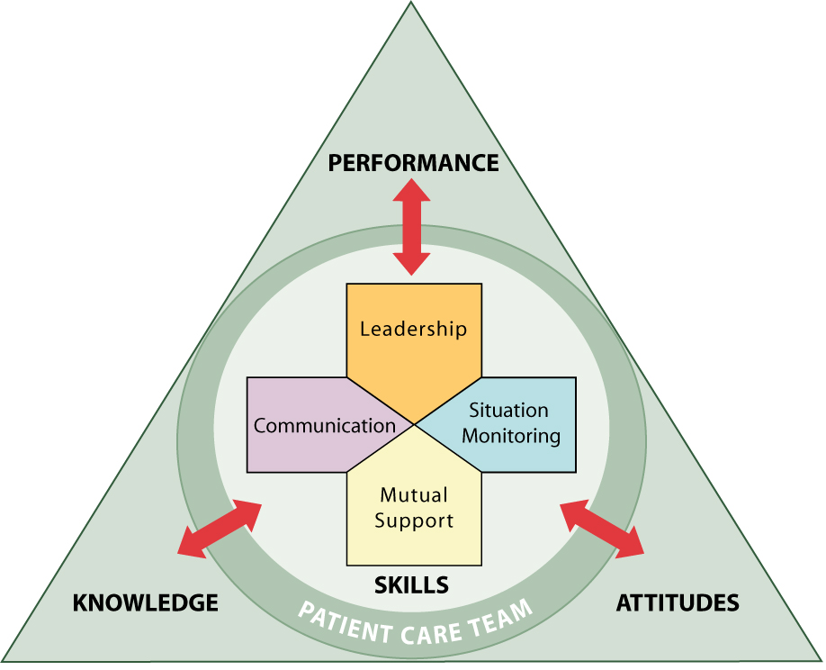
Module 4 Objectives
Define “effective leadership” for diagnostic teams.
Provide guidance to lead and facilitate the improvement of diagnosis-related provider communication.
Demonstrate the utility of four leadership tools: briefs, debriefs, huddles, and reflection.
Notes:
After completing this module, participants will be able to:
Define “effective leadership” for diagnostic teams.
Provide guidance to lead and facilitate the improvement of diagnosis-related provider communication.
Demonstrate the utility of four leadership tools: briefs, debriefs, huddles, and reflection.

Slide 3
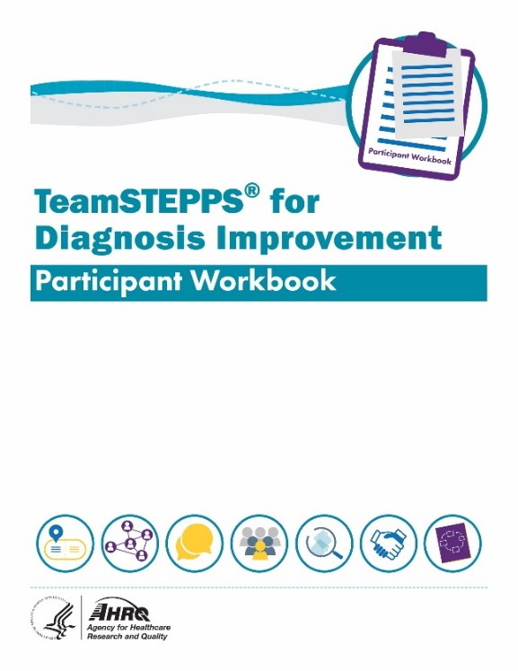
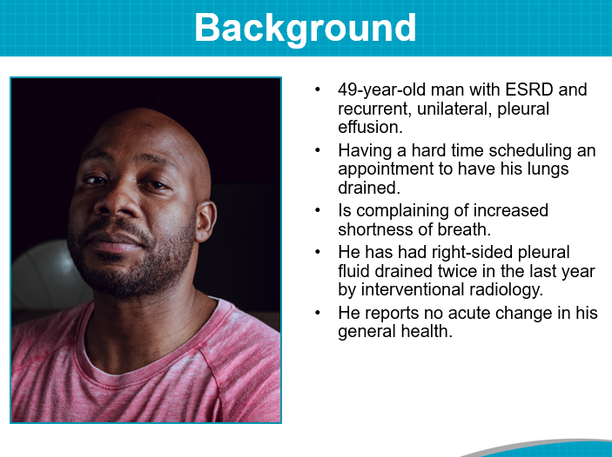
Materials for This Module
Participant Workbook
Team Assessment for Leadership
Leader Competencies in Diagnosis
Briefs
Huddles
Debriefs
The Diagnostic Journey of Mr. Kane
Facilitator’s Guide
Notes:
During this course, the Participant Workbook is the primary tool for learners to complete the course activities, such as exercises, case‐based scenarios, and reflective practices. In addition to engaging in the content, tools, discussion questions, and other activities, course participants can use results from these activities to help shape local improvement implementation plans.
A separate Facilitator’s Guide is also provided. The guide includes detailed instructions pertaining to the administration and implementation of course activities.
This module will also refer to The Diagnostic Journey of Mr. Kane.

Slide 4
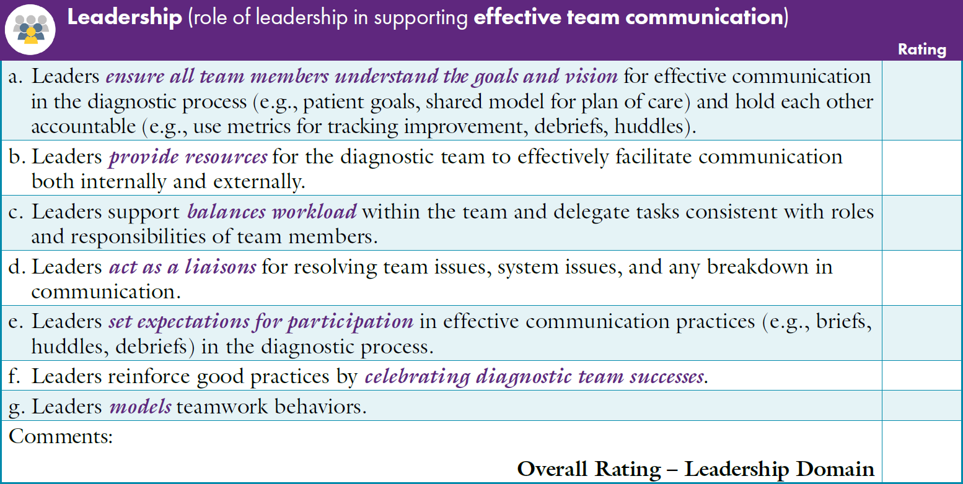

Team Assessment for Leadership To Improve Diagnosis
Notes:
The Participant Workbook includes the Team Assessment Tool for Improving Diagnosis. Participants should have completed the assessment at the beginning of the course after finishing Module 1, Introduction, and the course facilitator should have created an average summary score using the team’s results.
As a team, discuss the scores for each characteristic under the Leadership dimension. Invite them to consider the average summary rankings compared with how they individually ranked Leadership characteristics.
How does the average summary score on Leadership compare with the other TeamSTEPPS dimensions (Team Structure, Communication, Situation Monitoring, and Mutual Support)?
What are the highest scoring Leadership characteristics?
What are the lowest scoring Leadership characteristics?
How do team members at your site rate these characteristics?
After discussing the scores, ask participants to identify together where your site has the strongest leadership to support improved diagnosis and where opportunities exist to enhance leadership practices.
[Facilitator’s Tip: You can customize the slide to provide a summary of your site's results. Detailed instructions for completing the Team Assessment can be found in the Facilitator’s Guide.]
[Self-Paced Learner Tip: Take some time to reflect on your results using the same strengths and opportunities for improvement questions above.]

Slide 5
Leader Competencies in Diagnosis
Courage
Curiosity
Empathy
Flexibility
Humility
Integrity
Intellectual autonomy
Kindness
Patience
Persistence
Professionalism
Resilience & Adaptability
Respect
Tolerance of uncertainty
Reflection
And above all: Put the patient first
Reference: Olson, Rencic, Cosby, et al., 2019
Notes:
The leader of the diagnostic team needs to have and model the values and attitudes that would support optimal diagnosis. These competencies influence not only diagnosis, but also diagnostic improvement strategies and tactics, as well as the overarching patient safety climate.
In a recent study (Olson, Rencic, Cosby, et al., 2019), an interprofessional group reviewed existing competency expectations for multiple health professionals and conducted a search that explored quality, safety, and competency in diagnosis. An iterative series of group discussions and concept prioritization was used to derive a final set of competencies for all healthcare providers:
Courage
Curiosity
Empathy
Flexibility
Humility
Integrity, veracity
Intellectual autonomy
Kindness
Patience
Persistence
Professionalism
Resilience
Adaptability
Respect
Tolerance of uncertainty
Reflection
And above all - Put the patient first. Understand patients’ values and preferences; act in their best interests and advocate for them; help them navigate the healthcare system and the diagnostic process; and make the patient a member of the diagnostic team.
Definitions for each competency can be found in the Participant Workbook. Have participants think about The Diagnostic Journey of Mr. Kane and discuss which leadership competencies influenced the trajectory of his care.
[Self-Paced Learner Tip: Take some time to review the list of competencies and think about how they affected the trajectory of the Mr. Kane case.]

Slide 6




Effective Diagnostic Teams Need Cohesive Clinical and Administrative Leadership
Compelling Direction
Strong Structure
Supportive Context
Shared Mindset
Notes:
Effective diagnostic teams need cohesive clinical and administrative leadership. The goal is to create a climate that helps diverse, dynamic, sometimes geographically dispersed diagnostic teams provide diagnoses that are accurate, timely, and fully communicated. Leaders need to provide the components needed for success.
Compelling Direction: The foundation of every great team starts with a vision that energizes, orients, and engages its members. Teams cannot be inspired if they do not know what they are working toward and lack explicit goals. Achieving diagnostic excellence is an inspiring, challenging, and realistic goal. Evidence suggests that specific and challenging goals along with appropriate feedback contribute to higher task performance.
Goals must also be consequential. People have to care about achieving a goal, whether because they stand to gain extrinsic rewards, such as recognition, pay, and promotions; or intrinsic rewards, such as satisfaction and a sense of meaning. Preventing diagnostic harm is the foremost goal for patients and their families, as well as healthcare providers. It also reduces costs of care, builds trust, and improves population health.
Strong Structure: Teams need the right mix and number of members, optimally designed tasks and processes, and norms that promote positive dynamics and discourage destructive behavior. High‐performing teams include members with a balance of skills. Every individual does not need superlative technical and social skills, but the team overall needs both. Diversity in knowledge and perspectives, as well as in age, gender, and race, can help teams be more creative and avoid groupthink. Review Module 2 to reflect on the key members of a diagnostic team.
Supportive Context: Having consistent support is the third component that enables team effectiveness. This support includes maintaining a reward system that reinforces good performance, an information system that provides access to the data needed for the work, a system that offers relevant team training, and availability of the material resources needed to do the job, such as funding and sufficient time allocated to the task. Leaders can improve the likelihood of success by striving to have essential elements in place from the start.
Shared Mindset: Establishing the first three parameters creates a climate for team success, but research indicates that distance and diversity, as well as digital communication and changing membership, make teams prone to “us versus them” thinking. The solution is developing a shared mindset among team members – something team leaders can do by fostering a common identity and approaching problems from the vantage point of recognizing common ground (Haas & Mortensen, 2016).

Slide 7


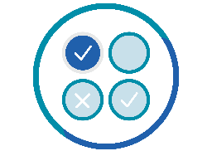
Leadership Role:
Facilitate Shift From Diagnosis
Status Quo to Improvement
Unfreeze Status Quo
Change
Understanding
Refreeze
Improvement
judgement and certainty
curiosity
collaboration
ownership of diagnosis
joint contribution
commitment
retrain or redesign
assess impact
communication
Notes:
Leadership’s role is to facilitate change that fosters diagnostic improvement. Dr. Kurt Lewin developed a well‐known three-stage change theory that involves unfreezing, changing, and then refreezing (Hussain, Lei, Akram, et al., 2018).
When we think about these three stages related to diagnosis, the change process involves first unfreezing the diagnostic process status quo. Individuals begin to let go of current thinking. This unfreezing often happens because they observe that long-held patterns of behavior do not work as well as they once did, or they experience influences from the external environment (for example, new technologies or individuals with new knowledge and skill) that spark curiosity.
Examples of “status quo” thinking related to diagnosis might be:
Judgment and certainty = Diagnosis is the role of the physician.
Ownership of diagnosis = Is diagnostic error my fault?
Retrain and redesign = Is it system flaws or human flaws?
The thawing of previously held practices and beliefs allows the second stage of the process: changed understanding of who members of the diagnostic team might be and why diagnostic improvement is needed. In addition, it creates the potential for learning how to use tools and approaches aimed at improving diagnosis. Examples of “changed understanding” related to diagnosis might be:
Curiosity = How might this process be different?
Joint contribution = How could we each contribute?
Assess impact = What impact has this change had?
The third and final stage involves implementing diagnosis improvement interventions and refreezing (establishing new norms for the diagnostic process) with appropriate tools and resources firmly embedded as common practice.
Examples of “refreeze improvement” thinking and behaviors might be:
Collaboration = How do we work as a diagnostic team?
Commitment = I must raise diagnostic safety concerns.
Communication = What communication style is best?

Slide 8
Know Your Context
Members of the Diagnostic Team May Vary:
When Creating or Supporting a Diagnostic Team Consider:
Senior/Executive Administrative and Clinical Leaders
Point of Care Diagnostic Team Members
  Ambulatory Care Staff
  Clinical Consultants/Specialists
  Ancillary Supports (Lab, Case Management, etc.)
  Patients and Families
Variation by site size/parameters
Variation by patient characteristics and presenting complaint/past medical history
Evolution of team during diagnostic process
  Variation based on results of testing, therapeutic response to treatment, need to see additional consultants, change in social determinants of health, etc.
Notes:
Leading efforts to improve communication related to diagnosis is not one size fits all. Members of the diagnostic team may vary based on patient characteristics (age, gender, presenting symptoms, previous medical history) and by clinical setting. Similarly, sites may vary by size, location, clinical discipline (e.g., oncology, cardiology, neurology) and services offered.
It is important for TeamSTEPPS facilitators to exhibit their leadership by considering these differences and tailoring diagnosis improvement efforts and training to meet the unique needs of each group. Context matters. Knowing and respecting context will aid effectiveness and impact of the training.
Context matters in diagnosis as well. Each patient is different, with unique biological factors, and their own set of circumstances, beliefs, wants, and needs. The leader of the diagnostic team and all the team members need to recognize, acknowledge, and manage this individuality as part of the diagnostic process.

Slide 9
Leadership Tools
Tools to support four critical leadership functions include:
  Planning: Briefs
  Problem Solving: Huddles
  Improvement Over Time: Debriefs and Reflection
Leadership has responsibility to assemble the team and use the tools.
Remember: Anyone can request a brief, huddle, or debrief.
Notes:
Individuals often attain leadership positions based on experiential knowledge and clinical expertise. It is tempting to rely on that same knowledge and skill when assigning responsibility to lead change efforts such as improving provider communication related to diagnosis. However, leading change also requires tools and resources. Fortunately, evidence‐based tools and resources are available to help guide individuals who lead these change efforts.
High‐performing team leaders ensure teams engage in three actions – planning, problem solving, and improving over time.
Briefs are held for planning purposes; huddles are used for problem solving; and debriefs and reflection are used for reflection and process improvement.
We will now explore each of these in greater detail. As we go forward, keep in mind that although the team leader typically facilitates team events, any team member can request a brief, huddle, or debrief at any time, as the need arises. This approach is an example of shared leadership.
[Facilitator’s Tip: Additional leadership tools and links to resources are included in the Facilitator’s Guide.]
(TeamSTEPPS Fundamentals Course: Module 4. Leading Teams, 2019)
(TeamSTEPPS for Office‐Based Care: Leading Teams, 2015)

Slide 10

Briefs
Form the team.
Designate team roles and responsibilities.
Set team climate and goals.
Recognize pitfalls and barriers.
Discuss the clinical status of the team’s patients.
Engage the team in short- and long-term planning.
Notes:
Briefs are held for planning purposes and are used to:
Form the team.
Designate team roles and responsibilities.
Set team climate and goals.
Recognize pitfalls and barriers.
Discuss the clinical status of the team’s patients.
Engage the team in short- and long-term planning.
For example, a complex case might require the establishment of a very specific coordinated team to address a diagnostic safety concern. In this case, a brief would:
Clarify who would lead the team so that others know to whom to look for guidance.
Open lines of communication among team members, ensuring that they all can contribute their unique knowledge base to the task. The brief sets the tone for management of the case. Protocols, responsibilities, and expected behaviors are discussed and reinforced to avoid possible misunderstandings.
Prepare the team for the patient’s clinic visit, establish contingency plans, and identify ways to resolve any unusual circumstances.
Increase understanding of what was expected, help prioritize what to do, and reduce chances of getting distracted by clarifying expectations.
(TeamSTEPPS for Office‐Based Care: Leading Teams, 2015)
In the Participant Workbook are the following questions related to briefs to discuss with participants:
When and where does clinic/site-level quality improvement planning occur now?
Who attends? Clinical or operations staff? Or both?
Who should attend?

Slide 11

Huddles
Discuss critical issues and emerging events.
Anticipate outcomes and likely contingencies.
Assign resources.
Express concerns.
Notes:
Huddles are held for problem-solving purposes. They are quick, reactive, touch-base meetings to gain or regain situation awareness. They allow team members to:
Discuss critical issues and emerging events.
Anticipate outcomes and likely contingencies.
Assign resources.
Express concerns.
A common example of when a team would use a huddle is if a key member of the diagnostic team has called in sick or cannot make it to work. The team strategy for the day has to be revised. It should not be assumed that everything will be taken care of. Instead, a huddle should be formed to address the ramifications of this team member being out for the day and how the team will compensate for his or her absence.
(TeamSTEPPS for Office-Based Care: Leading Teams, 2015)
In the Participant Workbook are the following questions related to huddles to discuss with participants:
Think about a situation in your office in which the team leader could have called a diagnosis improvement/communication-related huddle but did not. What were the results?
List a few examples of when a huddle should be used to improve diagnosis. These examples can be from actual experience or situations that you imagine could happen.
What members of the diagnostic team should feel empowered to call a huddle?
Do you think issues discussed during huddles should be tracked over time?
Why or why not?
How could that happen in your setting?
What would you want to learn if you decide to track issues?
[Facilitator’s Tip: You can find additional huddle resources at the following links or in the Facilitator’s Guide:
DoD Briefs and Huddles Toolkit: https://www.health.mil/Military-Health-Topics/Access-Cost-Quality-and-Safety/Quality-And-Safety-of-Healthcare/Patient-Safety/Patient-Safety-Products-And-Services/Toolkits/Briefs-and-Huddles-Toolkit
AHRQ HAI Daily Huddle Component Kit: https://www.ahrq.gov/hai/tools/ambulatory-surgery/sections/sustainability/management/huddles-comp-kit.html
AHRQ Huddle Slides: https://www.ahrq.gov/teamstepps/instructor/fundamentals/module4/slleadership.html#im13]

Slide 12

Debriefs
Conducted as process improvement sessions to exchange information and feedback.
Occurs after an event or shift.
Designed to improve teamwork skills.
Designed to improve outcomes.
Notes:
Debriefs are short, informal information exchanges used for process improvement. They occur after an event or shift and are designed to improve teamwork skills. Debriefs can include:
An accurate reconstruction of key events.
Analysis of what worked or did not work and why.
What should be done differently next time.
Recognition of good team contributions or catches.
For example, after dealing with a complex diagnostic situation, the team leader may conduct a debrief. This debrief would recap the established plan and key events that occurred and ask questions related to team performance, such as:
What events led up to the situation?
Did everything happen for a patient or patients that was intended?
Were patient followup needs clarified?
What roles did team leadership, situation awareness, mutual support, and communication play in the team’s performance?
What take-aways or lessons can be learned from this experience?
What are goals for improvement?
In the Participant Workbook are the following questions related to debriefs to discuss with participants:
Have you ever participated in a debrief? If so, what debrief questions were used?
Think about a diagnostic-related situation in your office in which the team leader should have called a debrief but did not. What were the results?
List a few examples of when a debrief should be used. These examples can be from actual experience or situations that you imagine could happen.
(TeamSTEPPS for Office-Based Care: Leading Teams, 2015)

Slide 13

Reflective Practice
  Reflection to start the day
    Which patient coming in today will present the largest challenge to us?
    Does everyone know their backup for today?
  Reflection for the end of the day
    What went well?
    Did we miss anything?
    How is everyone feeling?
Notes:
Taking a few moments to thoughtfully focus on individual and team goals at the beginning of the day often leads to improved attention to things that matter. A brief reflection at the beginning and end of each day could become a productive leadership habit. Reflections do not need to be time consuming or complex. Consider these examples:
Reflection to start the day:
Which patient coming in today will present the largest challenge to us?
Does everyone know their backup for today?
Reflection for the end of the day:
What went well?
Did we miss anything?
How is everyone feeling?

Slide 14
Module 4 Summary
Leaders need to provide compelling direction, strong structure, supportive context, and shared mindset.
High-performing leaders ensure teams engage in planning, problem solving, and improvement over time.
Leading change for diagnosis improvement requires evidence-based tools and resources.
Four valuable TeamSTEPPS leadership tools include briefs, debriefs, huddles, and reflection.
Notes:
In this module, participants learned that:
Leaders of effective diagnostic teams need to provide a compelling direction, strong structure, supportive context, and shared mindset.
High-performing team leaders ensure teams engage in planning, problem solving, and improvement over time.
Leading change for diagnosis improvement requires evidence-based tools and resources.
Four valuable TeamSTEPPS leadership tools include briefs, debriefs, huddles, and reflection.

Slide 15







Course Modules
Module 1: Introduction
Module 2:
Diagnostic Team Structure
Module 3: Communication
Module 4: Leadership
Module 5: Situation Monitoring
Module 6: Mutual Support
Module 7: Putting It All Together
Notes:
TeamSTEPPS® for Diagnosis Improvement has seven modules dedicated to improving diagnostic communication and teamwork. Communication strategies and tools to overcome some of the breakdowns in teamwork and team communication are available in each module and the accompanying Participant Workbook.
The TeamSTEPPS® for Diagnosis Improvement modules are:
Introduction.
Diagnostic Team Structure.
Communication.
Leadership.
Situation Monitoring.
Mutual Support.
Putting It All Together.

Slide 16
Module 4 References
Haas M, Mortensen M. The secrets of great teamwork. Harv Bus Rev. 2016 Jun;94(6):70-6, 117. PMID: 27491197.
Hussain ST, Lei S, Akram T, Haider MJ, Hussain SH, Ali M. Kurt Lewin’s change model: a critical review of the role of leadership and employee involvement in organizational change. J Innov Knowl. 2018 Sept-Dec;3(3):123-27. https://doi.org/10.1016/j.jik.2016.07.002.
Olson A, Rencic J, Cosby K, Rusz D, Papa F, Croskerry P, Zierler B, Harkless G, Giuliano MA, Schoenbaum S, Colford C, Cahill M, Gerstner L, Grice GR, Graber ML. Competencies for improving diagnosis: an interprofessional framework for education and training in health care. Diagnosis (Berl). 2019 Nov 26;6(4):335-41. https://doi.org/10.1515/dx-2018-0107.
TeamSTEPPS Fundamentals Course: Module 4. Leading Teams. Content last reviewed March 2019. Agency for Healthcare Research and Quality, Rockville, MD. https://www.ahrq.gov/teamstepps/instructor/fundamentals/module4/igleadership.html. Accessed January 5, 2022.
TeamSTEPPS for Office-Based Care: Leading Teams. Content last reviewed September 2015. Agency for Healthcare Research and Quality, Rockville, MD. https://www.ahrq.gov/teamstepps/officebasedcare/module4/office_lead-ig.html. Accessed January 5, 2022.
Notes:
The following are the list of references from this module.

