Slide 1

Module 5
Situation Monitoring To Improve Diagnosis
TeamSTEPPS® for Diagnosis Improvement
Notes:
Welcome to the TeamSTEPPS for Diagnosis Improvement Course. This presentation will cover Module 5, Situation Monitoring To Improve Diagnosis, that you will review as the facilitator.
Individuals who plan to take the course but will not complete it as part of a team should follow the Self-Paced Learner’s Roadmap found on the TeamSTEPPS for Diagnosis Improvement Course web page. The roadmap provides step-by-step instructions to maximize the value of time spent on the course and ways to leverage core principles and tools. Throughout the presenter’s notes, you will also find Self-Paced Learner Tips.
Estimated Time to complete this module: 30 minutes (14 slides)

Slide 2
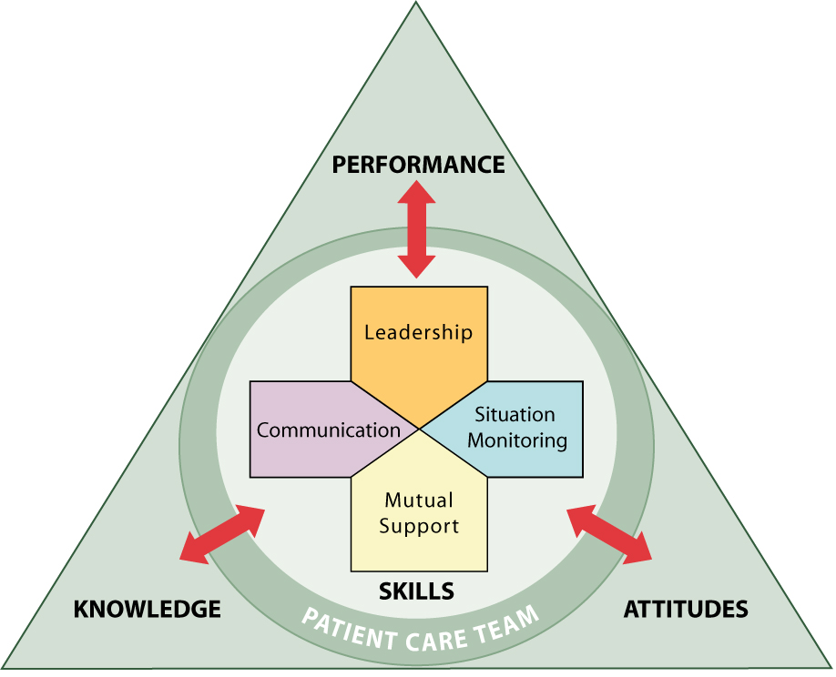
Module 5 Objectives
Define how situation monitoring may affect diagnostic outcomes.
Apply TeamSTEPPS reflective practice and communication tools to improve diagnosis.
Create a shared mental model for achieving a timely, accurate, and effectively communicated diagnosis.
Notes:
After completing this module, participants will be able to:
Define how situation monitoring may affect diagnostic outcomes.
Apply TeamSTEPPS reflective practice and communication tools to improve diagnosis.
Create a shared mental model for achieving a timely, accurate, and effectively communicated diagnosis.

Slide 3
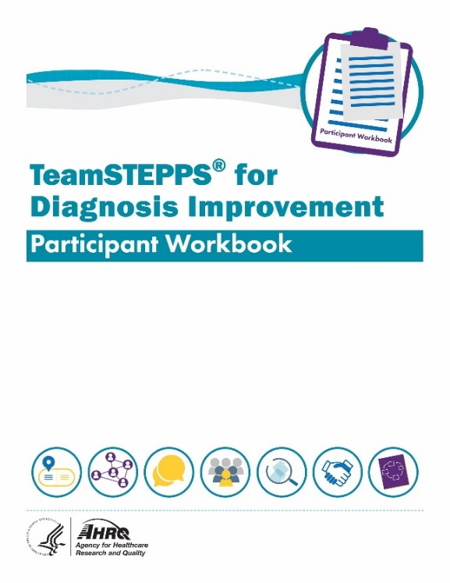
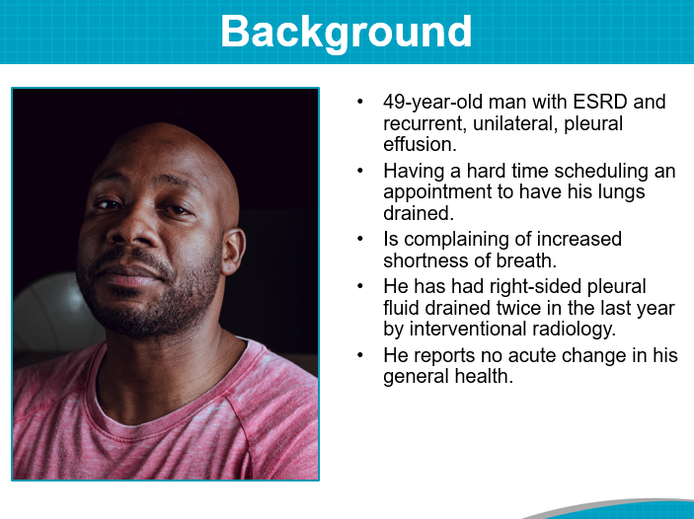
Materials for This Module
Participant Workbook
Team Assessment for Situation Monitoring
Mr. Kane: Using STEP
The Five “Whats” of
Diagnostic Reflective Practice
The Diagnostic Journey of Mr. Kane
Facilitator’s Guide
Notes:
During this course, the Participant Workbook is the primary tool for learners to complete the course activities, such as exercises, case‐based scenarios, and reflective practices. In addition to engaging in the content, tools, discussion questions, and other activities, participants can use the results of these activities to help shape local improvement implementation plans. Select the link to download the Participant Workbook.
A separate Facilitator’s Guide is also provided for use by the site champion who will serve as the local course trainer. The guide includes detailed instructions pertaining to the administration and implementation of course activities.
This module will also refer to The Diagnostic Journey of Mr. Kane.

Slide 4
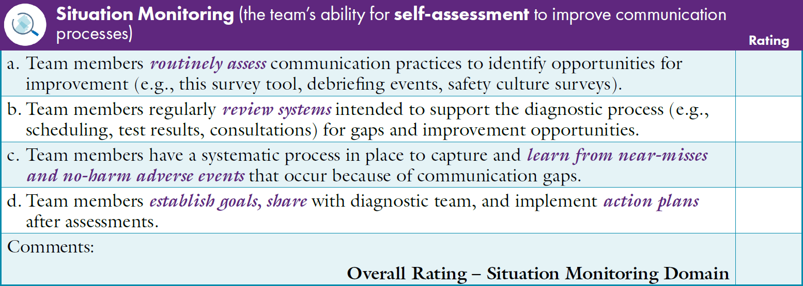

Team Assessment for Situation Monitoring To Improve Diagnosis
Notes:
The Participant Workbook includes the Team Assessment Tool for Improving Diagnosis. Participants should have completed the assessment at the beginning of the course after finishing Module 1, Introduction, and the course facilitator should have created an average summary score using the team’s results.
As a team, discuss the scores for each characteristic under the Situation Monitoring dimension. Invite the team to consider the average summary score compared with how they individually ranked the Situation Monitoring characteristics.
How does the average Summary Score on Situation Monitoring compare with the other TeamSTEPPS dimensions (Team Structure, Communication, Leadership, and Mutual Support)?
What are the highest scoring Situation Monitoring characteristics?
What are the lowest scoring Situation Monitoring characteristics?
How do team members at your site rate these characteristics?
After discussing the scores, ask participants to identify together where the site has the most effective Situation Monitoring methods to support improved diagnosis and where the site has opportunities to improve.
[Facilitator’s Tip: You can customize the slide to provide a summary of your site’s results. Detailed instructions for completing the Team Assessment can be found in the Facilitator’s Guide.]
[Self-Paced Learner Tip: Take some time to reflect on your results using the same strengths and opportunities for improvement questions above.]

Slide 5
Why Situation Monitoring?
Process of actively scanning behaviors and actions to assess elements of the situation or environment
Enables team members to identify potential issues or minor deviations early
Notes:
Situation monitoring is defined as the process of actively scanning behaviors and actions to assess elements of the situation or environment. Situation monitoring is a skill individual team members can acquire, practice, and improve. It enables team members to identify potential issues or minor deviations early enough to correct and handle them before they become a problem or pose harm to the patient.
Situation monitoring fosters mutual support by enhancing individual preparedness to assist other team members to improve diagnostic safety and team accountability. It also ensures staff are supported in times of stress or production pressures or when the day is just not going according to plan. Situation monitoring provides a safety net for both the patient and the team. Examples of situation monitoring include assessing the patient’s condition, noting malfunctioning equipment, and being aware of workload spikes and stress levels among team members.
It is important to engage the patient whenever possible. Stating explicitly that all team members want to provide the highest quality and safe care and asking patients and family members to speak up if they have questions or concerns about anything they see, hear, or experience fosters their engagement as central members of the diagnostic team.
Every team member, from the front desk staff to the patient to the providers to administrators in the office, plays an important role when considering situation monitoring to improve diagnosis. Situation monitoring for diagnostic safety will require every team member to practice the skill of being situationally aware. Situational awareness allows a team to be resilient, capturing potentially harmful errors in the care process before they result in harm to the patient. For example, if a medical assistant is out sick, the front desk staff may realize that faxed test results are not being entered into patients’ medical records as they normally would. Speaking up could ensure results are entered into the records and potentially avert a missed or wrong diagnosis.
(TeamSTEPPS for Office-Based Care: Situation Monitoring, 2015)

Slide 6

Situational Awareness Is Important to the Patient-Provider Relationship
Situational awareness ensures the patient and provider are:
On the same page,
With the same set of facts,
With an understanding of each other’s values and goals, and
With a shared understanding of where things are at.
Notes:
Situational awareness provides an important way to prevent or catch diagnostic errors. An important application of situational awareness is to assess the patient‐provider relationship. Ideally, patients and providers are on the same page, with the same set of facts, understanding each other’s values and goals and “where things are at” in the diagnostic process. Many malpractice suits illustrate the problems that arise when understanding and expectations are out of sync.

Slide 7
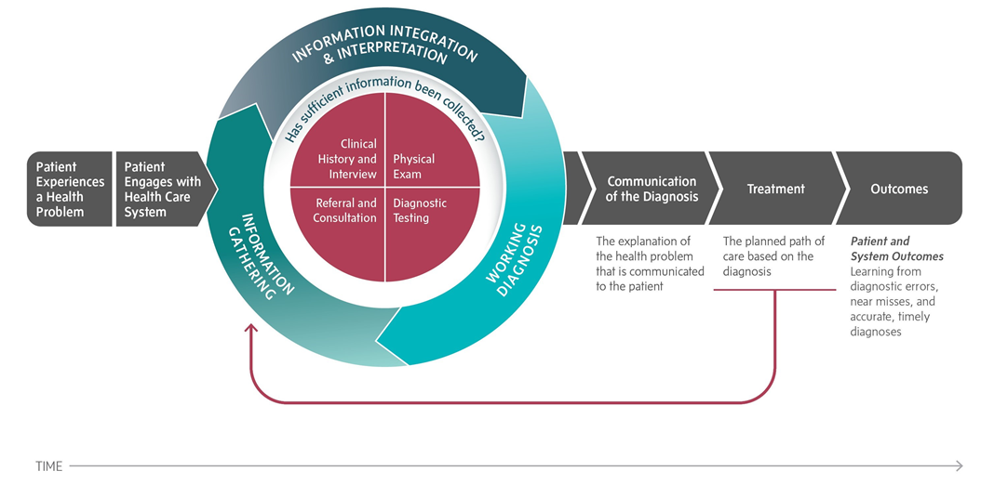
Where do failures occur and what role do I play?
Notes:
Situation monitoring is important across each step of the diagnostic process.
The National Academy of Medicine noted communication between team members, including between the patient and the care team, as a common point of failure across all facets and steps of the diagnostic process (National Academies of Sciences, Engineering, and Medicine, 2015).
Examples of breakdowns in communication include:
Failures in the patient accessing the healthcare system and engaging with the healthcare team.
Failure in information gathering.
Failure in information integration.
Failure in information interpretation.
Failure to establish an explanation for the health problem.
Failure to communicate the explanation.
Failures in treatments and followup.
One way to address the breakdowns and improve team effectiveness is to use a cross-monitoring process.
[Image source: National Academy of Medicine conceptualization of the diagnostic process, 2015.]

Slide 8
Cross-Monitoring
A process of ongoing monitoring to recognize risk or unfolding error
An opportunity to interrupt or correct an action or event before harm or injury to the patient occurs
A goal of “watching each other’s back”
Feedback to ensure the procedures
are being performed appropriately
Notes:
Cross-monitoring is a process of ongoing monitoring of the care environment to recognize risks or unfolding errors.
It allows individuals and teams to take steps to interrupt or correct an action or event before harm or injury to the patient occurs. Commonly referred to as “watching each other’s back,” cross‐monitoring involves monitoring all actions against the established plan and advocating or asserting a position or corrective action when the plan and actions differ or when risk is perceived as escalating and task assistance is needed.
Cross‐monitoring actions include providing feedback and keeping track of fellow team members’ behaviors to ensure procedures are being performed appropriately.
Cross‐monitoring is a form of active patient and caregiver advocacy and allows team members to check and correct their actions if necessary. Cross‐monitoring does not mean spying on other team members; rather, it is a way to provide a safety net or an error prevention or error interruption mechanism for the team, ensuring that mistakes or oversights are caught early.
When all members of the team understand the role of each staff member in the diagnostic process and trust the intentions of their fellow team members, a strong sense of team orientation and a high degree of psychological safety result.
(TeamSTEPPS for Office-Based Care: Situation Monitoring, 2015)
[Facilitator’s Tip: Ask learners to take a moment to reflect on an example in which cross-monitoring to improve diagnosis was successful and one in which cross-monitoring should have been used but was not.]

Slide 9
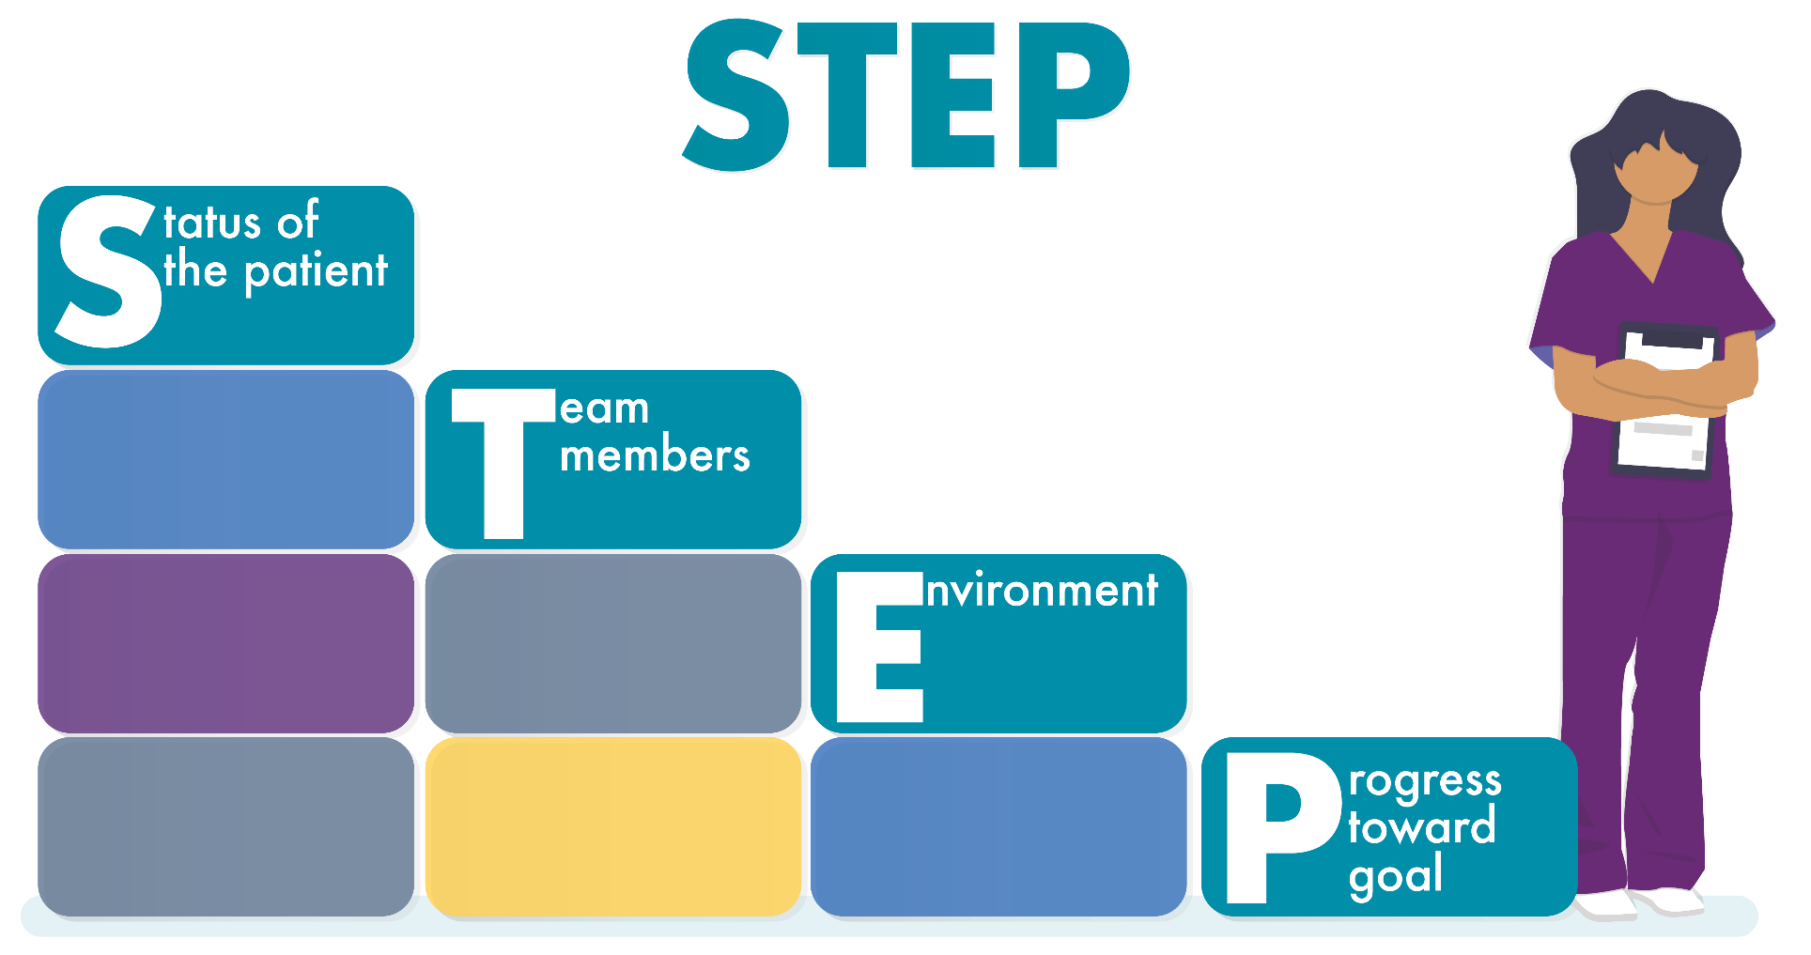
STEP Process for
Situation Monitoring
Notes:
One approach that helps with situation monitoring is to use the STEP process. The STEP process is a mnemonic tool that can help team members monitor the situation and the overall environment.
The STEP process involves ongoing monitoring of the:
Status of the patient: What are the patient’s status, vital signs, medications, and stress level?
Team members: What/how are the team members doing? What is their workload, fatigue level, and stress level? What is the skill level of individual team members?
Environment: Are the exam rooms properly stocked? Are the blood pressure cuffs, otoscope, ophthalmoscopes, and other equipment working properly? Do we need any special equipment for a procedure today? Do we have enough staff to handle all the patients?
Progress toward the goal: What is the progress toward today’s goals? For example, how is the day going? Are we behind? Are patients waiting too long? Are things being left undone because of time pressure? Is the patient care plan still appropriate, or does it need to be revised?
(TeamSTEPPS Fundamentals Course: Module 5. Situation Monitoring, 2019)
(TeamSTEPPS for Office-Based Care: Situation Monitoring, 2015)
[Facilitator’s Tip: Additional situation monitoring tools and links to resources, including the AHRQ STEP video, are included in the Facilitator’s Guide.]

Slide 10
Mr. Kane: Using STEP
S - Status of the Patient
T - Team Members
E - Environment
P - Progress
Notes:
In the Participant Workbook is the following STEP exercise based on The Diagnostic Journey of Mr. Kane. Review Mr. Kane’s case and consider the following questions to discuss with participants.
1. What was the presenting status of the patient at each of his clinic visits?
As understood by the patient, Mr. Kane?
As understood by his son?
As understood by his primary care provider?
As understood by his pulmonologist?
As understood by his nephrologist?
2. Who were the members of the diagnostic team?
Did they see themselves as members of the same team?
If not, how might that have been addressed?
3. Did environmental factors play a role in Mr. Kane’s treatment?
If so, what were they?
Were they adequately addressed?
If not, what might have been done differently?
4. How was Mr. Kane’s clinical progress measured and understood?
By the patient?
By his son?
By his primary care provider?
By his pulmonologist?
By his nephrologist?
5. Discuss: What actions might have improved Mr. Kane’s diagnostic journey?
[Facilitator’s Tip: Additional questions to consider and discussion prompts are included in the Facilitator’s Guide.]
[Self-Paced Learner Tip: Take some time to reflect on The Diagnostic Journey of Mr. Kane using the same questions above.]

Slide 11

The Five “Whats” of
Diagnostic Reflective Practice
What do I KNOW?
What are the ALTERNATIVES?
What INFORMATION would help?
What are the CONSEQUENCES?
What are the next STEPS?
What is the evidence to support what I think?
Does this make sense?
What is an alternative viewpoint?
What else can it be?
What information is missing or uncertain?
Have I listened to all team members?
Do I know what the patient/family are thinking?
If this, what else?
What is the worst it could be?
How would this affect the patient and family?
Who will be affected/involved?
What needs to be done and when?
What is the plan for continuing assessment?
What may be biasing my thinking?
What are the assumptions?
Notes:
A set of questions can help develop a reflective mindset and aid in the situation monitoring process. The five-question mnemonic “KAICS” (Know, Alternatives, Information, Consequences, Steps) was developed by the course team to help look beyond the first answer to consider other perspectives.
Begin with what do I KNOW? Review objective and subjective data in light of evidence, possible biases, and assumptions.
What are the ALTERNATIVES? Explore what else could be going on. Avoid premature closure by considering at least three other possibilities. Question the first answer; reflect whether the answer makes sense, whether the evidence adds up, or whether there are other alternatives to explore. What do I see now that I did not see before?
Where else can I get INFORMATION (or from whom)? Reflect on what is known and what is uncertain. Examine assumptions for bias. Do other members of the team have diverse ideas? Did anyone ask the patient and family for their perspectives? Listening to all members of the team helps provide a more well-rounded perspective of the situation and may uncover additional information.
What are the CONSEQUENCES? Actions have consequences, so if this, then what? You may imagine the worst case patient scenario to rule out possibilities and safeguard against diagnostic errors. Consider the impact of your actions and recommendations on the patient and family. Ask yourself, if this were my family member, would I think the same way?
What are the next STEPS? Developing an action plan involves who, what, how, and when. Diagnostic reflective practice includes action, communicating with the patient and family what will follow and how. What processes are involved? It is important to continuously assess and update the plan throughout the diagnostic journey.
A reflective mindset of Asking, Listening, and Acting makes every facet of the diagnostic process safer and offers the potential for fewer missed diagnoses, delayed diagnoses, and wrong diagnoses.
The Participant Workbook includes an example demonstrating how the five-question KAICS mnemonic can be applied to a clinical diagnosis case.

Slide 12
Module 5 Summary
Situation monitoring enables team members to identify potential issues before they become a problem or pose harm to the patient.
Situation monitoring has a direct impact on diagnostic outcomes.
Reflective practice and communication tools such as STEP can improve diagnosis.
Notes:
In this module, participants learned that:
Situation monitoring enables team members to identify potential issues before they become a problem or pose harm to the patient.
Situation monitoring has a direct impact on diagnostic outcomes.
Reflective practice and communication tools such as STEP can improve diagnosis.

Slide 13







Course Modules
Module 1: Introduction
Module 2:
Diagnostic Team Structure
Module 3: Communication
Module 4: Leadership
Module 5: Situation Monitoring
Module 6: Mutual Support
Module 7: Putting It All Together
Notes:
TeamSTEPPS® for Diagnosis Improvement has seven modules dedicated to improving diagnostic communication and teamwork. Communication strategies and tools to overcome some of the breakdowns in teamwork and team communication are available in each module and the accompanying Participant Workbook.
The TeamSTEPPS® for Diagnosis Improvement modules are:
Introduction.
Diagnostic Team Structure.
Communication.
Leadership.
Situation Monitoring.
Mutual Support.
Putting It All Together.

Slide 14
Module 5 References
National Academies of Sciences, Engineering, and Medicine. Improving Diagnosis in Health Care. Balogh EP, Miller BT, Ball JR, eds. Washington, DC: National Academies Press; 2015.
TeamSTEPPS Fundamentals Course: Module 5. Situation Monitoring. Content last reviewed March 2019. Rockville, MD: Agency for Healthcare Research and Quality. https://www.ahrq.gov/teamstepps/instructor/fundamentals/module5/igsitmonitor.html. Accessed January 10, 2022.
TeamSTEPPS for Office-Based Care: Situation Monitoring. Content last reviewed September 2015. Rockville, MD: Agency for Healthcare Research and Quality. https://www.ahrq.gov/teamstepps/officebasedcare/module5/office_sitmon-ig.html. Accessed January 10, 2022.
Notes:
The following are the list of references from this module.

