Slide 1
Module 6 Mutual Support To Improve Diagnosis
TeamSTEPPS® for Diagnosis Improvement
Notes:
Welcome to the TeamSTEPPS for Diagnosis Improvement Course. This presentation will cover Module 6, Mutual Support To Improve Diagnosis, that you will review as the course facilitator.
Individuals who plan to take the course but will not complete it as part of a team should follow the Self-Paced Learner’s Roadmap found on the TeamSTEPPS for Diagnosis Improvement Course web page. The roadmap provides step-by-step instructions to maximize the value of time spent on the course and ways to leverage core principles and tools. Throughout the presenter’s notes, you will also find Self-Paced Learner Tips.
Estimated Time to complete this module: 30 minutes (24 slides)

Slide 2
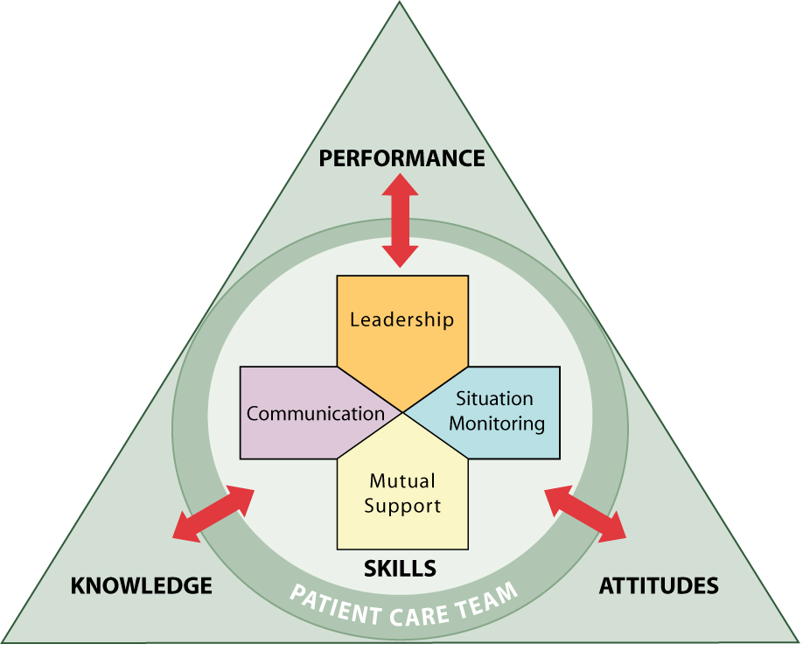
Module 6 Objectives
Describe how mutual support affects team processes and outcomes.
Discuss specific strategies to foster mutual support, such as task assistance and feedback.
Identify specific tools to facilitate mutual support.
Describe conflict resolution strategies.
Notes:
After completing this module, participants will be able to:
Describe how mutual support affects team processes and outcomes.
Discuss specific strategies to foster mutual support, such as task assistance and feedback.
Identify specific tools to facilitate mutual support.
Describe conflict resolution strategies.

Slide 3
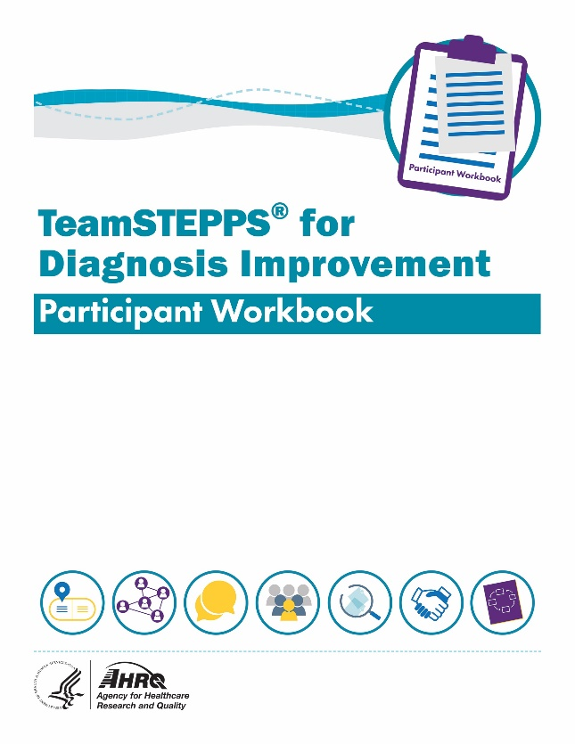
Materials for This Module
Participant Workbook
Team Assessment for Mutual Support
Assertive Statement Exercise
Two-Challenge Rule
Facilitator’s Guide
Notes:
During this course, the Participant Workbook is the primary tool for learners to complete the course activities, such as exercises, case‐based scenarios, and reflective practices. In addition to engaging in the content, tools, discussion questions, and other activities, participants can use results from these activities to help shape local improvement implementation plans.
A separate Facilitator’s Guide is also provided for use by the course facilitator. The guide includes detailed instructions pertaining to the administration and implementation of course activities.

Slide 4
Team Assessment for Mutual Support To Improve Diagnosis
Notes:
The Participant Workbook includes the Team Assessment Tool for Improving Diagnosis. Participants should have completed the assessment at the beginning of the course after finishing Module 1, Introduction, and the course facilitator should have created an average summary score using the team’s results.
As a team, discuss the scores for each characteristic under the Mutual Support dimension. Invite the team to consider the average summary score compared with how they individually ranked Mutual Support characteristics.
How does the average Summary Score on Mutual Support compare with other TeamSTEPPS dimensions (Team Structure, Communication, Leadership, and Situation Monitoring)?
What are the highest scoring Mutual Support characteristics?
What are the lowest scoring Mutual Support characteristics?
How do team members at your site rate these characteristics?
After discussing the scores, ask participants to identify together where your site has the most effective Mutual Support methods to support improved diagnosis and where the site has opportunities to improve.
[Facilitator’s Tip: You can customize the slide to provide a summary of your site’s results. Detailed instructions for completing the Team Assessment can be found in the Facilitator’s Guide.]
[Self-Paced Learner Tip: Take some time to reflect on your results using the same strengths and opportunities for improvement questions above.]

Slide 5
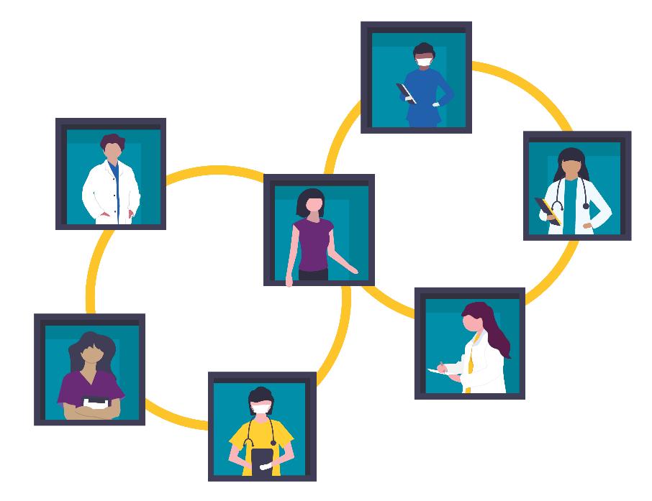
Mutual Support
Anticipate what would be helpful to other team members through knowledge of their tasks and responsibilities.
Provide a safety net for work overload situations that may increase the risk of error.
Notes:
Mutual support – commonly referred to as “backup behavior” in teamwork literature – is the essence of teamwork. Mutual support includes the ability to anticipate the needs of other team members through knowledge of their tasks and responsibilities. Mutual support also suggests some degree of task interchangeability among members, because they must fully understand and, in some cases, be cross-trained in what each of the other team members does.
In a diagnostic process, one team member’s work overload may result in a diagnostic error. Mutual support provides a safety net to help prevent errors, increase effectiveness, and minimize strain caused by work overload. Over time, continuous mutual support fosters team adaptability, mutual trust, and team orientation.
In this module, three specific strategies to foster mutual support are discussed:
Task Assistance
Feedback
Advocacy and Assertion
[Facilitator’s Tip: Additional mutual support tools and links to resources are included in the Facilitator’s Guide.]
(TeamSTEPPS Fundamentals Course: Module 6. Mutual Support, 2019)
(TeamSTEPPS for Office-Based Care: Mutual Support, 2015)

Slide 6
Task Assistance
Foster a climate in which it is expected that assistance will be actively sought and offered to reduce the occurrence of error:
“I need a hand.”
“Can I give you a hand?”
Notes:
Several strategies can build mutual support.
Task assistance is actively seeking help from or offering help to team members as a way to reduce errors, and it occurs when there is a climate of mutual support where such assistance is expected. Task assistance is guided by situation monitoring, because situation awareness allows team members to effectively identify the need for assistance by others on the team.
It is important that leaders empower team members to ask for assistance and foster a culture where asking for and offering assistance is expected. Some people have been conditioned to avoid asking for help because they fear it suggests a lack of knowledge or confidence. In support of diagnostic safety, however, offering and seeking task assistance should be standard.
(TeamSTEPPS Fundamentals Course: Module 6. Mutual Support, 2019)
(TeamSTEPPS for Office-Based Care: Mutual Support, 2015)

Slide 7
Task Assistance Examples
Asking for assistance when overwhelmed or unsure
Offering information others on the team may not have
Helping team members perform their tasks
Shifting workload by redistributing tasks to other team members
Delaying or rerouting work so the overburdened member can recover
Filling in for overburdened team members
Notes:
Task assistance may involve:
Asking for assistance when overwhelmed or unsure.
Offering information others on the team may not have.
Helping team members perform their tasks.
Shifting workload by redistributing tasks to other team members.
Delaying or rerouting work so the overburdened member can recover.
Filling in for overburdened team members.
Some practical examples of task assistance are:
Medical assistant helping front desk staff with patient registrations so all radiology reports can be logged in and reported to key clinical staff (timeliness and accuracy).
Front desk staff alerting a provider to a patient in the waiting room exhibiting atypical confusion to avoid an emergency situation (patient-centered communication).
Nurse practitioner offering to see a patient scheduled for a physician colleague who is unexpectedly detained (timeliness, patient-centeredness).
Staff members connecting a patient experiencing a prolonged or difficult diagnostic journey with a patient advocate or a member of the patient-family advisory council to provide emotional and social support.
Error vulnerability increases when people are under stress, in high-risk situations, or fatigued. Task assistance should be actively offered and given whenever a concern for diagnostic safety arises related to workload.
If the diagnostic process gets bogged down or is not working smoothly, consider providing task assistance for the patient. The patient may appreciate something as simple as a timely update and some encouragement. In other cases, consider connecting patients with a patient navigator or someone from the patient‐family advisory council.
(TeamSTEPPS Fundamentals Course: Module 6. Mutual Support, 2019)
(TeamSTEPPS for Office‐Based Care: Mutual Support, 2015)

Slide 8
What Is Feedback?
Fosters improvement in work performance
Meets the team’s and individual’s need for growth
Promotes better working relationships
Helps the team set goals for ongoing improvements
Notes:
Feedback is another mutual support strategy to improve team performance. Feedback is the giving, seeking, and receiving of performance‐related information among team members. By giving feedback, you are investing in team members with the goal to improve team performance.
The ability to communicate self-improvement information to an individual in a respectful and professional way is an important skill. Any team member can give feedback at any time. It is not limited to management roles or formal evaluation mechanisms. Performance feedback benefits the team in several ways:
Fosters improvement in work performance
Meets the team’s and individual’s need for growth
Promotes better working relationships
Helps the team set goals for ongoing improvements
Feedback is an important tool to reinforce positive behaviors. We all benefit from knowing that we have done a good job and that our performance has been recognized by others. However, for the feedback to be effective, it must be delivered appropriately. It is important to give thought to when and where to give feedback to an individual.
Feedback must be timely for an individual to be able to readily associate it with the behavior. Delivering feedback several weeks after poor performance has occurred is too late for it to be effective. Negative feedback should never be expressed to individuals in front of other team members, because this approach may cause the individual receiving feedback to feel humiliated.
(TeamSTEPPS Fundamentals Course: Module 6. Mutual Support 2019)
(TeamSTEPPS for Office‐Based Care: Mutual Support, 2015)

Slide 9
Characteristics of Effective Feedback
Feedback can be either formal or informal, and it can be constructive or evaluative.
Effective feedback is:
Timely.
Respectful.
Specific.
Directed toward improvement.
Considerate.
“Feedback is where the learning occurs.”
Notes:
Anyone on the team can provide feedback. It can be either formal or informal, and it can be constructive or evaluative.
Formal feedback tends to be retrospective in nature, is typically scheduled in advance, takes place away from the clinical area, and has an evaluative quality. Examples include collaborative discussion, case conferences, and individual performance reviews.
Informal feedback, on the other hand, occurs in real time and on an ongoing basis. It focuses on knowledge and practice skills development. Examples of informal feedback include huddles and debriefs.
Feedback can also be categorized as constructive or evaluative.
Constructive feedback is considerate, is task specific, and focuses attention on the performance, not on the individual. It is usually provided by any team member regardless of role. It is most beneficial when it is focused on team processes and provided regularly.
Evaluative feedback helps the individual understand performance by comparing behavior with standards or with the individual’s own past performance. It is not a comparison of the individual’s performance with that of other team members. Most often, it is provided by individuals in a mentoring or coaching role.
Rules of effective feedback include the following:
Timely: If you wait too long, you forget facts, and the feedback loses its impact. Feedback is most effective when the behavior being discussed is fresh in the receiver’s mind.
Respectful: Feedback should not be personal, and it should not be about personality. It should be about behavior. Never attribute a team member’s poor performance to internal factors (e.g., personal life event), because such destructive feedback lowers self-efficacy and subsequent performance.
Specific: Feedback should be related to a specific situation or task. Imagine that you are receiving feedback from a peer who tells you that your patient relationship skills need work. That statement is too general to use as a basis for improvement. You will be better able to correct or modify performance if the feedback is that you use too much medical jargon and patients struggle to understand what you tell them.
Directed: Goals should be set for improvement to help prevent the same problem from recurring in the future.
Considerate: It is important to be considerate of team members’ feelings when delivering feedback and remember to praise good performance. A feedback message will seem less critical if you also provide information on the positive aspects of a person’s performance as well as how the person may improve. Generally, fairness and respect will soften the effect of any negative feedback.
(TeamSTEPPS Fundamentals Course: Module 6. Mutual Support, 2019)
(TeamSTEPPS for Office‐Based Care: Mutual Support, 2015)

Slide 10
Feedback Examples
1. Cautioning team members about potentially unsafe situations | “The asthma patient appears to be breathing harder after the nebulizer treatment. Do you think we should address this issue by informing Dr. Smith?”
2. Providing necessary information | “Did you know that the patient saw her pulmonologist last week? There’s no report in the chart. I’ll contact the pulmonary office and ask them to send us the report.”
3. Providing encouragement | “Thank you for taking the extra time to get me the pulmonary consult. Now I can modify my diagnosis and call the patient, as he was very anxious about the results."
Notes:
Examples of effective feedback include:
Cautioning team members about potentially unsafe situations: “The asthma patient appears to be breathing harder after the nebulizer treatment. Do you think we should address this issue by informing Dr. Smith?”
Providing necessary information: “Did you know that the patient saw her pulmonologist last week? There’s no report in the chart. I’ll contact the pulmonary office and ask them to send us the report.”
Providing encouragement: “Thank you for taking the extra time to get me the pulmonary consult. Now I can modify my diagnosis and call the patient, as he was very anxious about the results."

Slide 11
Feedback on Diagnostic Outcomes Can Improve the Diagnostic Process
Many patients experiencing diagnostic errors never inform their provider – they simply seek care elsewhere.
Ideally, if the diagnosis changes, the “upstream” providers should be informed.
Feedback can improve calibration, encourage reflection, and improve the diagnostic process.
Notes:
According to experts, improving feedback on diagnostic outcomes could improve the diagnostic process and help reduce the likelihood of future diagnostic errors, especially now that autopsies have become so uncommon. In the past, nothing provided a more powerful lesson than an autopsy disclosing an unsuspected diagnosis. Many patients experiencing diagnostic errors never inform their provider – they simply seek care elsewhere.
Ideally, if the diagnosis changes, “upstream” providers should be informed (upstream providers are clinicians who saw the patient earlier for their current complaints). For example, a patient with shortness of breath and cough is admitted to the hospital from clinic with suspected pneumonia. The inpatient evaluation reveals an unsuspected pulmonary embolism, a diagnosis different from what the outpatient clinical team determined earlier in the process. When the inpatient providers inform the outpatient clinic about the actual diagnosis, this feedback can improve outpatient diagnostic decision making in the future, by encouraging reflection and consideration of a variety of diagnoses that may present similar to pneumonia.

Slide 12
Advocacy and Assertion
Advocate for the patient.
Invoke when team members’ viewpoints do not coincide with those of a decision maker.
Assert a corrective action in a firm and respectful manner.
Notes:
A third mutual support strategy is advocacy and assertion. It is the responsibility of every team member to advocate for the patient. Advocacy and assertion interventions are invoked when a team member determines the unfolding actions differ from the expected or established plan of care.
In advocating for the patient and the medical care plan, the observing team member asserts a corrective action. You should advocate for the patient even when the point of view is unpopular, contradicts another person’s view, or questions authority. When advocating, you should assert your point of view in a firm and respectful manner. Be persistent, be persuasive, and provide the data or evidence for your concerns.
(TeamSTEPPS Fundamentals Course: Module 6. Mutual Support, 2019)
(TeamSTEPPS for Office‐Based Care: Mutual Support, 2015)

Slide 13
The Assertive Statement
Respect and support authority while clearly asserting concerns and suggestions.
Use an assertive statement that is nonthreatening and ensures that critical information is addressed.
Complete five steps:
Open the discussion.
State the concern.
State the problem, real or perceived.
Offer a solution.
Obtain an agreement.
Notes:
To be effective advocates, team members must be able to assert their concerns. This requires a culture of safety, fostered by team leadership, in which all team members feel their input is valued and expected.
Team members must respect and support the authority of the team leader while clearly asserting their suggestions or communicating concerns. These two concepts go hand in hand. Respect for team members means speaking up when patient safety is at stake.
When the clinical situation dictates that the team member must be assertive and address concerns regarding patient care, the assertive statement should be used. It is a nonthreatening, respectful way to ensure that the concern or critical information is addressed. The assertive statement is a five-step process consisting of the following:
Open the discussion.
State the concern.
State the problem, real or perceived.
Offer a solution.
Obtain an agreement.
The Participant Workbook has an “Assertive Statement” exercise to conduct with teams or individually.
Consider a scenario in which a nurse witnesses a physician treating a receptionist rudely in front of a patient. The nurse waits until after the incident and takes the physician aside.
Individually or in small groups, pretend you are the nurse in this scenario. Following the Five Steps and prompts below, build an assertive statement that you could use with the doctor.
Open the discussion: “I’d like to share my thoughts on ___________________________.”
State the concern: “I am concerned that ___________________________________.”
State the problem, real or perceived: “This is a problem because ____________________.”
Offer a solution: “In the future _________________________________.”
Obtain an agreement: “Can we agree that _______________________________________?”
(TeamSTEPPS Fundamentals Course: Module 6. Mutual Support , 2019)
(TeamSTEPPS for Office‐Based Care: Mutual Support, 2015)

Slide 14
Conflict Resolution Options
Information Conflict
(We have different information)
Personal Conflict
(Hostile and harassing behavior)
Two-Challenge Rule
DESC script
Notes:
When differences and conflicts in healthcare arise, they tend to be rooted in either our information or our personalities. The tools to manage these conflicts differ as well.
Information conflict tends to be task related. It involves differing views, ideas, and opinions. It could be a disagreement about the content of a decision.
Personal conflict stems from interpersonal incompatibility and is not usually task related. Tension, annoyance, and animosity are common, and personal conflict can be argumentative.
It is important to resolve both types of conflict before they interfere with work and undermine quality and patient safety. Information conflicts left unresolved may evolve into personal conflict in the long run and severely weaken teamwork.
Disruptive behaviors among staff should be actively discouraged. Organizations need to develop guidelines for acceptable behavior to assist staff in better identifying, reporting, and managing behaviors that cause disruption to patient safety. Types of disruptive behavior include condescending language or voice intonation, impatience with questions, reluctance or refusal to answer questions or telephone calls, strong verbal abuse, or threatening body language and physical abuse.
(TeamSTEPPS Fundamentals Course: Module 6. Mutual Support, 2019)
(TeamSTEPPS for Office-Based Care: Mutual Support, 2015)

Slide 15
Two-Challenge Rule
Invoke when an initial assertion is ignored.
It is your responsibility to assertively voice your concern at least two times to ensure that it has been heard.
If the outcome is still not acceptable:
Take a stronger course of action.
Use chain of command.
The member being challenged must acknowledge the concerns.
Notes:
The two-challenge rule empowers all team members to “stop the line” if they sense or discover an essential safety breach. It is based on the notion that it is your responsibility to assertively voice your concern at least two times to ensure that it has been heard.
It is important that the challenger advocate and assert his or her concern by restating the concern, and, if the initial assertion is ignored, by rephrasing it. These two attempts may come from the same person or from two different team members.
The first challenge should be in the form of a question, and the second should provide some support for the concern. Keep in mind – this technique is about advocating for the patient. This two-challenge tactic ensures that an expressed concern is heard, understood, acknowledged, and ultimately acted on.
If both attempts are made and the concern is still disregarded, and the individual believes patient or staff safety is or may be compromised, the two-challenge rule dictates taking a stronger line of action, such as contacting a supervisor. This approach addresses the natural tendency to believe that the team leader must always know what he or she is doing, even when the actions taken depart from established guidelines.
When invoking this rule and moving it up the chain, it is essential to communicate to the entire team that additional input has been solicited.
It is also important to remember that if you personally are challenged by a team member, patient, or family member, it is your responsibility to acknowledge the concerns instead of ignoring the person who brought the concern to you.
The Participant Workbook notes the following questions to discuss with participants:
Have you ever spoken up regarding diagnosis-related issues? Examples: missing lab results, orders that seem inconsistent with the care plan, concerns or questions raised by patients that are not being addressed.
What did you consider before speaking up?
How did you decide to whom you should speak?
How did it feel to raise your concern?
Was the outcome what you hoped?
If the outcome was not what you anticipated, what did you do or what could you have done?
Has anyone ever raised a concern about diagnosis-related issues TO you?
What did you consider before responding?
Might your response have been different if the person raising the concern was a:
Colleague?
Support staff?
Manager?
Physician provider?
“Stopping the line” in healthcare refers to the ability of any individual to speak up immediately if they see a risk to patient safety, including diagnostic safety.
Are team members able/encouraged to “stop the line” for diagnostic safety? Can you share any examples?
Are patients and family members encouraged to “stop the line” for diagnostic safety? Can you share any examples?
[Self-Paced Learner Tip: Reflect on a time when you could have used the two-challenge rule or when one of your patients and families could have asserted the rule. How could it have changed the outcome?]
(TeamSTEPPS Fundamentals Course: Module 6. Mutual Support, 2019)
(TeamSTEPPS for Office-Based Care: Mutual Support, 2015)

Slide 16
Conflict Resolution: DESC Script
A constructive approach for managing and resolving conflict:
D—Describe the specific situation.
E—Express your concerns about the action.
S—Suggest other alternatives.
C—Consequences should be stated.
Ultimately, consensus should be reached.
Notes:
Another tool for managing conflict when opinions or personalities differ is the D-E-S-C, or DESC, script.
This script is a constructive approach for communicating effectively and for managing and resolving all types of conflict, but particularly conflict that has become personal in nature. The DESC script is used in scenarios in which acceptable behaviors (e.g., team members helping each other at the end of the day) are not practiced, when hostile or harassing behaviors (e.g., eye rolling, sharp or curt responses to questions or passive-aggressive silence among team members) are ongoing, and when safe patient care is in jeopardy. Open, collaborative, and patient‐focused communication is essential for the diagnostic process.
DESC is the mnemonic for the following actions:
D — Describe the specific situation.
E — Express your concerns about the action.
S — Suggest other alternatives.
C — State the consequences.
For example, a nurse could say to a physician:
D —“When I asked you about implications of the lab results on Ms. Kearney and you didn’t respond, I felt belittled.”
E — “I am concerned because I want to learn from you so I can be a more productive team member.”
S — “I would appreciate it if you would respond when I ask a question. You could let me know if you thought my question was not appropriate or if there would be a better time to ask it so that you could take time to teach me.”
C — “I am concerned neither of us will be as effectives as we could be in caring for our patients or supporting other members of the team if we don’t communicate openly. I have a lot to learn from you and want to be able to ask questions.”
Ultimately, we strive to reach consensus without any compromise to patient safety.
(TeamSTEPPS Fundamentals Course: Module 6. Mutual Support, 2019)
(TeamSTEPPS for Office‐Based Care: Mutual Support, 2015)

Slide 17
DESC-It
Ensure that the discussion is timely.
Work on “win-win.”
Choose the location.
Use “I” statements to minimize defensiveness.
Focus on what is right, not who is right.
Notes:
When you initiate and use the DESC script, you need to ensure that the following crucial actions are taken:
Ensure that the discussion is timely.
Work on win‐win. Despite the interpersonal conflict with the other party, team unity and quality of care depend on coming to a solution all parties can live with. Frame problems in terms of personal experience and lessons learned.
Choose the location. A private location that is not in front of the patient or other team members will allow both parties to focus on resolving the conflict, rather than on saving face.
Use “I” statements rather than blaming statements. For example, “When you question my judgment in front of others, I feel embarrassed, and it makes me very uncomfortable.”
Keep in mind that critique is not criticism, and focus on what is right, not on who is right.
(TeamSTEPPS Fundamentals Course: Module 6. Mutual Support, 2019)
(TeamSTEPPS for Office‐Based Care: Mutual Support, 2015)

Slide 18
Use CUS Words but only when appropriate!
Notes:
The C-U-S (CUS) technique provides another framework for conflict resolution, advocacy, and mutual support. Common signal words, such as “Danger,” “Warning,” and “Caution,” are meant to demand attention. CUS is intended to have a similar effect in verbal communication. When the CUS phrases are spoken, all team members will understand clearly not only the issue, but also the magnitude of the issue.
CUS stands for the following:
I am concerned. (State why you are concerned.)
I am uncomfortable. (State why you are uncomfortable.)
This is a safety issue. (If the conflict is not resolved, state that there is a safety issue and describe how the concern is related to safety. If the safety issue is not acknowledged, notify a supervisor.)
CUS is a good tool to use with team members when you want to “stop the line” and alert colleagues to your concerns and how they can help.
For example, an office nurse could say to a records clerk, “I am concerned about Mr. Smith’s blood pressure even though he says the high reading I am seeing is good for him. He doesn’t want his medications adjusted. I am uncomfortable not changing his medication without reviewing records from the provider who cared for him before his recent move to our community. His hypertension is a safety issue. I know you have been busy, but could you please call the practice where he received care previously and ask them to send his records as soon as possible?
CUS is not a good tool to address interpersonal issues (disagreements among staff, for example.)
(TeamSTEPPS Fundamentals Course: Module 6. Mutual Support, 2019)
(TeamSTEPPS for Office-Based Care: Mutual Support, 2015)

Slide 19
Ineffective Approaches to Conflict Resolution
Compromise—Both parties settle for less.
Avoidance—Issues are ignored or sidestepped.
Accommodation—Focus is on preserving relationships.
Dominance—Conflicts are managed through directives for change.
Notes:
Many commonly used methods to resolve conflict do not result in the best outcome. Some of these commonly used, but often ineffective, methods are:
Compromise. With this method, both parties settle for less.
Example: The practice is trying to standardize routine tasks. The receptionist and the records clerk share responsibility for updating patient files and facilitating requested consults after each visit. The receptionist prefers to handle all at the end of the day. The records clerk likes to start her day with followup from the day before. They decide that patients seen in the morning will be handled by the receptionist and patients seen in the afternoon will be handled by the records clerk.
Avoidance. With this method, issues are temporarily ignored or sidestepped, which can be worse than compromise because people’s feelings become bottled up and will eventually seep out somehow. Thus, avoidance is a poor option for ensuring that safety and patient care are put first.
Example: A physician in the practice begins to routinely extend her lunch break to work on patient records, but that results in afternoon appointments starting late. Colleagues are concerned about the impact on patient satisfaction scores, but she is a great clinician, so they say nothing.
Accommodation. With this method, the focus is on preserving relationships, which is not a good option, because the focus should be on safety and patient care.
Example: The new receptionist who likes things done “her way” prepares and posts the patient schedule for the following day on her way out the door at 5 p.m. Clinicians would prefer to see it by mid‐afternoon so they know what to anticipate, but they do not speak up because they have had trouble keeping receptionists and do not want to lose another one.
Dominance. With this method, conflicts are managed through directives for change. This option is authoritative and does not promote a culture of communication and support.
Example: The practice manager decides (without input from clinicians or office staff) that because of tensions between two clinical providers, support staff schedules will be adjusted so each clinical provider has “their own” staff support.

Slide 20
Collaboration
Collaboration is a mutually satisfying solution resulting in the best outcome.
Both the patient and the provider have a commitment to work together to establish an appropriate diagnosis.
True collaboration is a process, not an event.
Notes:
A more effective approach to resolve conflict is collaboration.
Collaboration is defined as working together to resolve a conflict to achieve a mutually satisfying solution that results in the best outcome. Unlike compromise, where someone wins and someone loses, collaboration is the integration of the best of both sides. This is the best way to address conflict, because collaboration has the highest potential for a win-win situation for all parties – that is, for all members of the patient care team and for the patient.
Collaboration involves a commitment to a common mission, which is the safe and improved care of the patient. Collaboration is a process, not an event. It takes time and effort, and it is not always feasible, particularly in critical situations when time is of the essence. In such cases, the issue can be included at staff meetings, and ways to handle the situation in the future can be addressed.
With collaboration, goals and relationships come into play. Collaboration involves full and open communication and all team members must be attentive and open to each other.
The patient’s role on the diagnostic team is also described as a collaboration. Both the patient and the provider have specific responsibilities and a commitment to work together to establish an appropriate diagnosis. The patient is responsible for providing a complete history, completing consults and diagnostic tests requested, communicating if symptoms change or how they respond to treatment, and trusting that the healthcare team is acting optimally on their behalf. The healthcare team is responsible for completing each step of the diagnostic process to the best of their abilities, keeping the patient’s interest foremost in mind.
Communication is the key to this collaboration working effectively – the healthcare providers are responsible for making sure the patient knows where things stand in the diagnostic process and conveying any uncertainty that might exist.
If the patient or providers are uncomfortable with the progress being made, or with the diagnoses being considered, obtaining a second opinion is an appropriate and typically effective next step. Healthcare providers should encourage second opinions in this setting and help the patient identify someone to provide this service.
(TeamSTEPPS Fundamentals Course: Module 6. Mutual Support , 2019)
(TeamSTEPPS for Office-Based Care: Mutual Support, 2015)

Slide 21
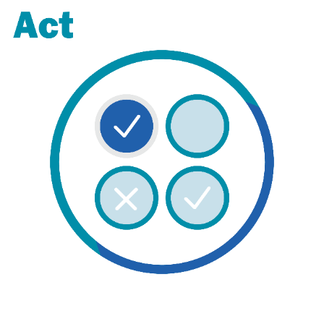
Module 6 Reflective Practice
How do I increase self-awareness to be aware of the impact of actions on me, others/team/patient, and the environment?
What are ways I demonstrate support to each team member?
How do we create and sustain an environment in which our team members are able to ask for assistance when overloaded or uncertain?
Notes:
The reflective practice strategies of Ask, Listen, and Act will make the use of each of these mutual support tools more effective and your comfort with them longer lasting. Encourage the use of mutual support tools and reflect alone or with colleagues on how to continue building skills.

Slide 22
Module 6 Summary
Mutual support fosters team adaptability, mutual trust, and team orientation.
Task assistance, feedback, and advocacy and assertion are effective support strategies to foster mutual support.
Conflicts tend to be rooted in either information or our personalities and the tools to manage these conflicts differ as well.
Notes:
In this module, participants learned that:
Mutual support fosters team adaptability, mutual trust, and team orientation.
Task assistance, feedback, and advocacy and assertion are effective support strategies to foster mutual support.
Conflicts tend to be rooted in either information or our personalities, and the tools to manage these conflicts differ as well.

Slide 23
Course Modules
Module 1: Introduction
Module 2:
Diagnostic Team Structure
Module 3: Communication
Module 4: Leadership
Module 5: Situation Monitoring
Module 6: Mutual Support
Module 7: Putting It All Together
Notes:
TeamSTEPPS for Diagnosis Improvement has seven modules dedicated to improving diagnostic communication and teamwork. Communication strategies and tools to overcome some of the breakdowns in teamwork and team communication are available in each module and the accompanying Participant Workbook.
The TeamSTEPPS for Diagnosis Improvement modules are:
Introduction.
Diagnostic Team Structure.
Communication.
Leadership.
Situation Monitoring.
Mutual Support.
Putting It All Together.

Slide 24
Module 6 References
TeamSTEPPS Fundamentals Course: Module 6. Mutual Support. Content last reviewed March 2019. Rockville, MD: Agency for Healthcare Research and Quality. https://www.ahrq.gov/teamstepps/instructor/fundamentals/module6/igmutualsupp.html. Accessed January 10, 2022.
TeamSTEPPS for Office-Based Care: Mutual Support. Content last reviewed September 2015. Rockville, MD: Agency for Healthcare Research and Quality. https://www.ahrq.gov/teamstepps/officebasedcare/classroom.html. Accessed January 10, 2022.
Notes:
The following are the list of references from this module.

